Slide 1
Dear Parents,
Please work through these powerpoints with your child.
Press F5 or Slideshow – From Beginning to begin the slideshow.
The first few slides often revise sounds and words that we may have already learnt. Don’t worry if your child is unsure of any. We will often say them with the children, or ask them to repeat them after us.
We then encourage you to read the stories to your child and ask them to do the different tasks.
These might include:
Reading words or sentences out loud
Writing words in the air
Writing words on paper
Finding words
They are all familiar with these powerpoints as we have been using them this term.

Slide 3
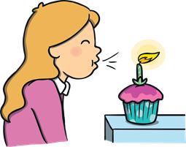
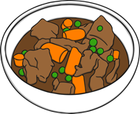
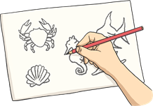
Revisit and Review

Slide 4
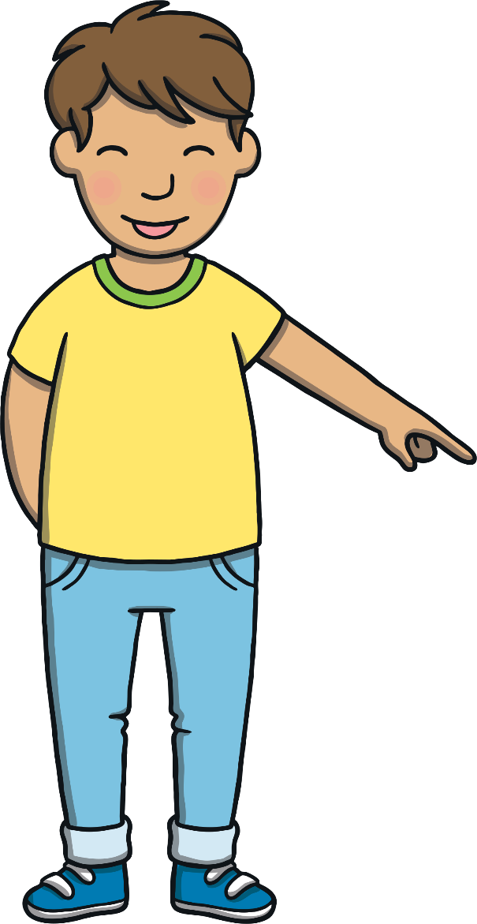
Revisit and Review
Here are this week’s focus words for reading…
any
eyes

Slide 5
Tricky Word Cards
Teach
Say the tricky words as they appear on the cards. Watch out for the tricky words any and eyes!
eyes
because
any
many
any
different
eyes
any
laughed
eyes

Slide 6
Teach
Today, we are learning to read words that contain y for /ee/.
X
‘y’ is an alternative grapheme for the sound /ee/. Children will already be familiar with the other alternative graphemes for this sound: ‘ee’, ‘ea’, ‘e_e’ and the long vowel ‘e’.
Click me for Kit’s teaching tips!

Slide 7
Teach
Sometimes, we use y to make the /ee/ sound at the end of words. Let’s say these examples:
happy
funny
hairy
X
This week, the ‘y’ grapheme will most often be found at the end of words. It can often be found at the end of adverbs which will be covered in Level 6.
Click me for Kit’s teaching tips!

Slide 8
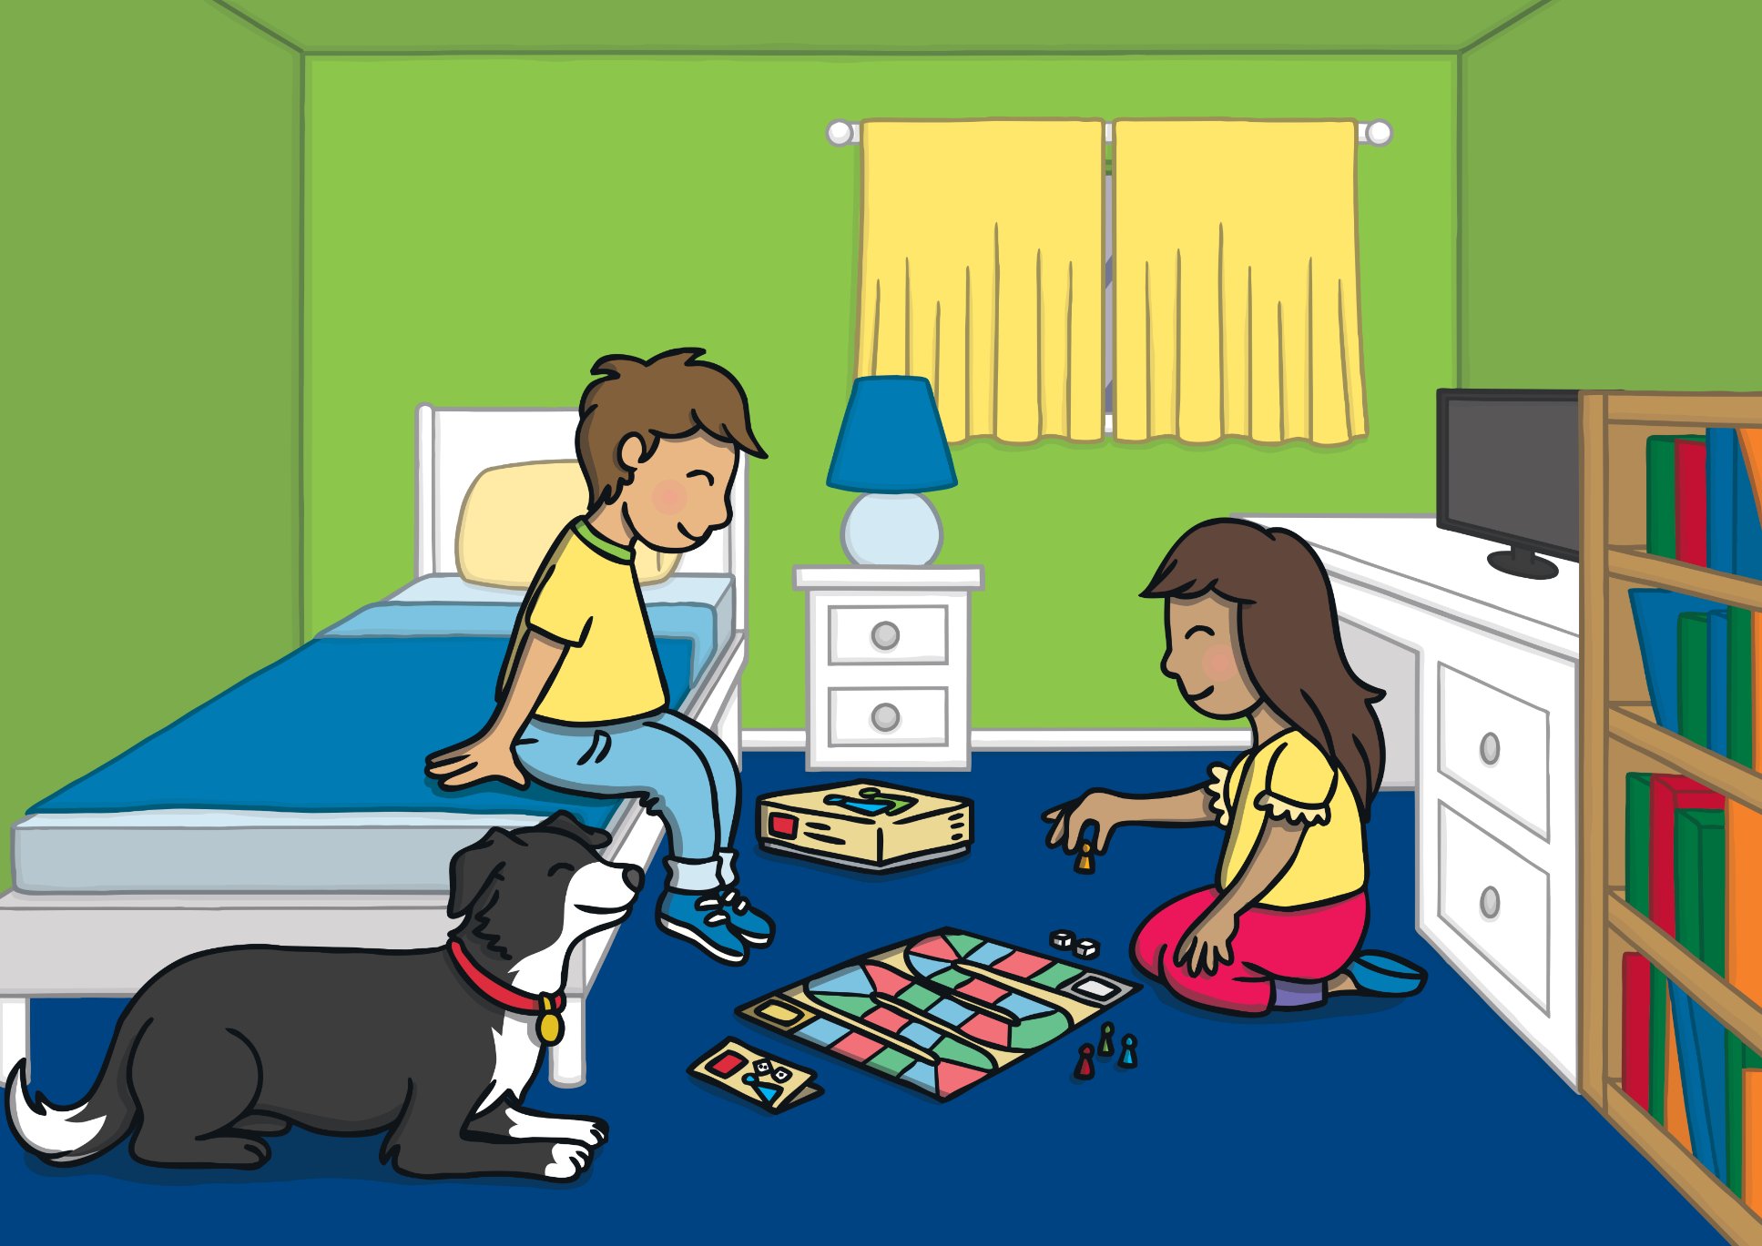
Teach
It was the weekend and Mum and Dad were busy doing some jobs around the house while Kit and Sam were playing a board game together. Ben was lying on the floor beside them.

Slide 9
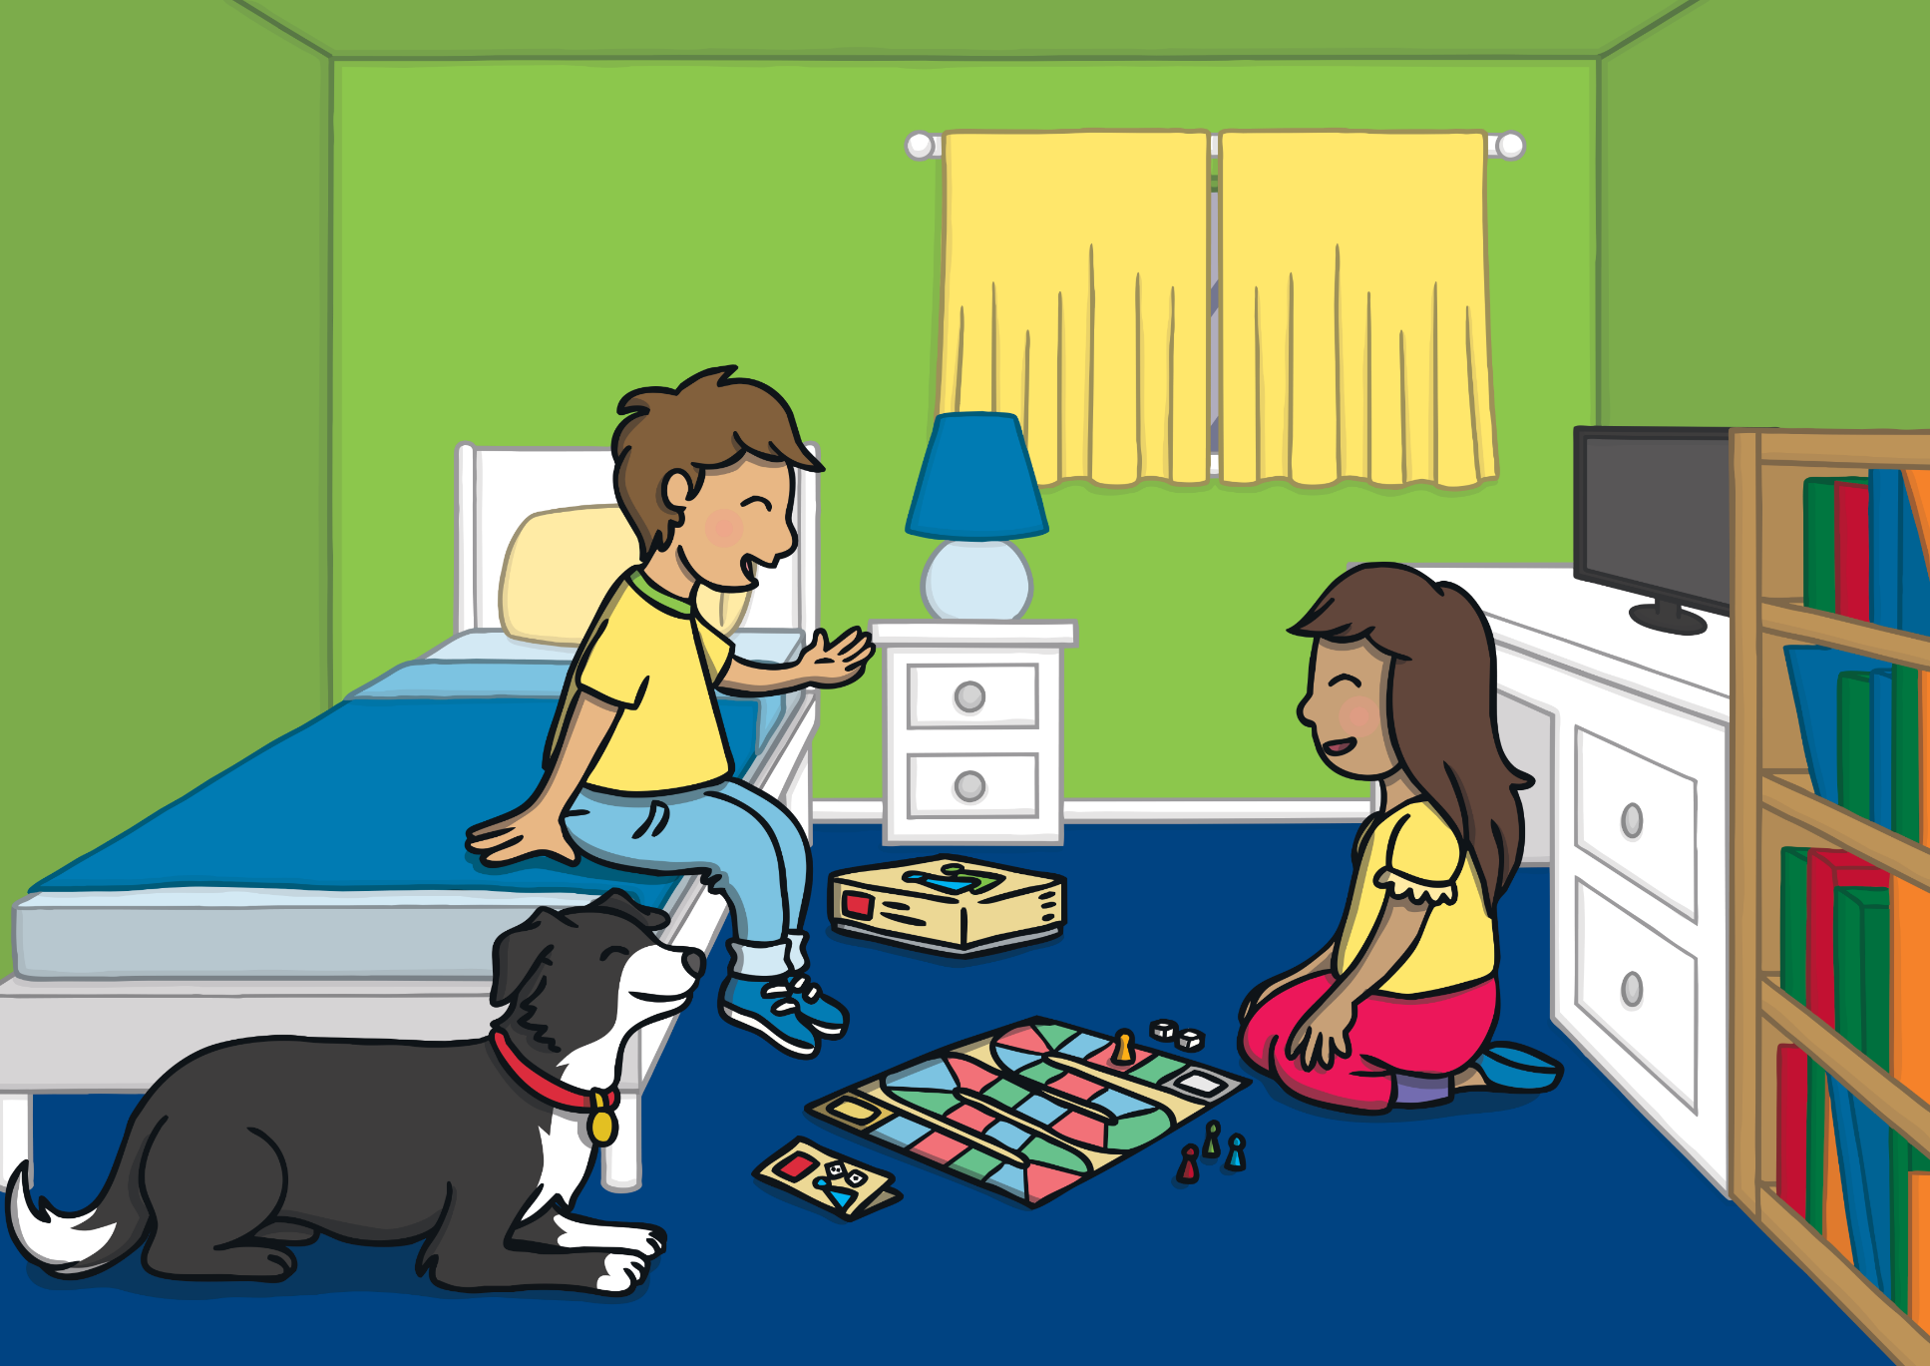
Teach
After a while, Sam said, “Kit, it’s a sunny day. We should go outside!”
“What do you want to play?” asked Kit.
“Hmm,” she paused. “Oh, I have an idea! We could go on an adventure!”

Slide 10
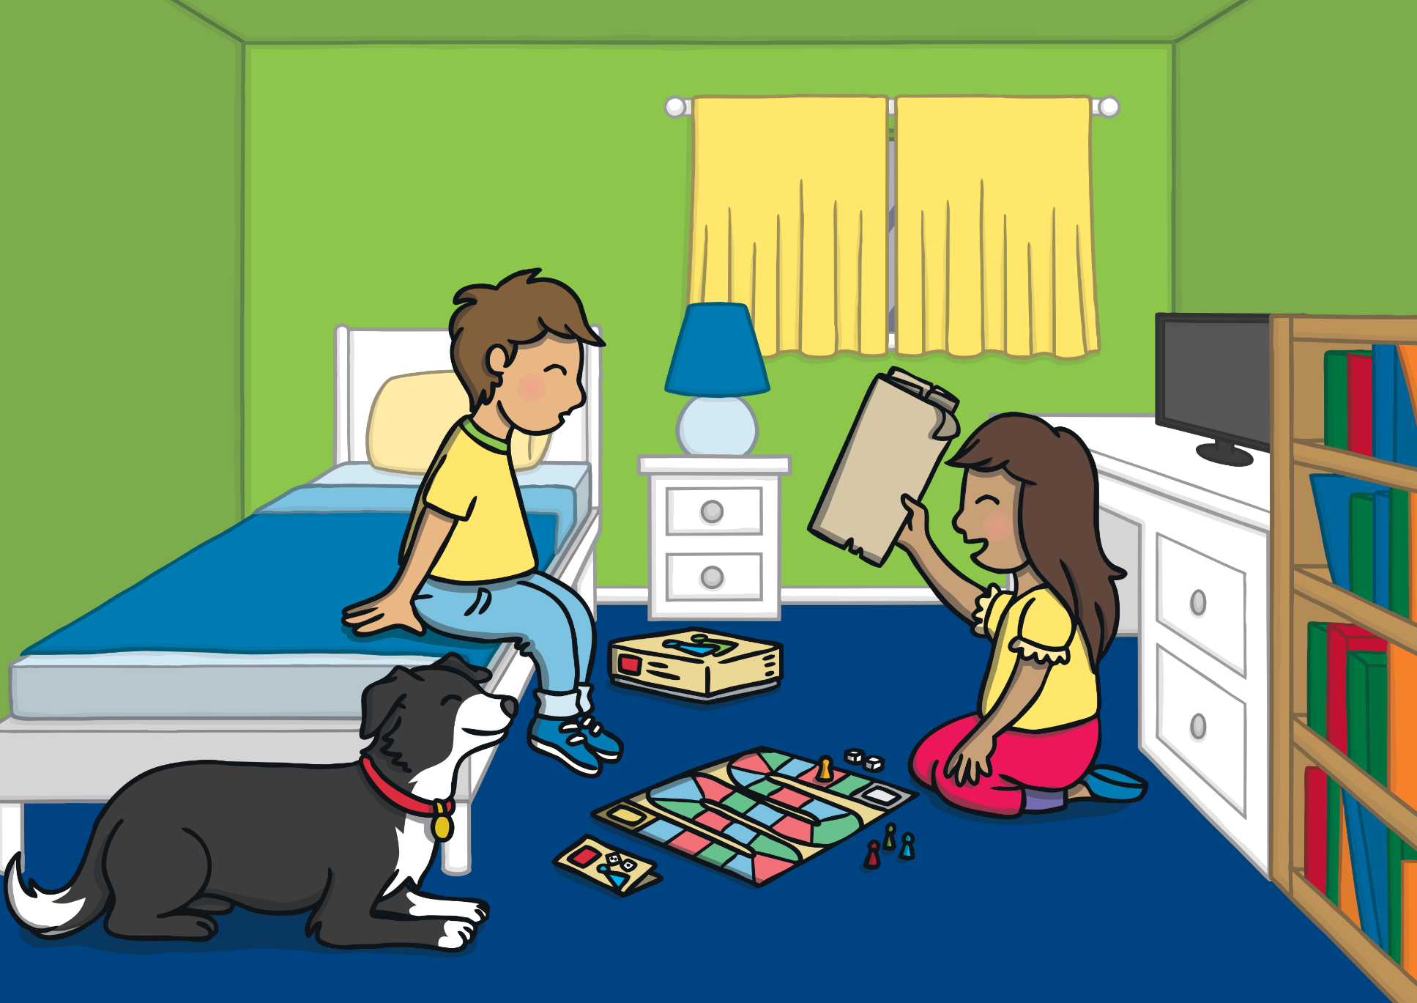
Teach
Sam quickly ran out of Kit’s bedroom. She reappeared with the magic map. “I wonder where we could go this time?” said Sam.
“Ben could come too,” suggested Kit.
Ben jumped up when he heard his name and licked Kit.

Slide 11
Teach
Ben likes hearing his name being called. He thinks he is going for a walk! Click on the objects to reveal the y words. Can you read them?
X
Sometimes the letter before the ‘y’ is doubled as in the examples we are now going to look at.
Click me for Kit’s teaching tips!

Slide 12
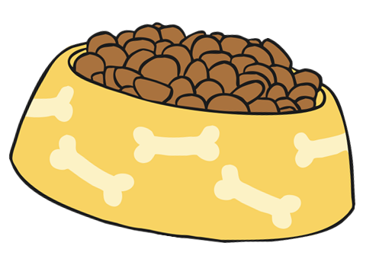
Teach
happy
sunny
funny
furry

Slide 13
Hidden Map Words
Practise
Sam wants to go somewhere she and Kit have never been to before. Look at the map and find the hidden y words.
Can you read the words?

Slide 14
Practise
X
X
mummy
X
very
daddy
X
poppy
X
copy
X
penny

Slide 15
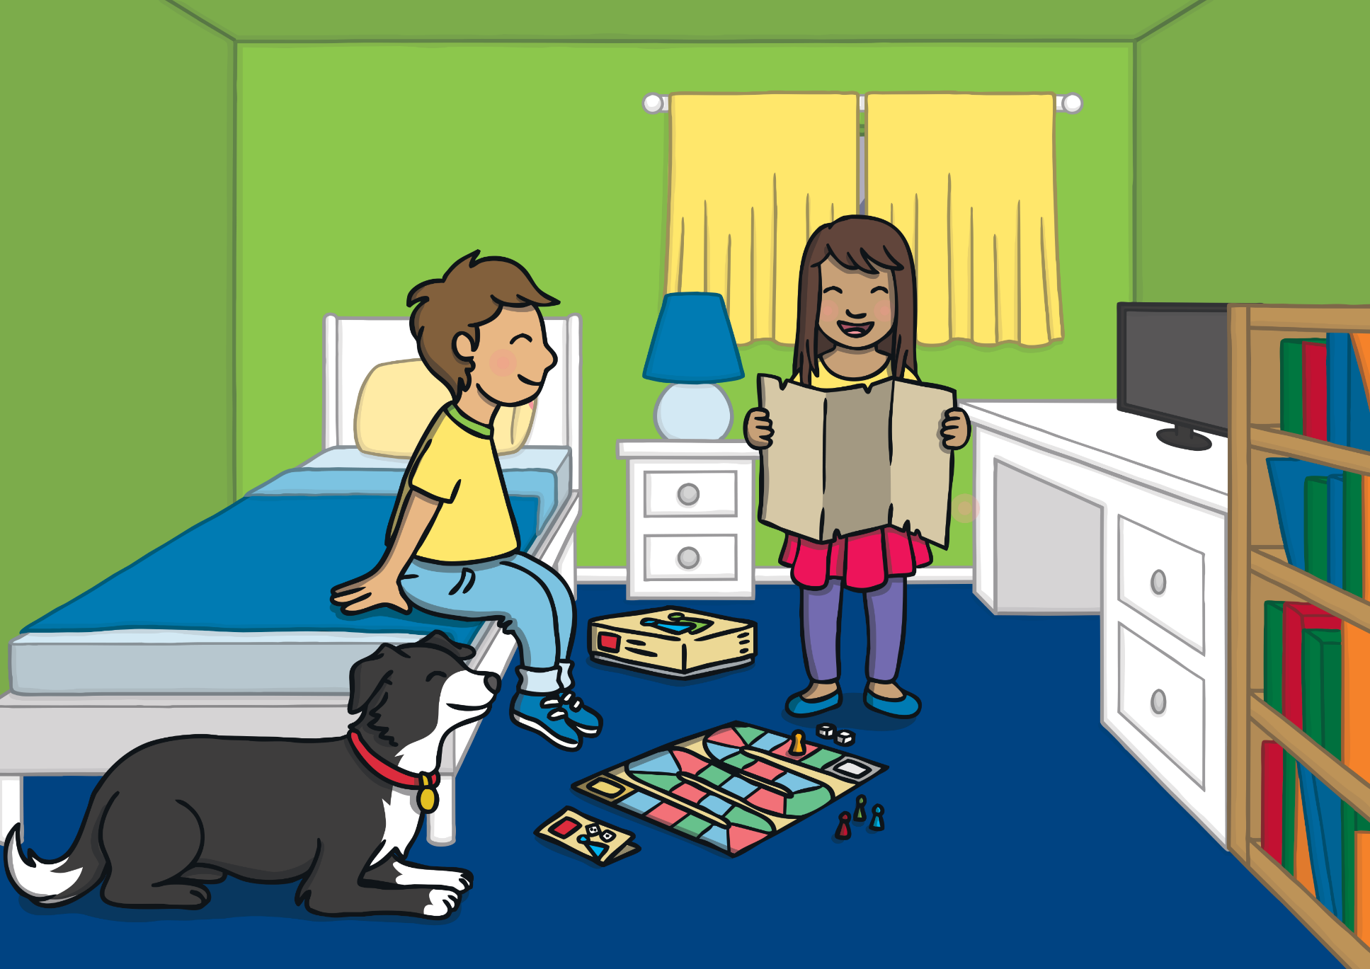
Apply
“I would love to go on one of those special boats along the Mississippi River,” said Kit, taking the map from Sam and unfolding it. “Dan was telling me all about it at Beavers. He went on one last summer with his family.”

Slide 16
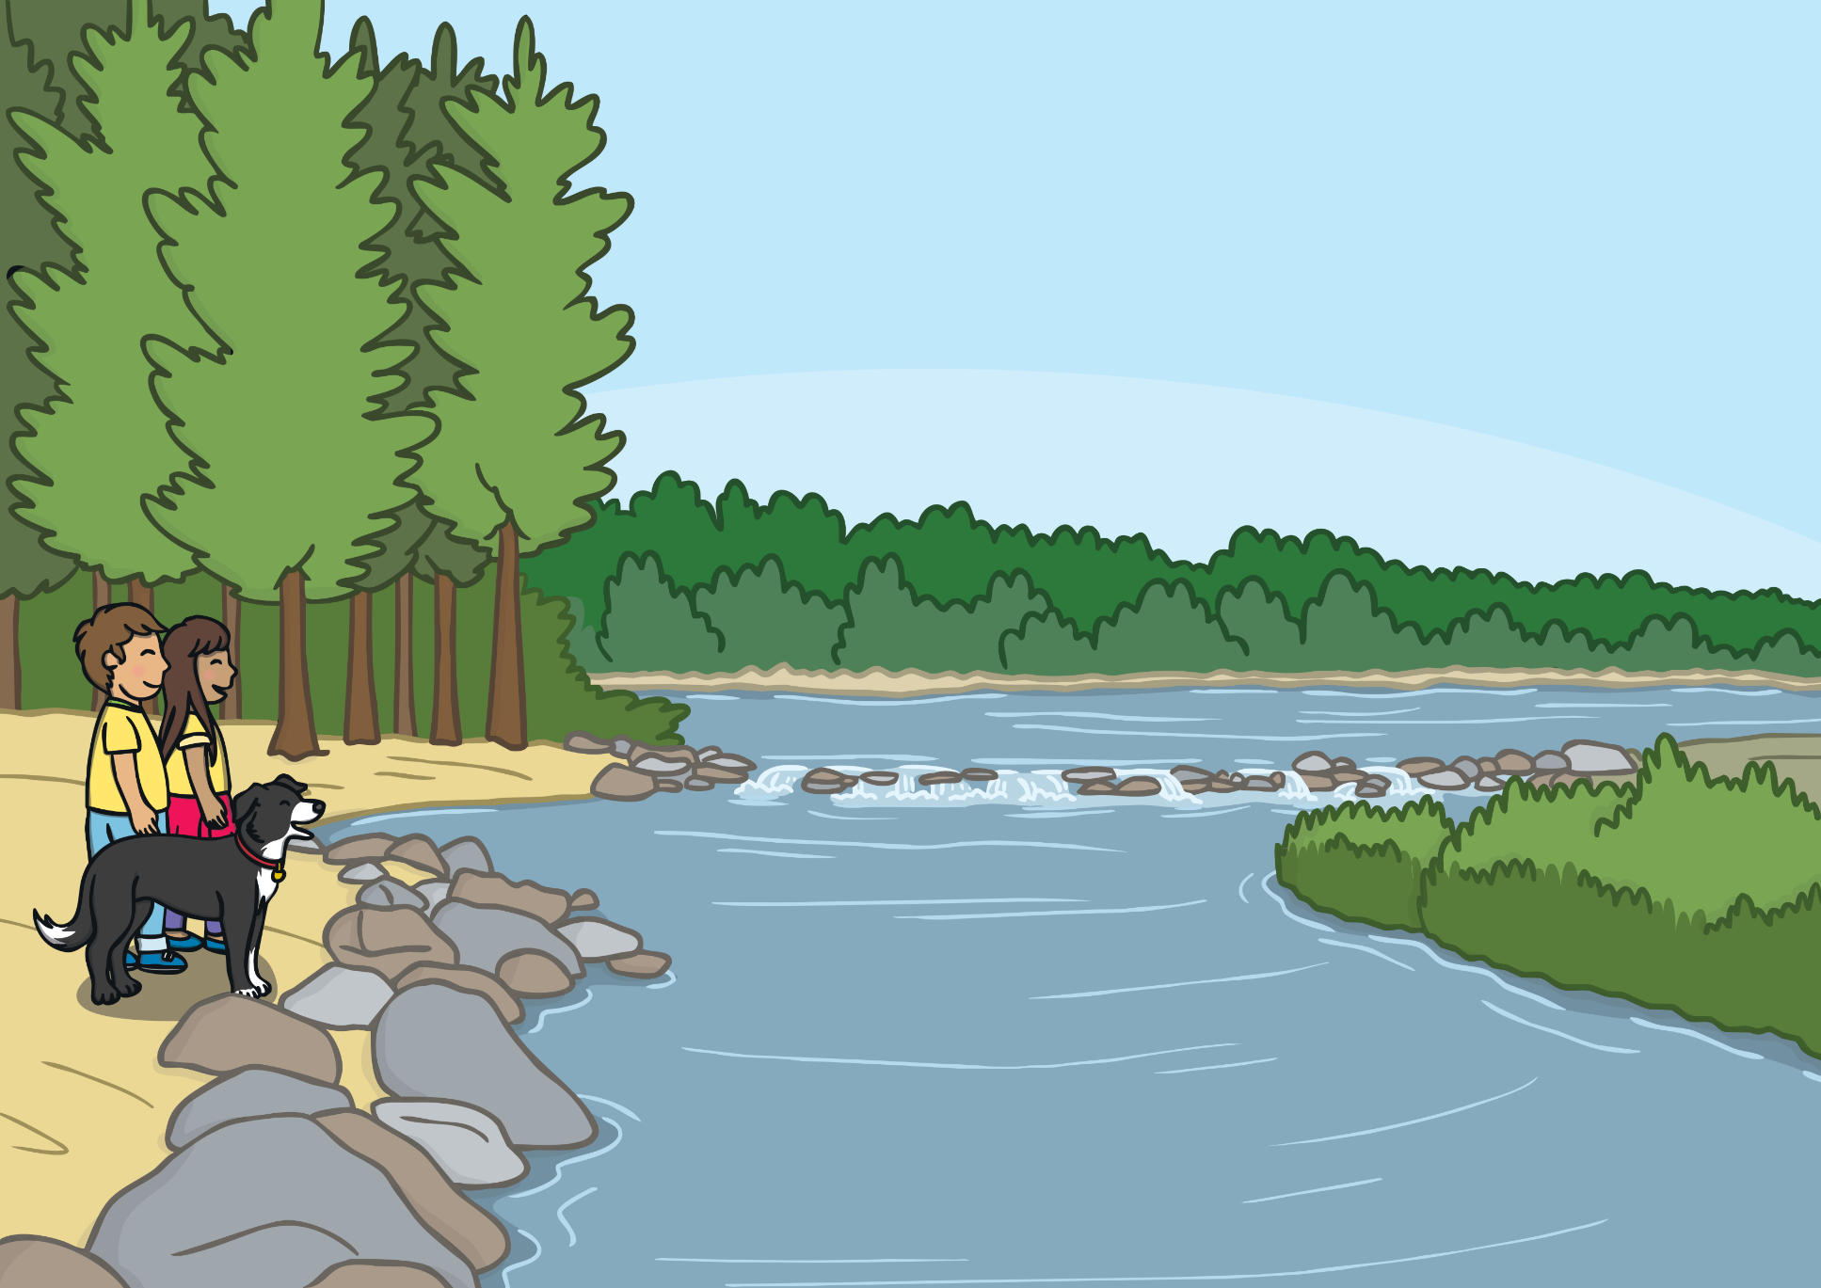
Apply
Sam was puzzled and asked, “Which river? The Miss..iss..ippi? Where is…?” But before Sam got to finish her sentence, the magic had started to work. Within a flash, Kit, Sam and Ben were standing in front of a huge river!

Slide 17
Sentence Time
Apply
Sam is staring at the water in front of her. What is she thinking?
Read the sentence and then click ‘Show’ to reveal the answer!

Slide 18
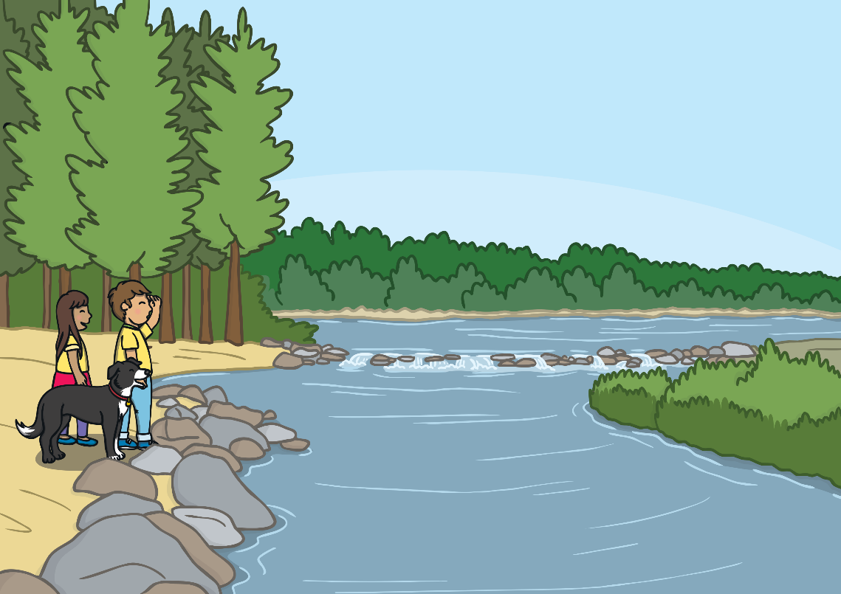
Apply
Is this the Mississippi River that Dan and his family visited?
Sound Buttons on/off
Show

Slide 19
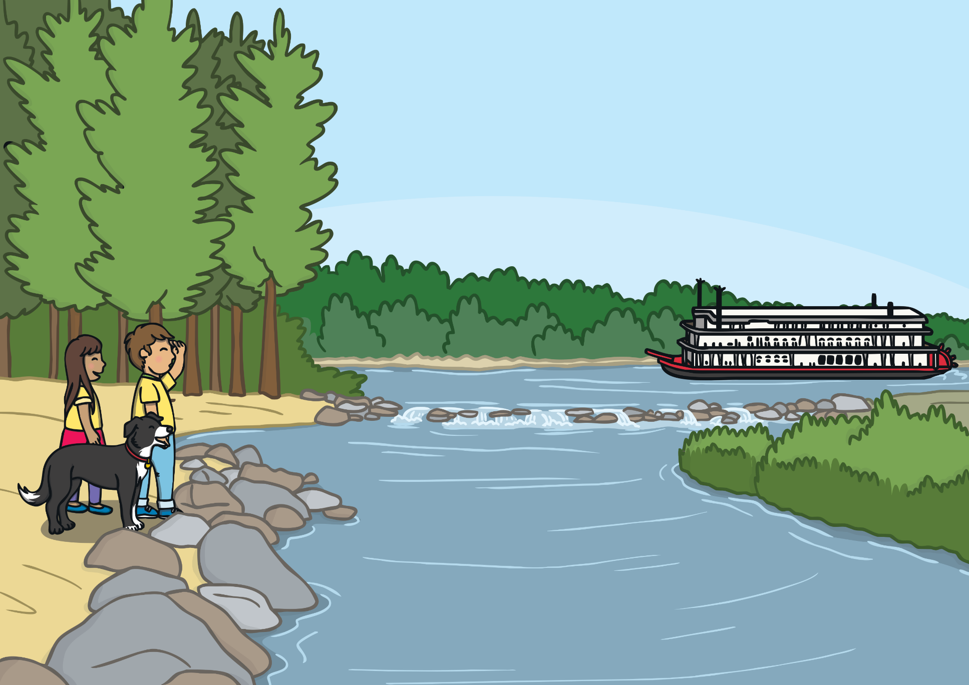
Apply
Sam turned to Kit and said, “Any idea where we are, Kit?”
Kit did not hear Sam because he was deep in thought. His eyes were fixed on a huge steam boat which was very slowly making its way up the river. Suddenly, Kit shouted with excitement, “We are here!”

Slide 20
Today, we have learnt…
y
saying /ee/
The adventure continues next lesson!

