Slide 2
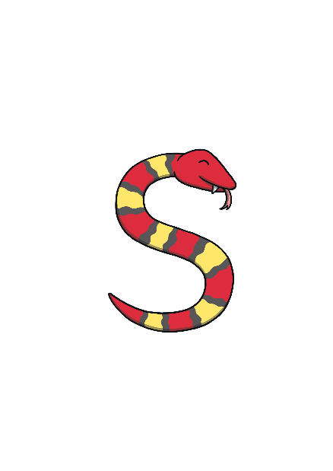
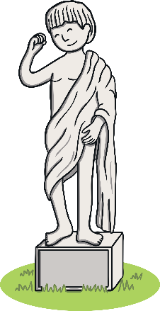
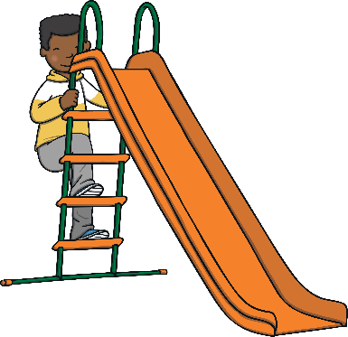
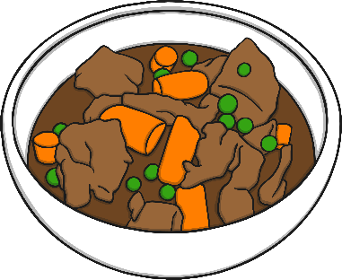
Revisit and Review
Let’s practise Sam’s Sounds and Common Exception Words!
oy
ue
ue
ew
ew
e_e
ir
i_e
o_e
ay
u_e
ou
a_e
ie
ea
house
work

Slide 3
Teach
Today, we are learning to read words that contain
y saying /ee/.

Slide 4
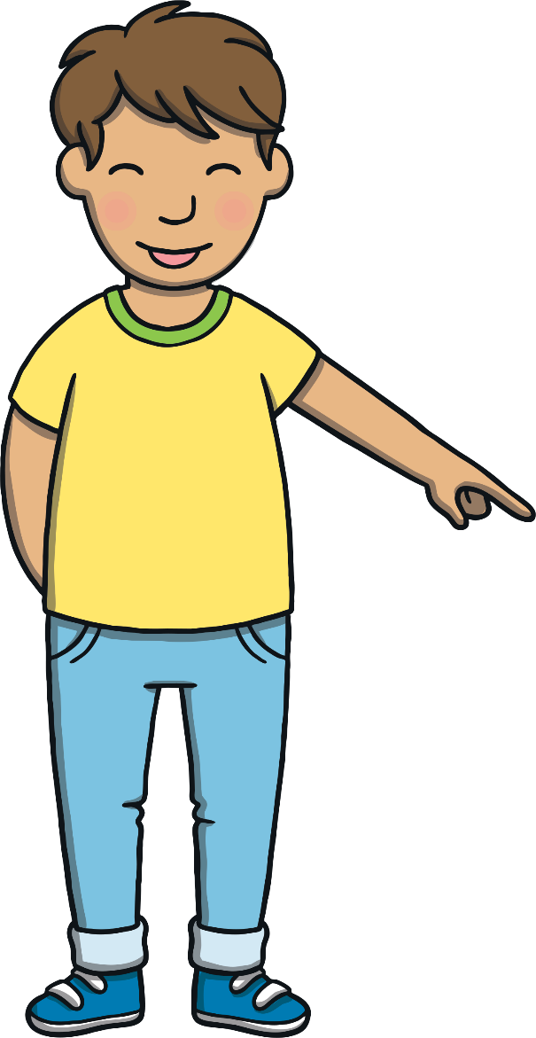
Teach
Let’s practise reading some of this weeks focus words that contain the y sound.
very
family
body
happy

Slide 5
Teach
Now, let’s write some with the magic pencil…

Slide 6
Teach
v
e
r
y
Play

Slide 7
Teach
f
a
m
i
l
y
Play

Slide 8
Teach
b
o
d
y
Play

Slide 9
Teach
h
a
p
p
y
Play

Slide 10
Teach
Sam noticed where Kit was staring. At the massive boat! It had four decks with shiny white railings around each of them. The front of the boat had a big red turning wheel. Sam suddenly shouted to Kit, “The boat is on fire! Look there is smoke coming out of it!”

Slide 11
Teach
“It is not on fire!” replied Kit, “It is a steam boat.” He continued, “This is a Mississippi boat like the one Dan went on. It is powered by a steam engine.”
“Are we in America, Kit?” asked Sam, pointing to one of the many flags on the boat.

Slide 12
Teach
Before Kit could answer, Ben barked. He was wagging his tail in excitement as the boat got closer. “Yes, we are in America. This is the famous Mississippi River. I think the boat is going to go into the port a bit further up there,” said a very happy Kit.

Slide 13
Teach
Read each of the y words on the flags.
happy

Slide 14
Teach
body

Slide 15
Teach
funny

Slide 16
Teach
furry

Slide 17
Teach
family

Slide 18
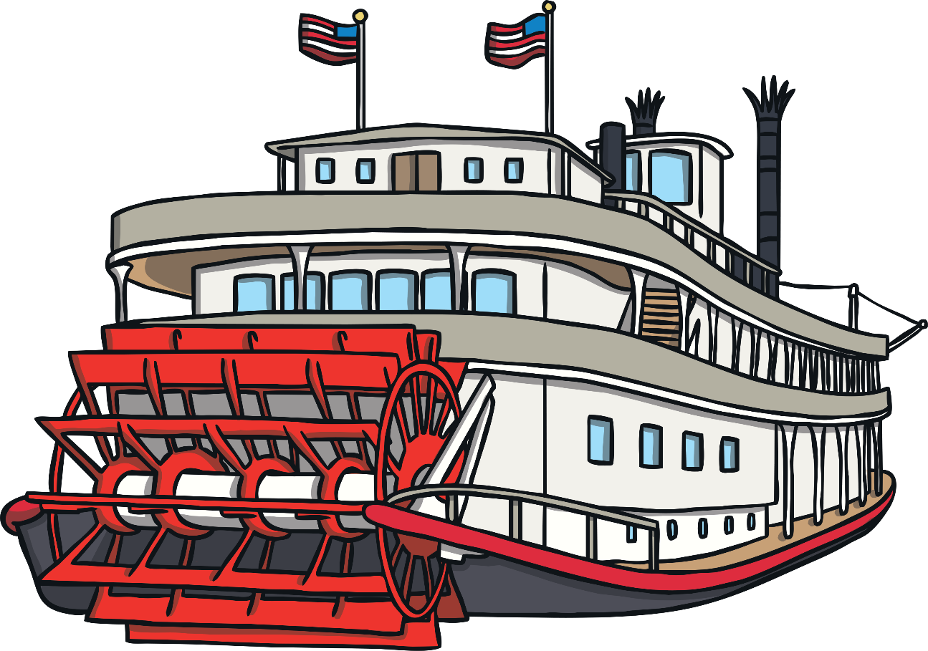
Practise
Turning Wheel
Click on the red paddle wheel to turn it. As the wheel turns a word is revealed. Can you read the words?

Slide 19
Practise
twenty
family
lonely
silly
baby

Slide 20
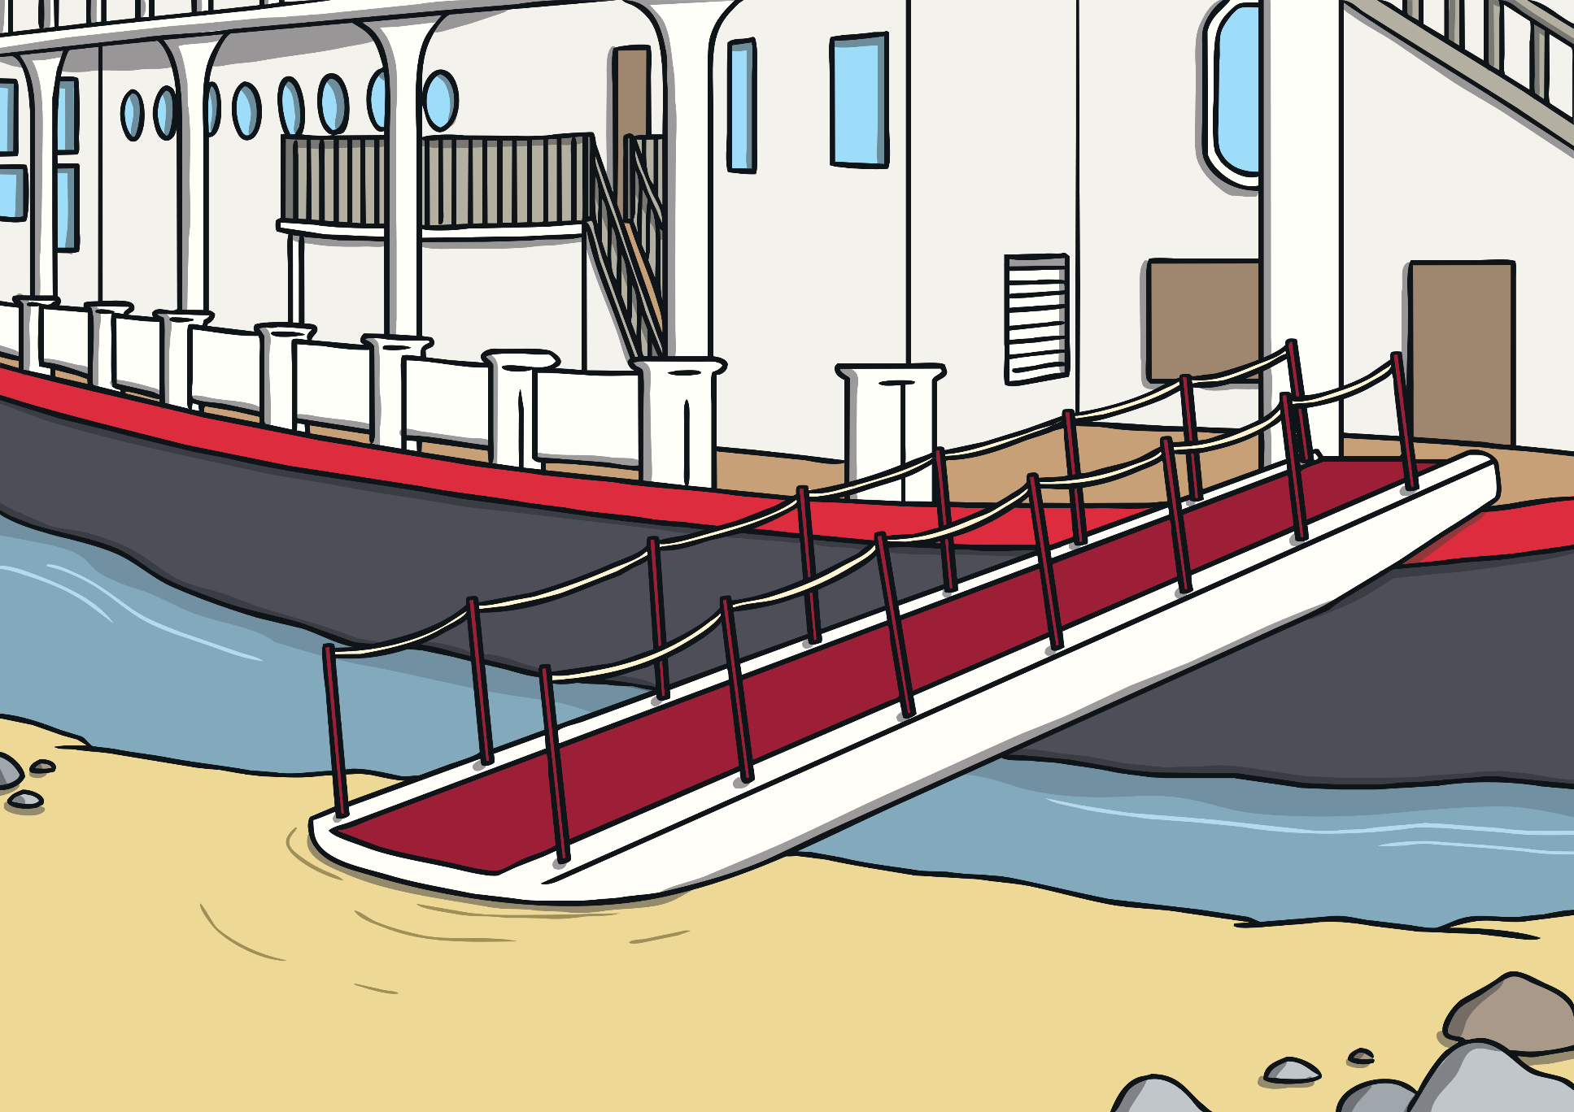
Apply
It was a sunny day and so Kit, Sam and Ben were happy to walk along the riverbank. After a short time following the boat, they reached the port. There were lots of people queueing up. The shiny, white steam boat was docking.

Slide 21
Apply
Once the boat had docked, the queue of people started to board the boat. One passenger was carrying a black and white dog. “That’s funny,” Sam said to Ben, “that furry dog looks like you! His body is just a bit smaller!”

Slide 22
Sentence Time
Apply
Read the sentence and then click ‘Show’ to reveal the answer! What was Kit thinking to himself?

Slide 23
Apply
I think we could go on the boat because no one seems to have any tickets.
Sound Buttons on/off
Show

Slide 24
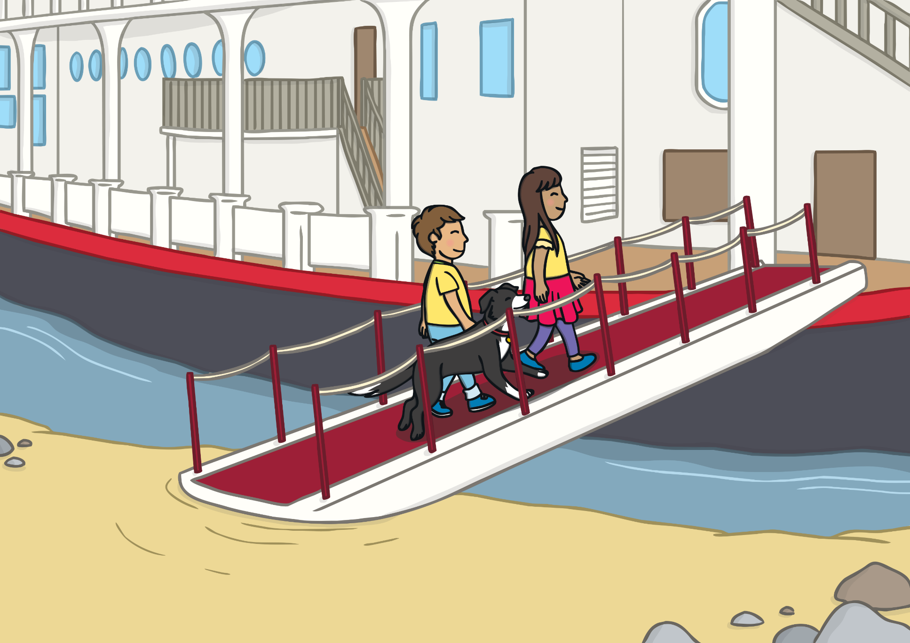
Apply
Kit, Sam and Ben mounted the bridge to the boat. They had never been onboard such a giant boat. They had never even been in America before.
“Wow!” exclaimed Kit and Sam together as they got on the boat.

Slide 25
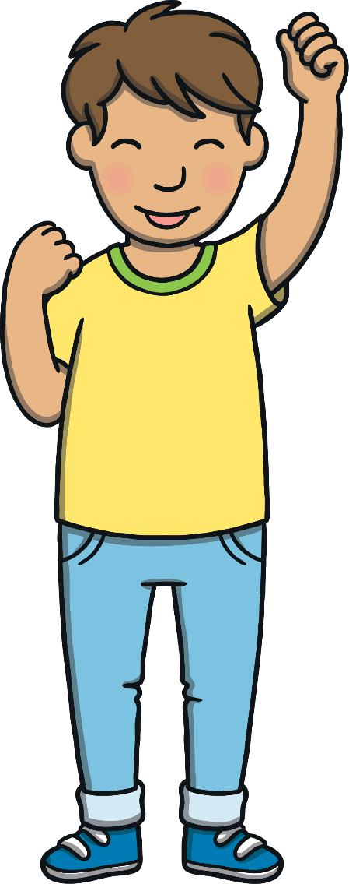
Today, we have learnt…
y
saying /ee/
The adventure continues next lesson!

