Slide 2
Revisit and Review
Let’s revisit last week’s focus words…
I’ll say them and you write them down!

Slide 3
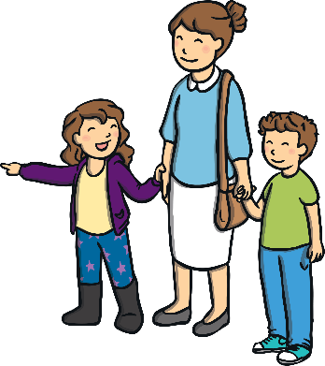
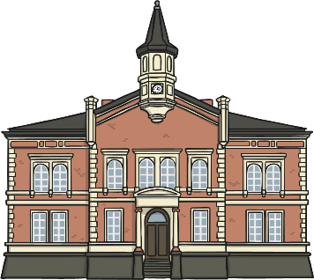
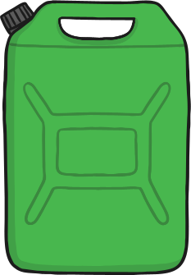
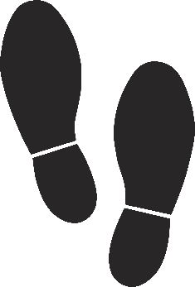
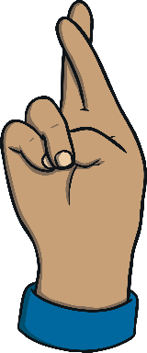
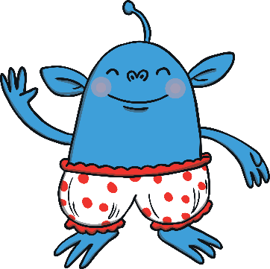
Revisit and Review

Slide 4
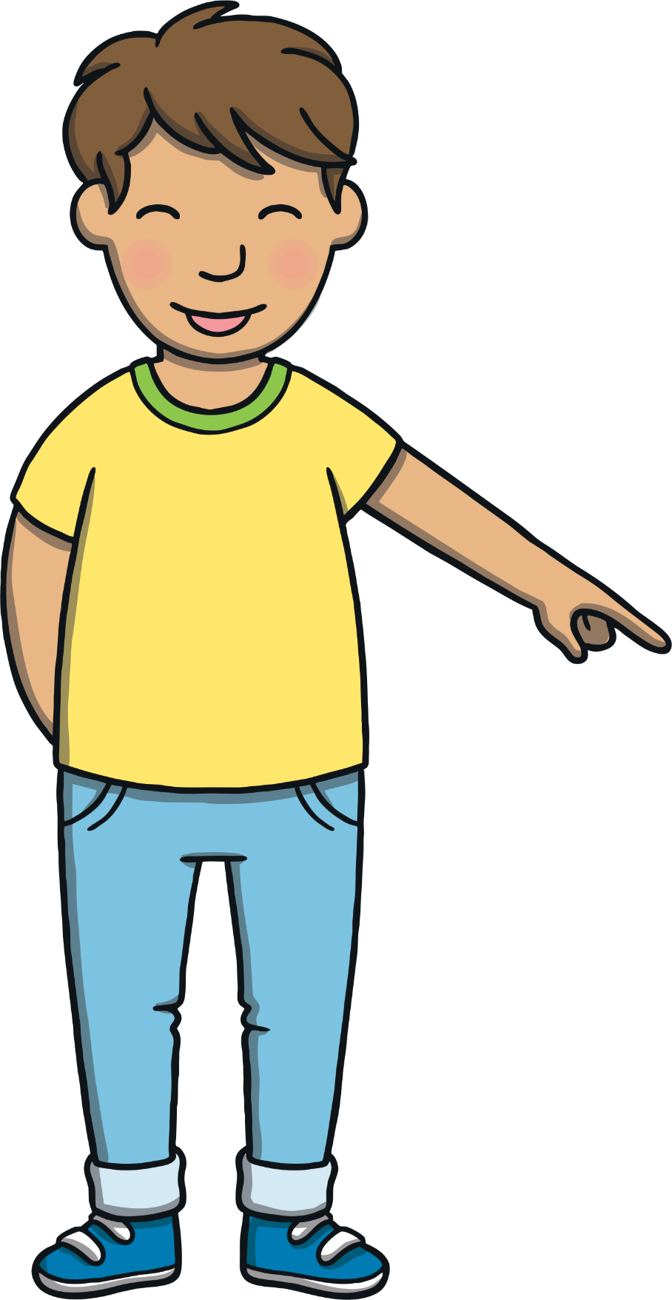
Teach
Here are this week’s focus words for reading…
because
different

Slide 5
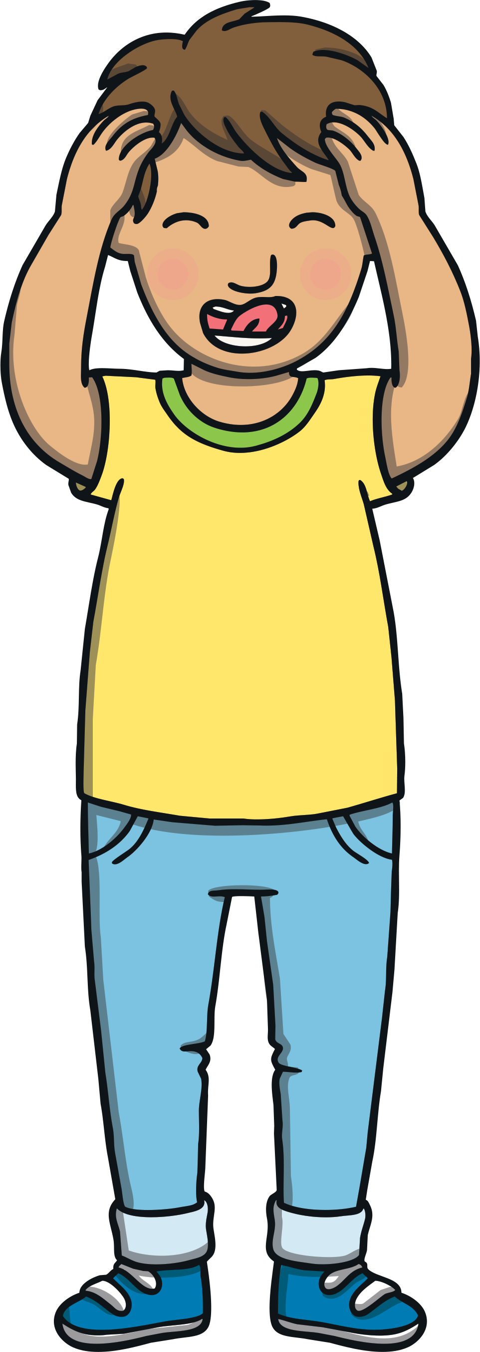
Teach
Today, we are learning to write words that contain ew saying /yoo/.

Slide 6
Teach
Sometimes, e and w work as partners to make the /yoo/ sound. Let’s say these examples:
new
pew
newt

Slide 7
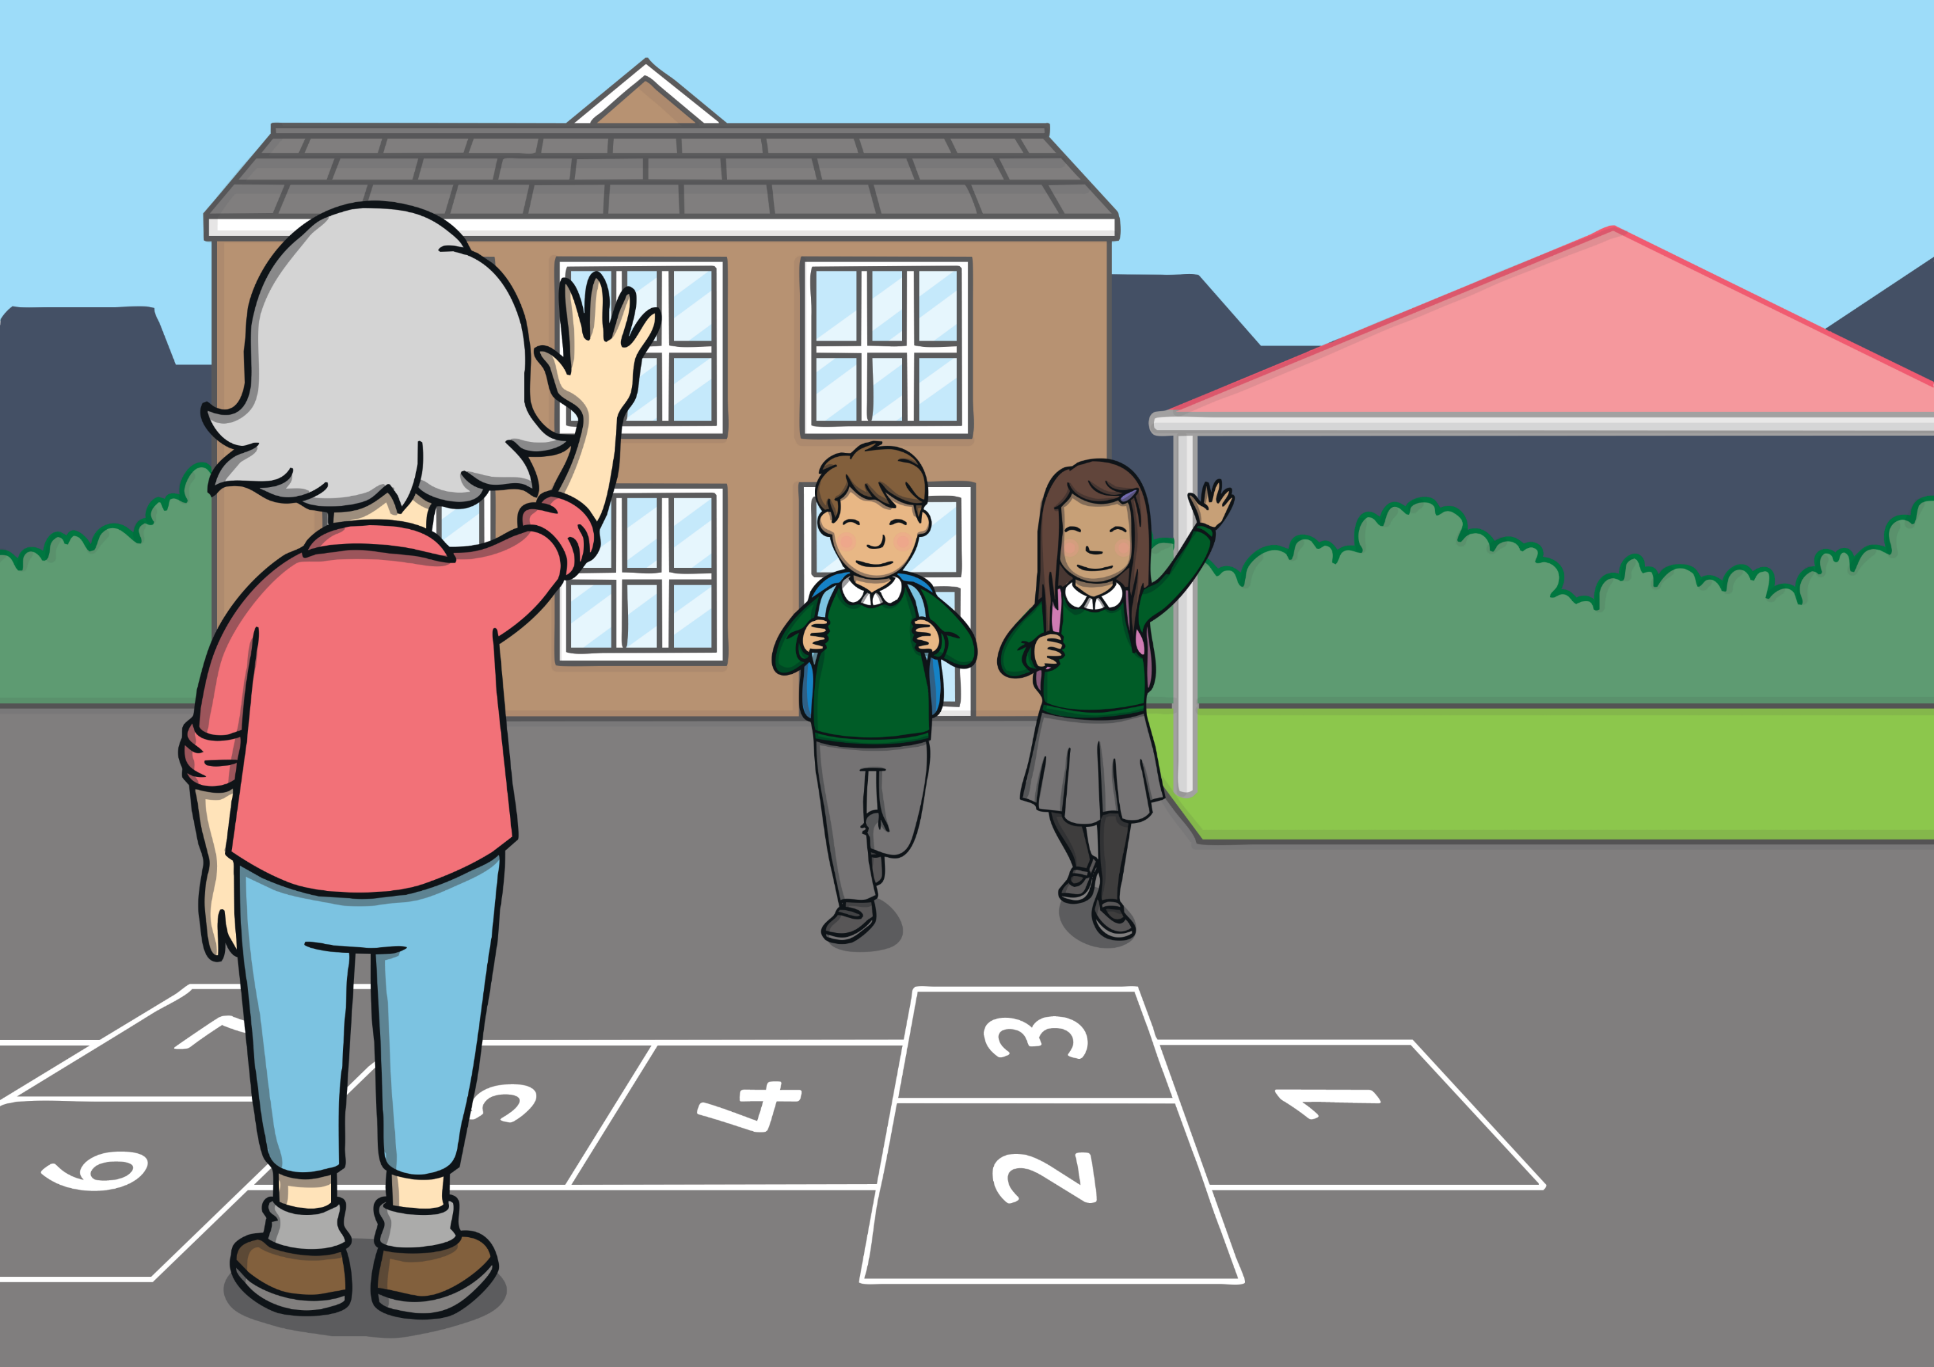
Teach
Kit and Sam’s class had just finished their history lesson. They had packed up and were ready to go home. They were excited to see Grandma was waiting for them in the playground.

Slide 8
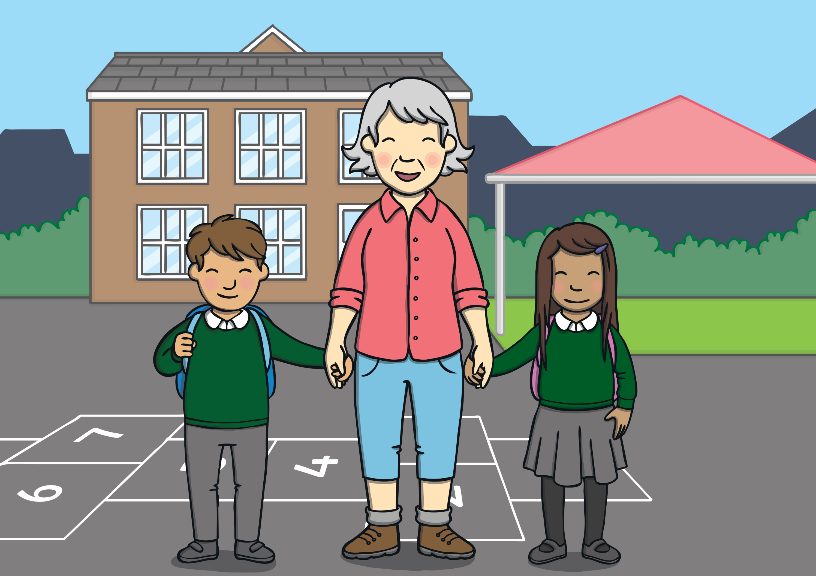
Teach
Grandma greeted them with a warm smile and a big hug. “Grandma! We are going to be learning about the Victorians at school!” blurted Kit.

Slide 9
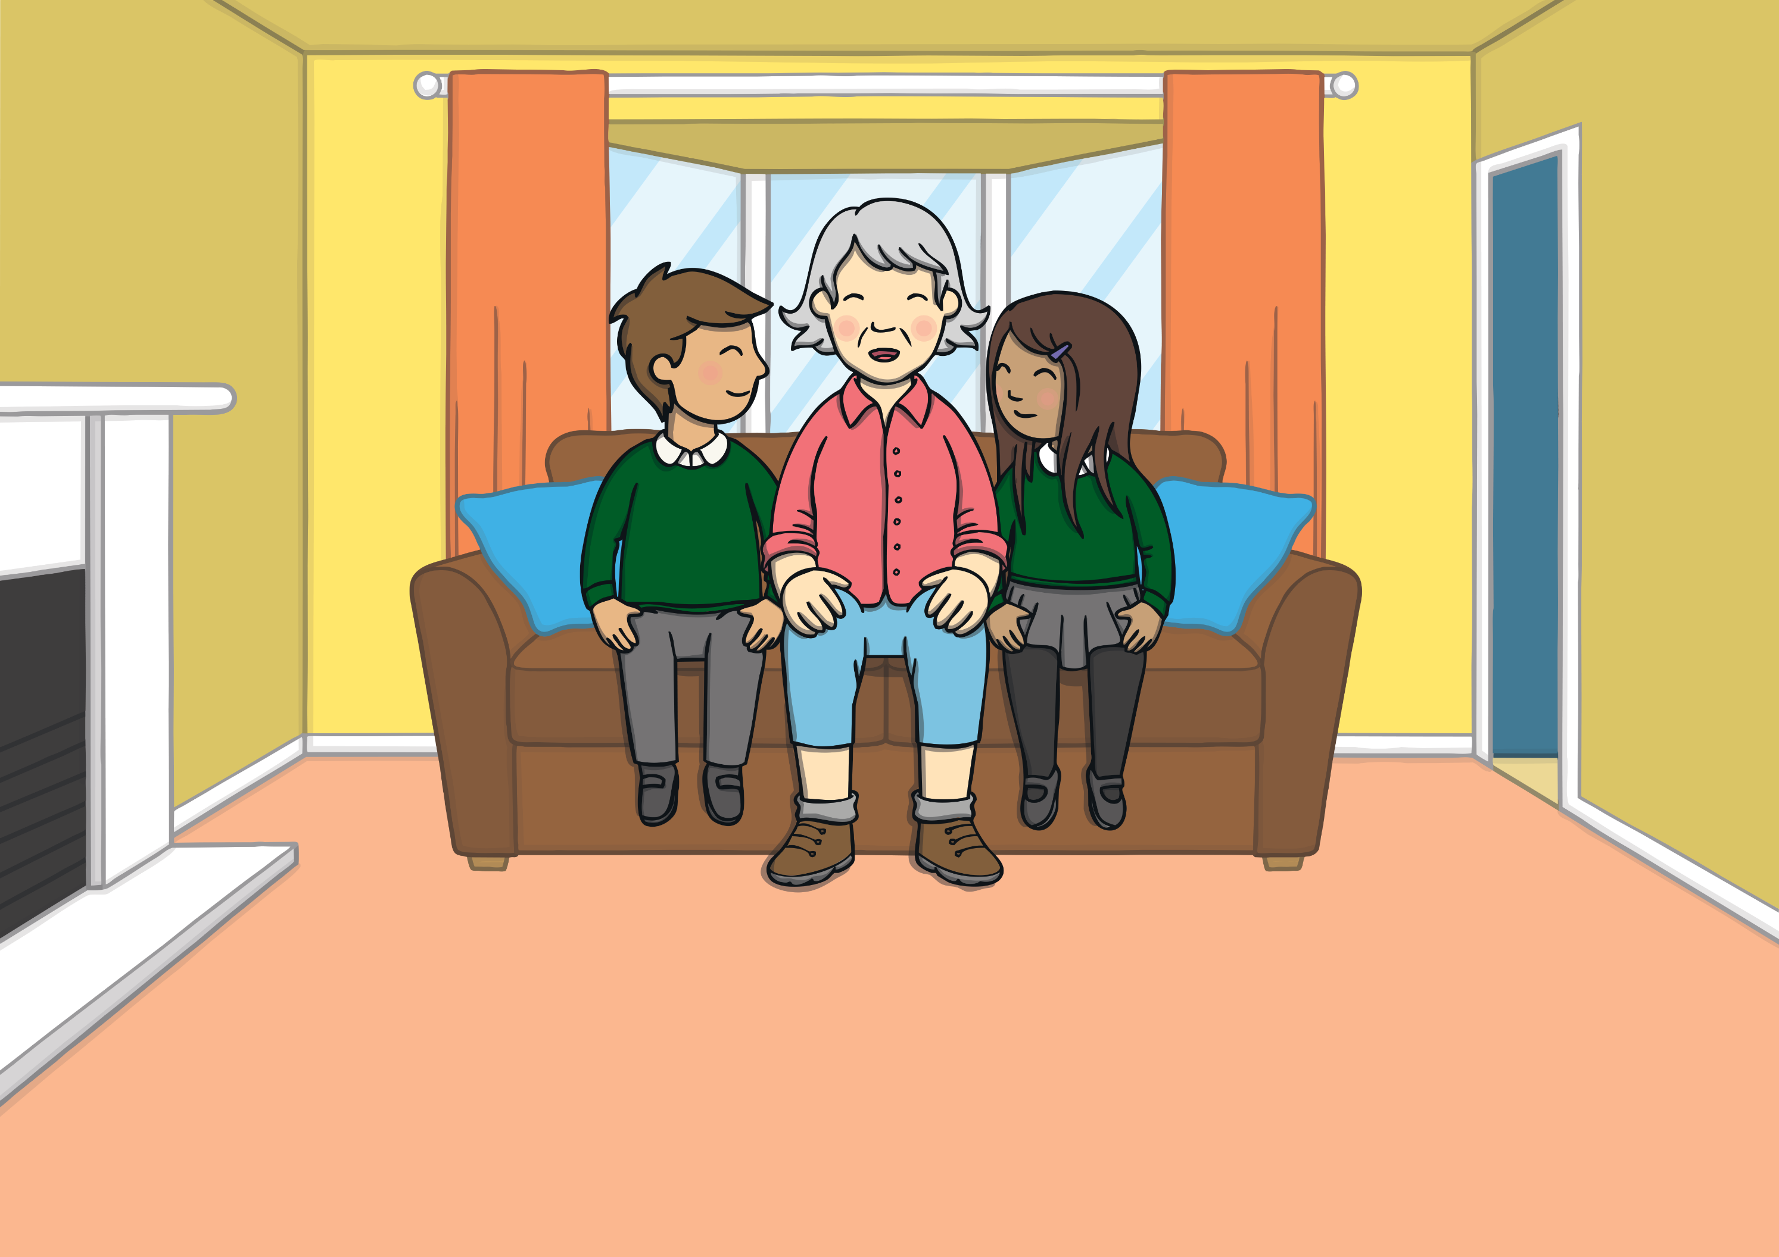
Teach
At home, Sam started asking Grandma about the Victorian times and especially what school would have been like. “Oh, you know I love history! Such an important period,” she started. “To start with, you should see the toys they played with. Very different from what’s in your toy box at home.”

Slide 10
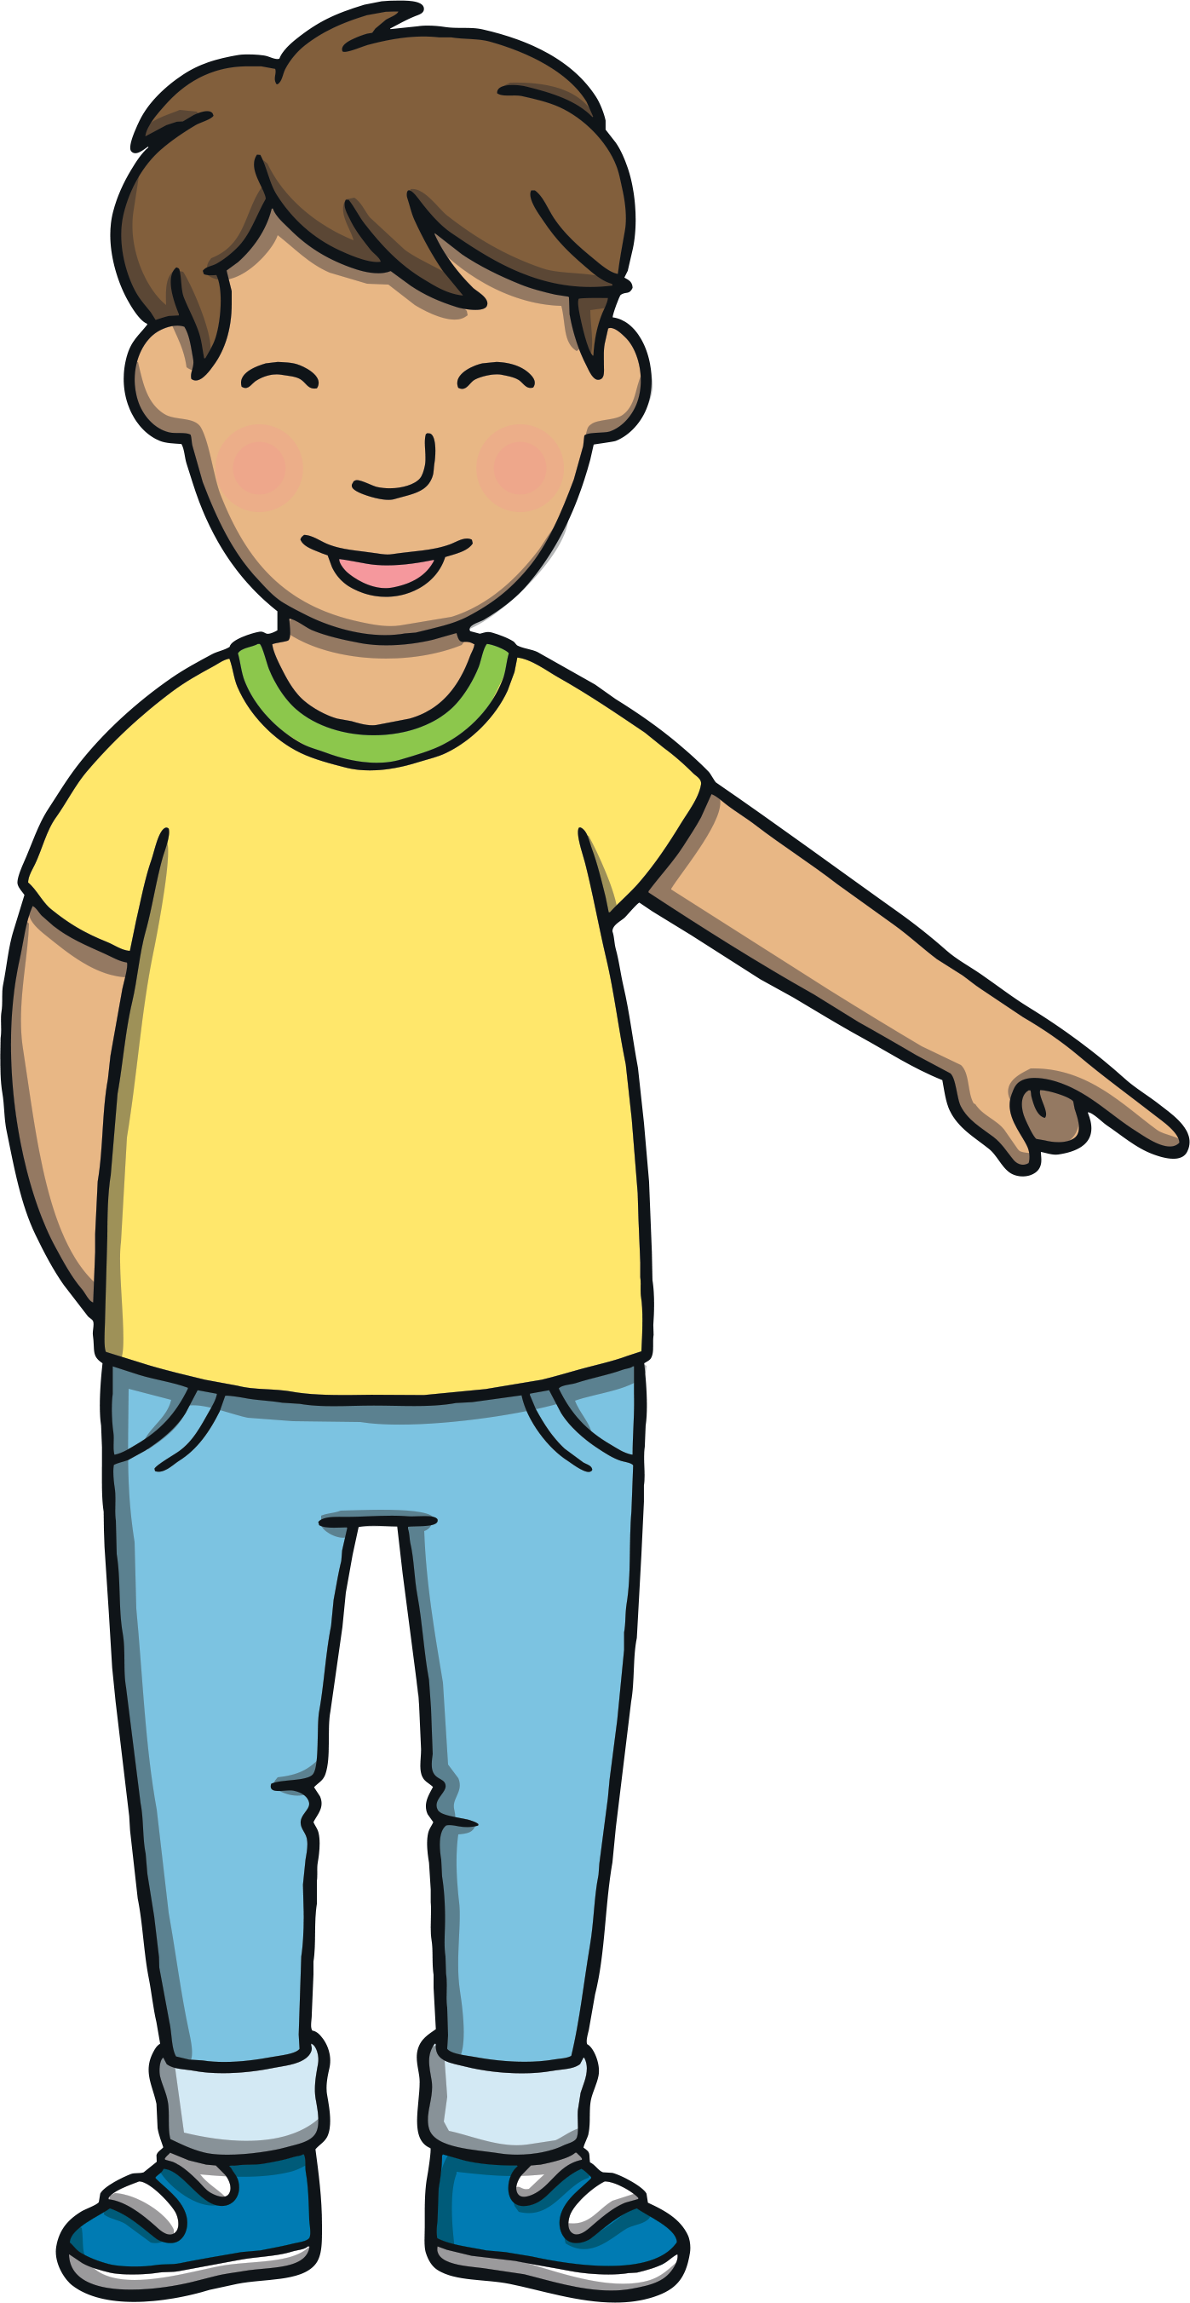
Victorian Toys
Teach
Grandma tells Kit and Sam about what children used to play with. Click on a toy to reveal an ew word. Can your read what it says?

Slide 11
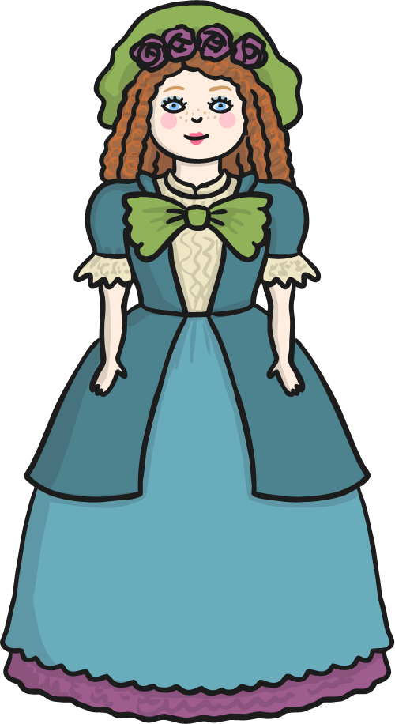
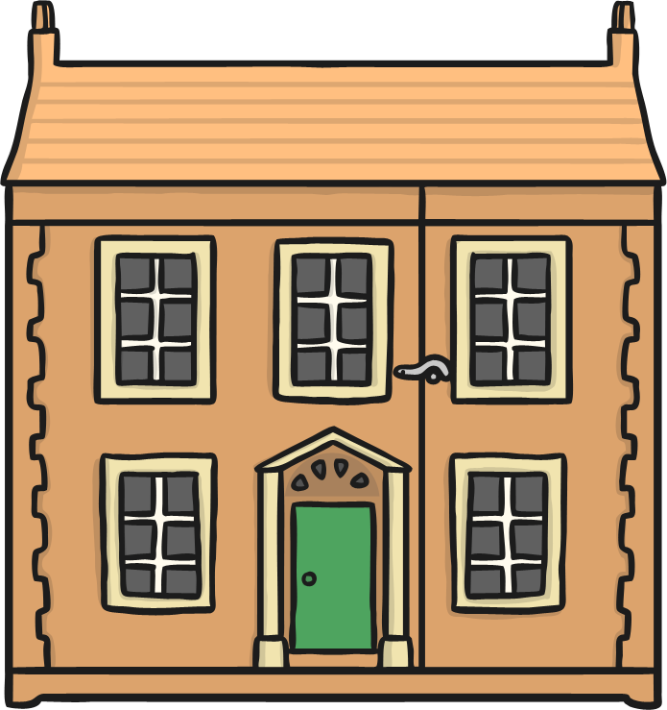
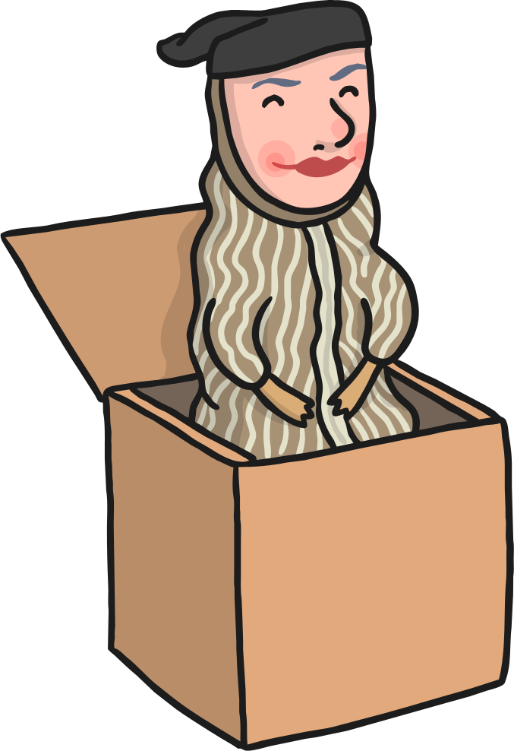
Teach
few
stew
dew
newt

Slide 12
Victorian Puzzle
Practise
Grandma explains that some of the toys were the same. Can you read the words that are hiding in the Victorian puzzle?
See if you can complete the puzzle by clicking on the words after you’ve read them.

Slide 13
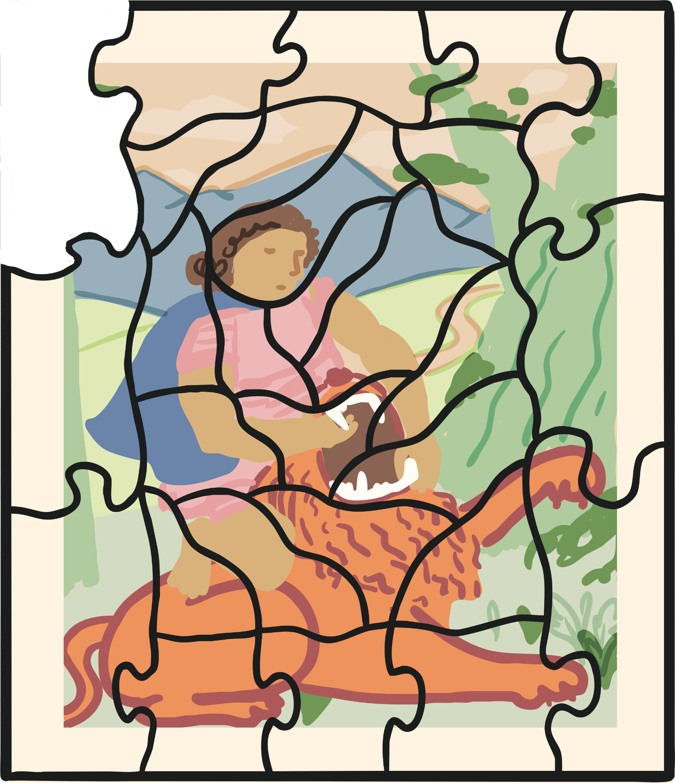
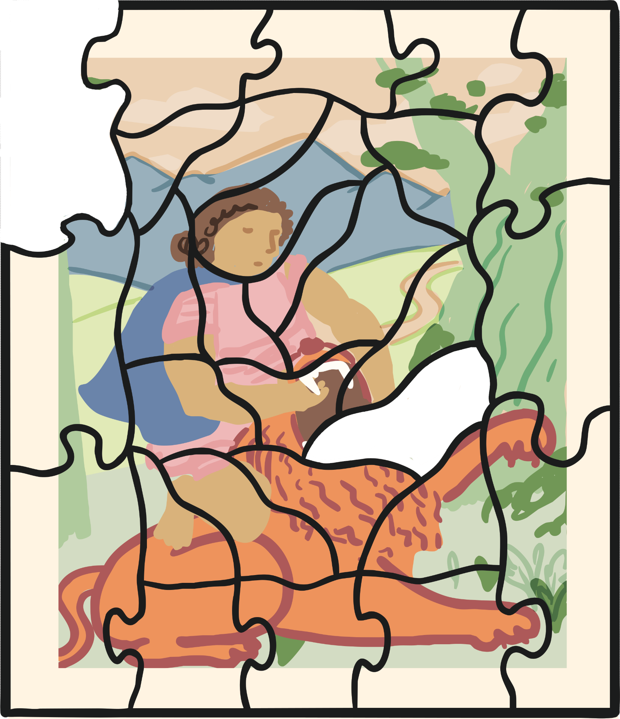
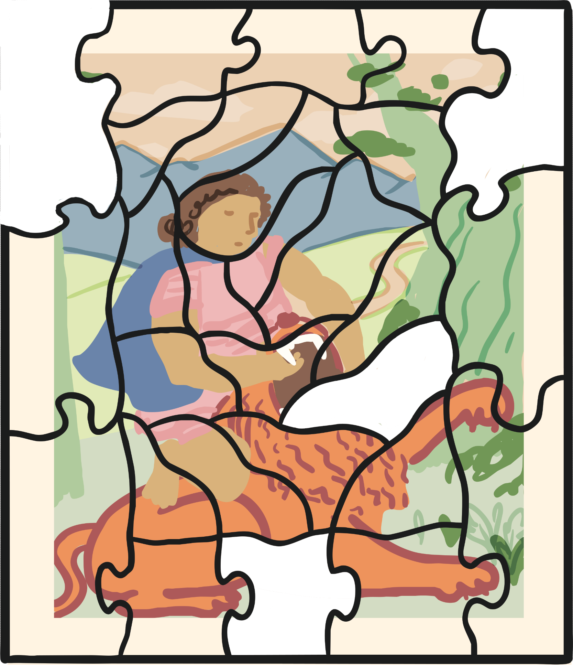
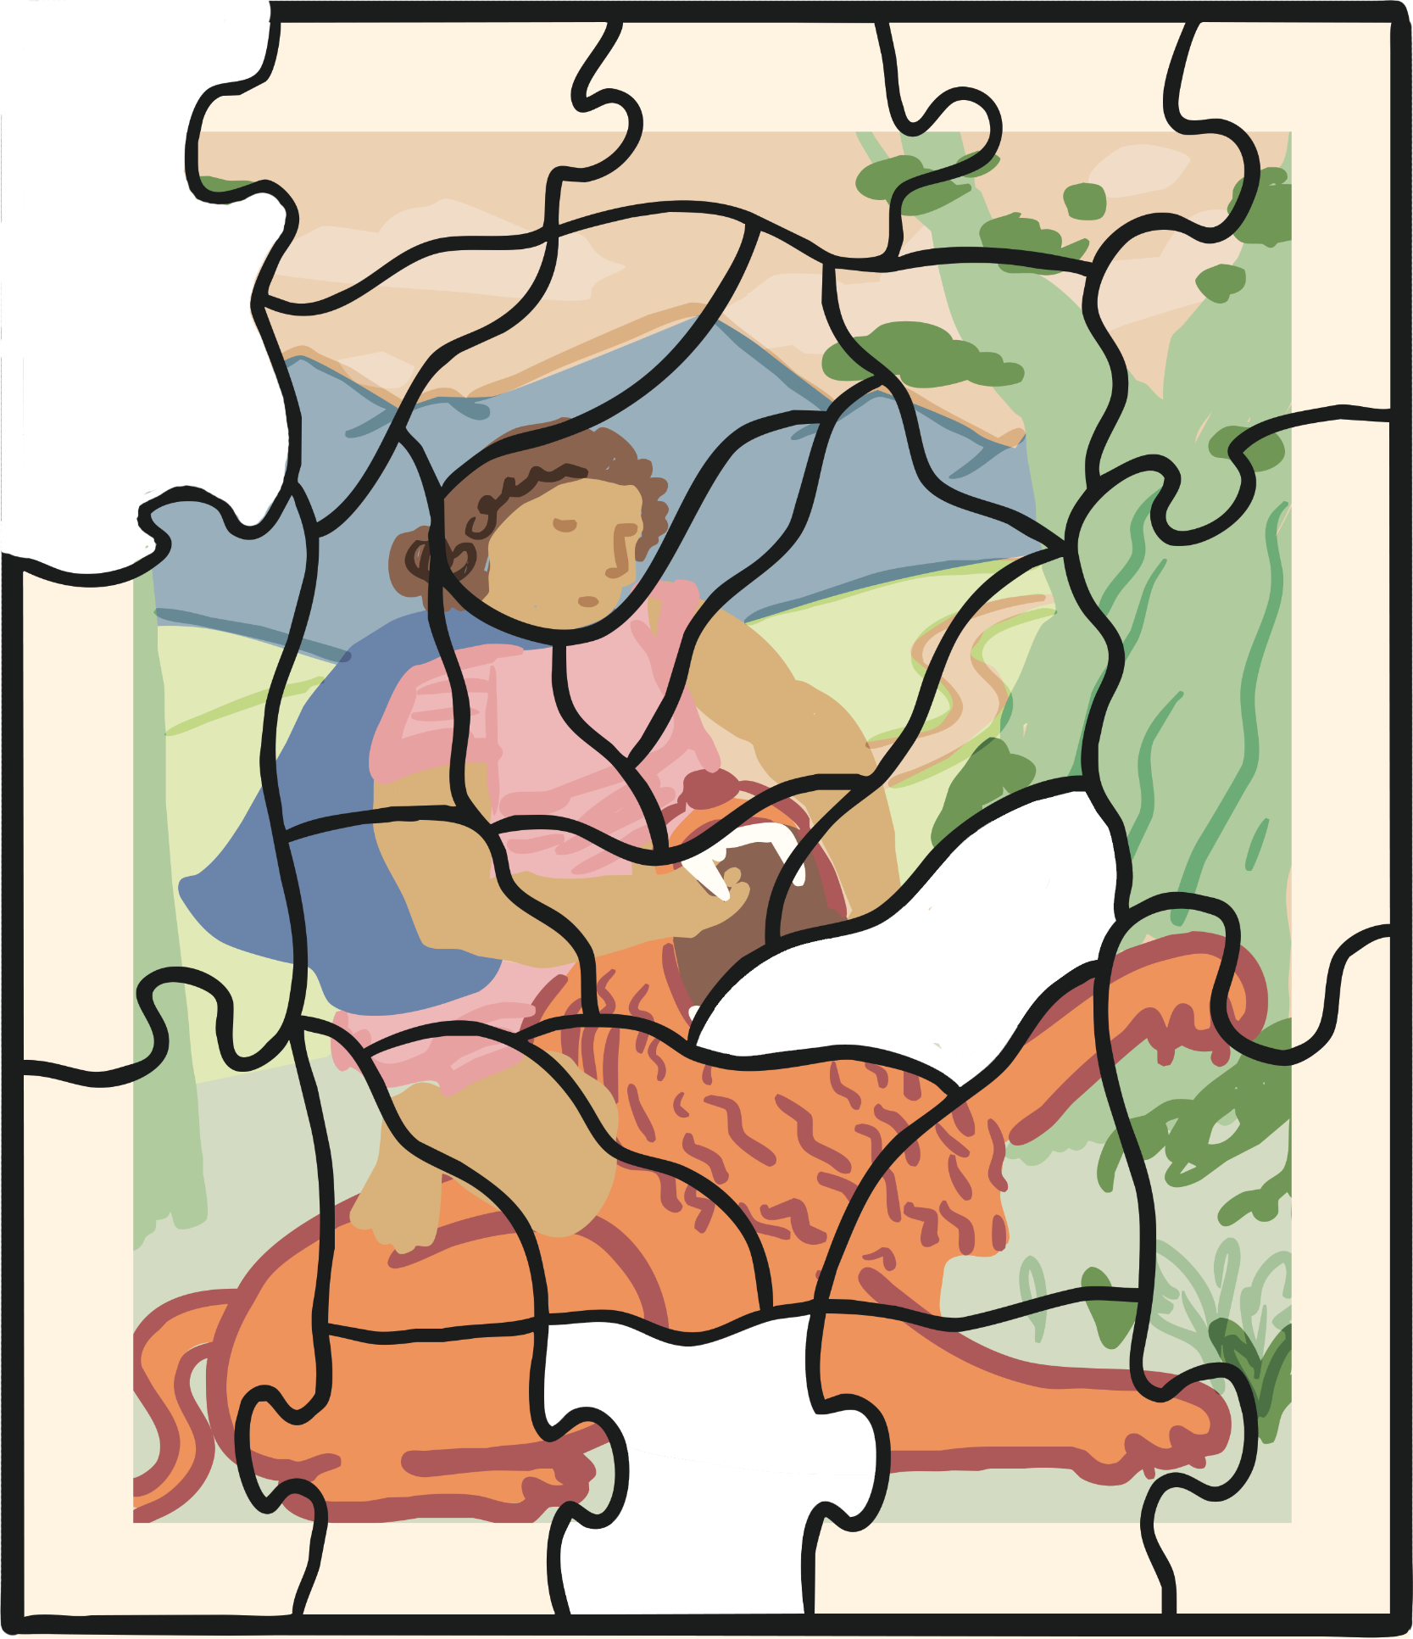
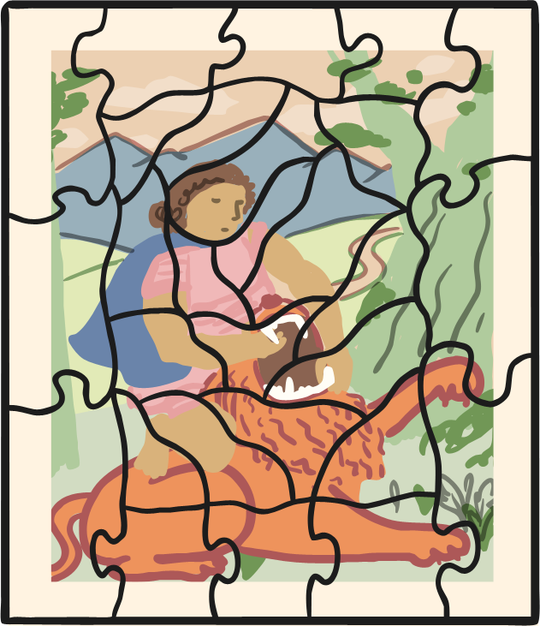
Practise
dew
pew
mew
newt

Slide 14
Apply
“School back then was very strict, too!” Grandma explained. “I know it will be hard for you to imagine but there were no computers and fancy interactive boards. The children would have used slate boards with chalk to write,” Grandma said, yawning.

Slide 15
Sentence Time
Apply
What does Kit whisper to Sam?
Read the sentence and click ‘Show’ to see the answer.

Slide 16
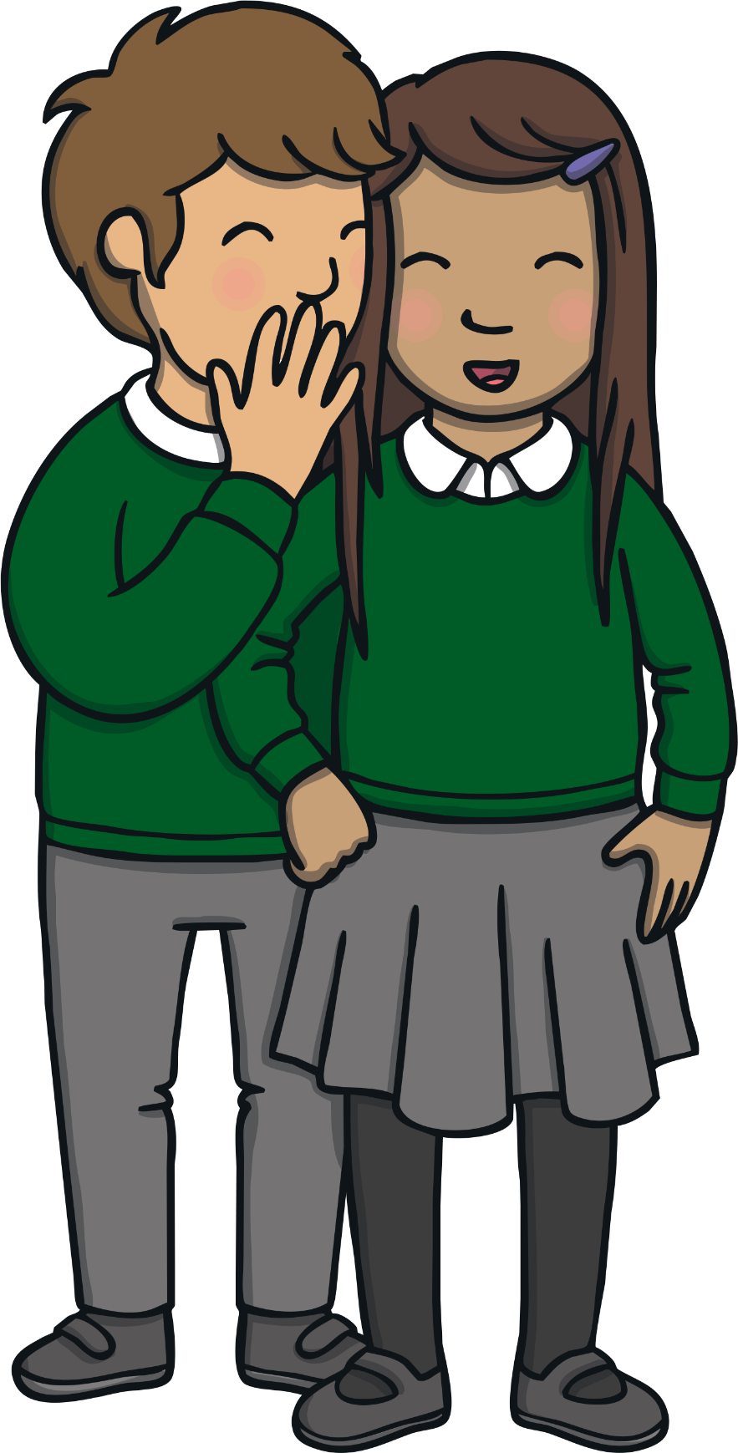
Apply
Do you think school was that different back then?
Sound Buttons on/off
Show

Slide 17
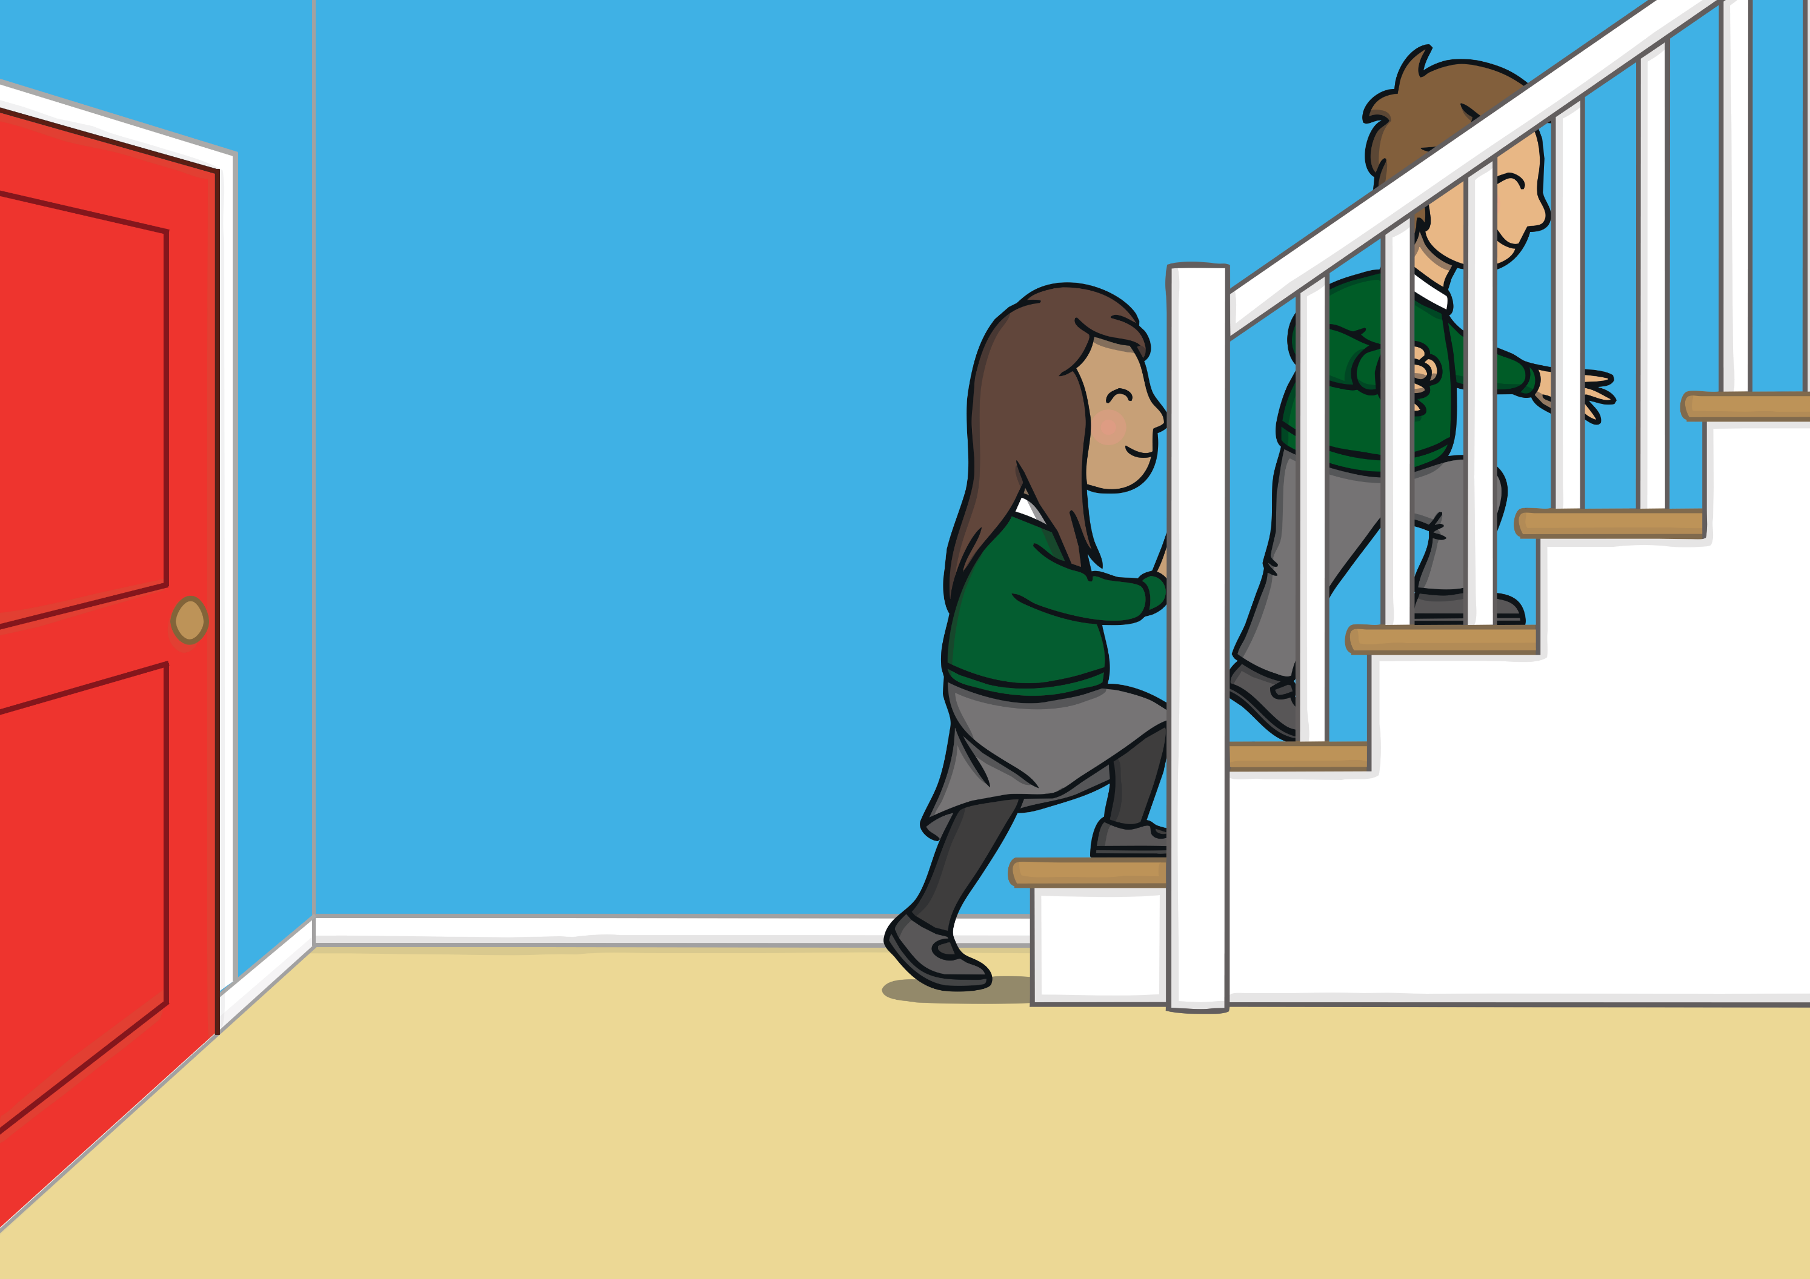
Apply
“I don’t know but we could find out for ourselves?” Sam whispered back.
“That’s just what I was thinking,” replied Kit with a smile. As Grandma drifted off to sleep, Kit and Sam quietly tip-toed upstairs to find the magic watch…

Slide 18
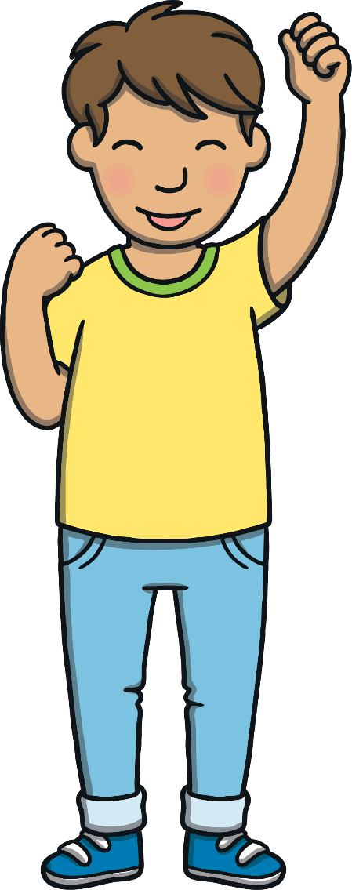
Today, we have learnt…
ue
saying /oo/
The adventure continues next lesson!

