Slide 2
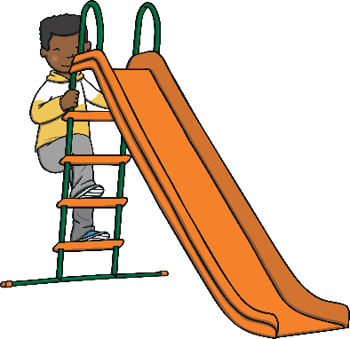
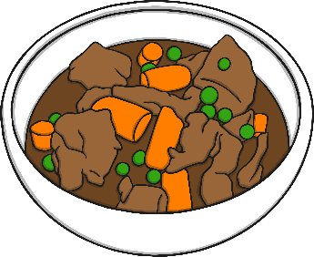
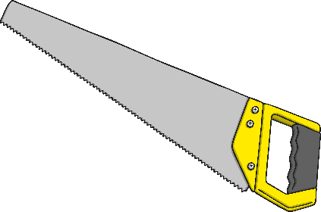
Revisit and Review
Let’s practise Sam’s Sounds and Common
Exception Words!
i_e
aw
ph
wh
ie
ew
u_e
e_e
ou
ow
ea
please
any
laughed
different
because
Monday
Tuesday
many
eyes
coming
friend
once
lived
horse

Slide 3
Today, we are learning to read and write g saying /j/ and c saying /s/ words.

Slide 4
Teach
Let’s practise reading all of this week’s focus words.
gem
cell
magic
city
giant
face
ginger
slice
many
laughed

Slide 5
Teach
Now, let’s write them with the magic pencil…

Slide 6
Teach
gem
Play

Slide 7
Teach
magic
Play

Slide 8
Teach
giant
Play

Slide 9
Teach
ginger
Play

Slide 10
Teach
cell
Play

Slide 11
Teach
city
Play

Slide 12
Teach
face
Play

Slide 13
Teach
slice
Play

Slide 14
Teach
many
Play

Slide 15
Teach
laughed
Play

Slide 16
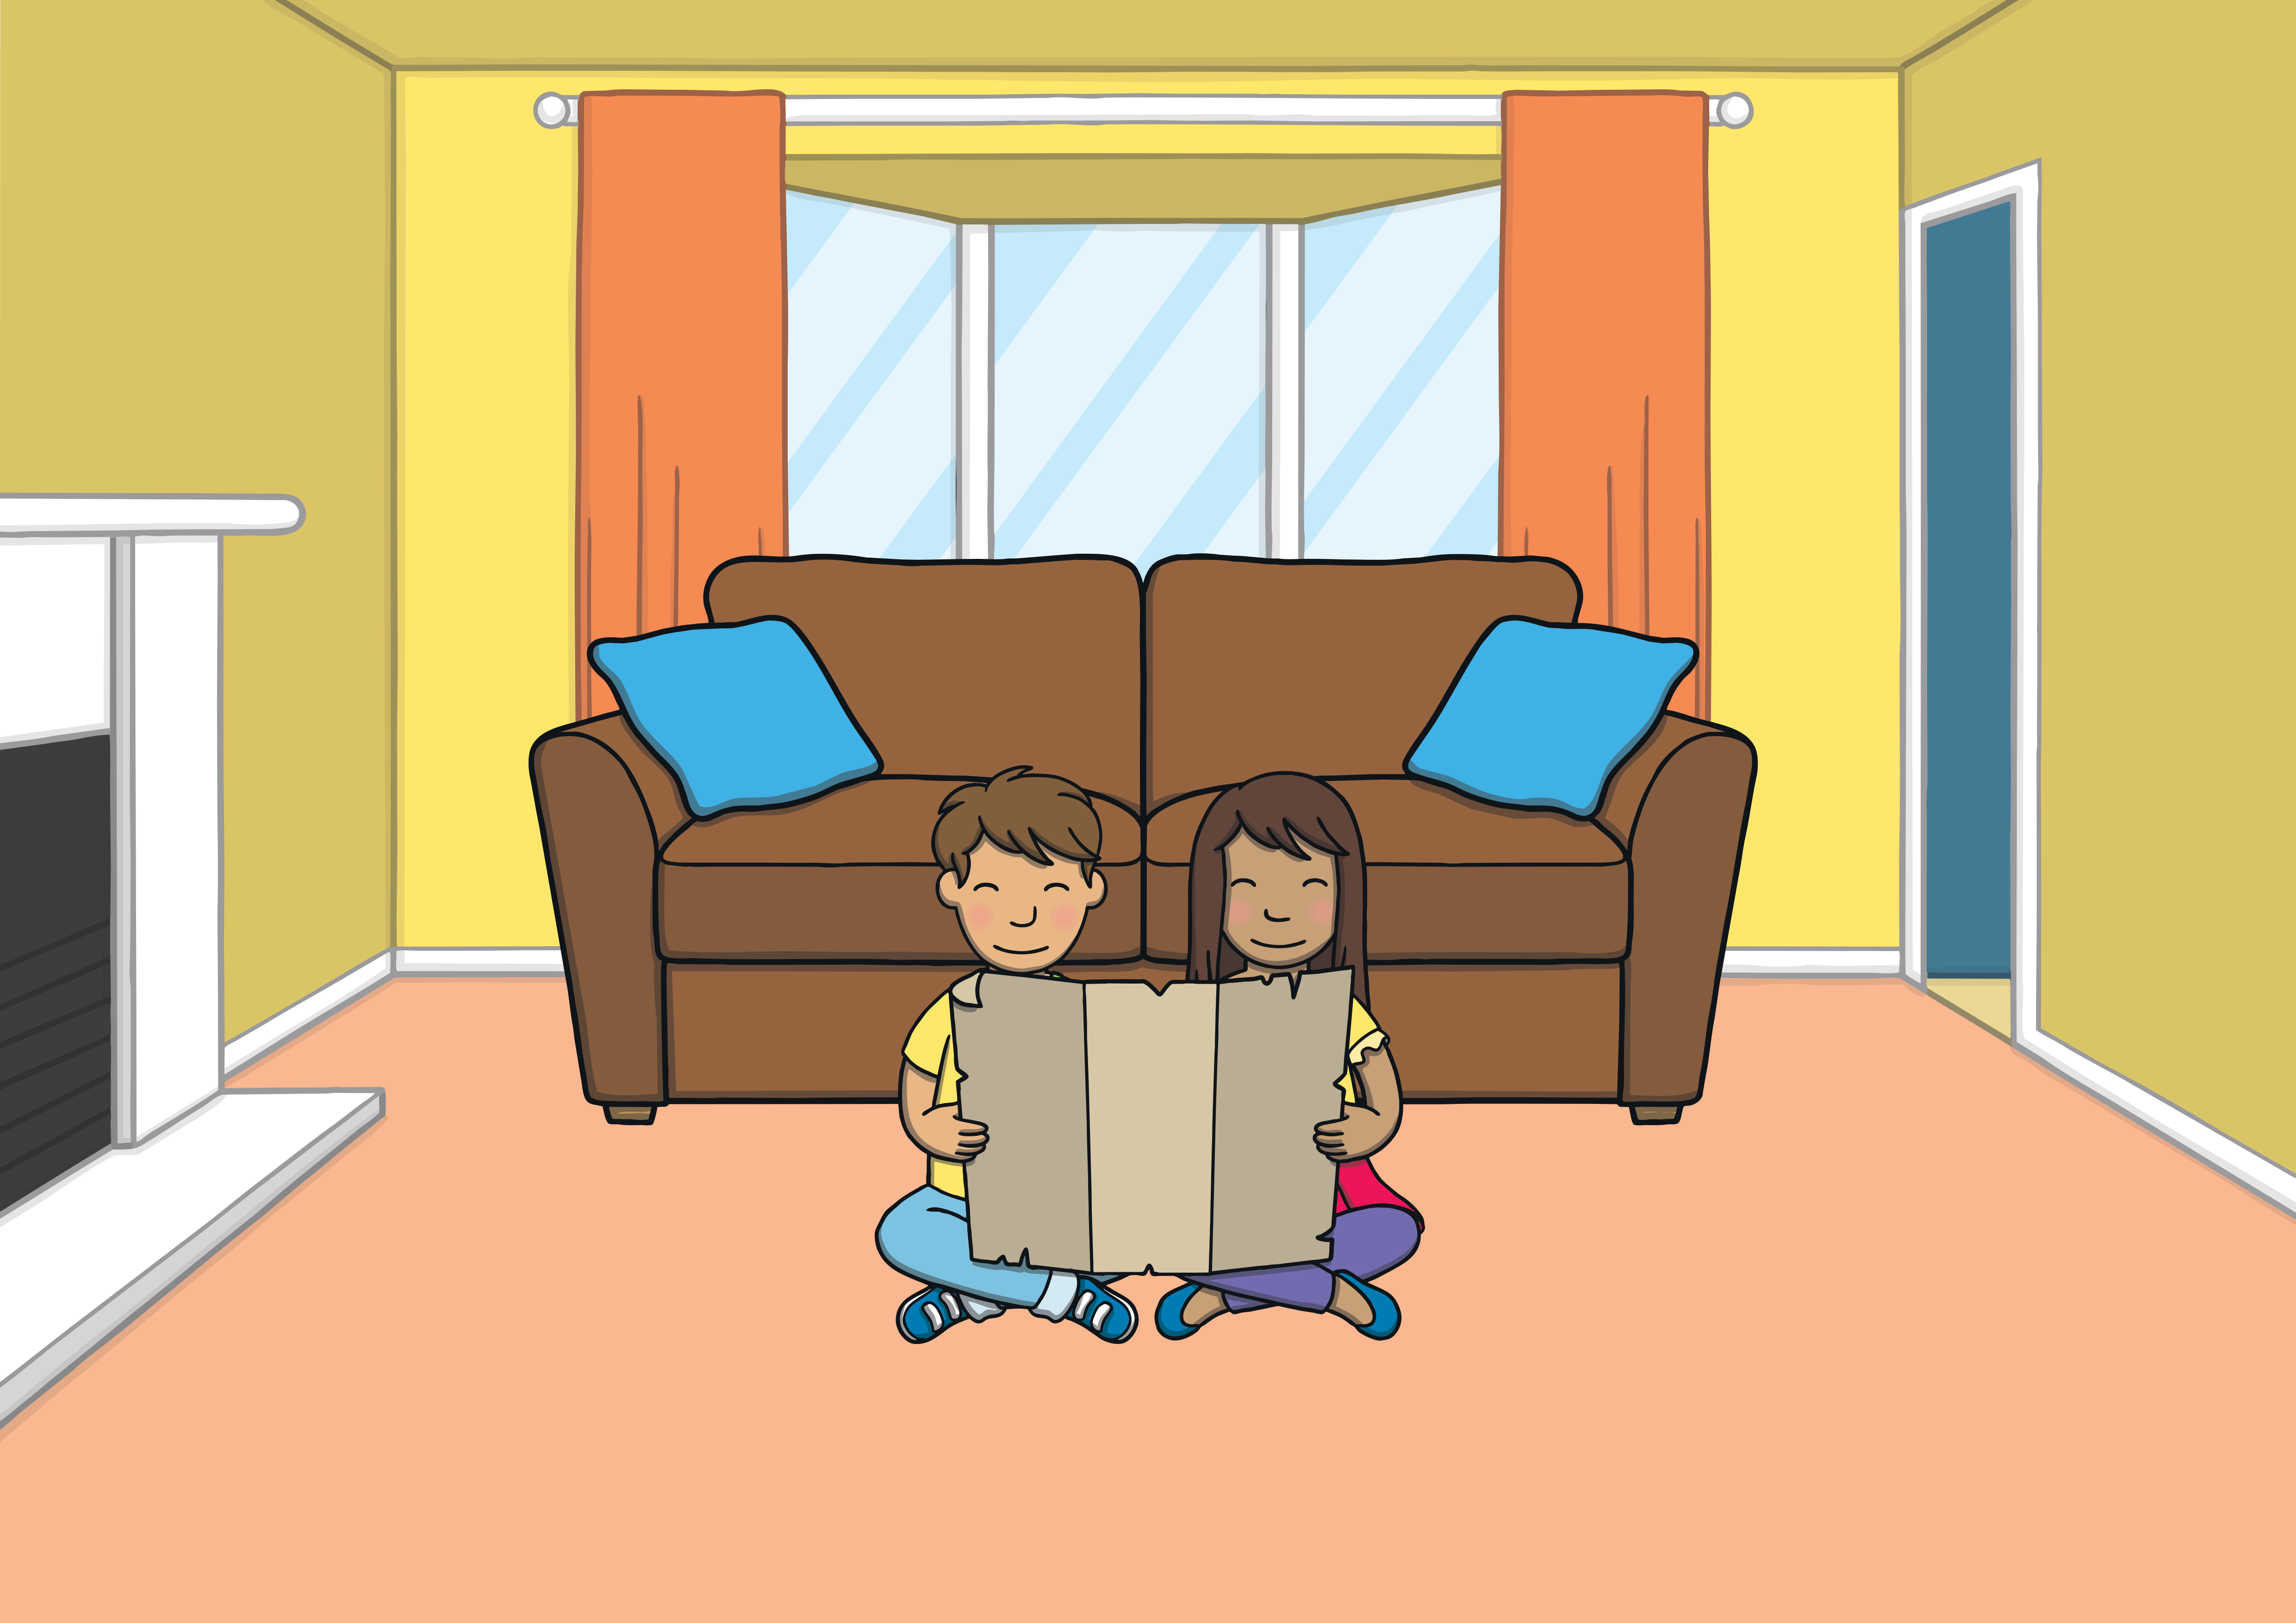
Teach
Kit and Sam were back at home after their Egyptian adventure. They decided to look at the magic map once more.

Slide 17
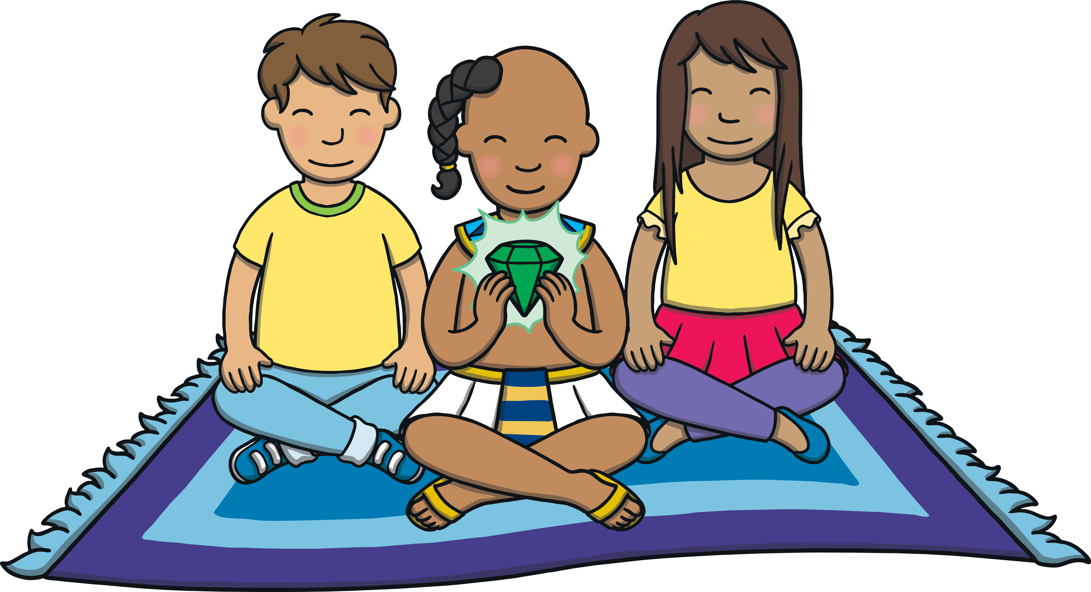
Teach
“It was so exciting to meet Prince Asim,” said Sam.
“Yes,” said Kit, “I’m pleased we were able to help him to get the gem back from his uncle.”

Slide 18
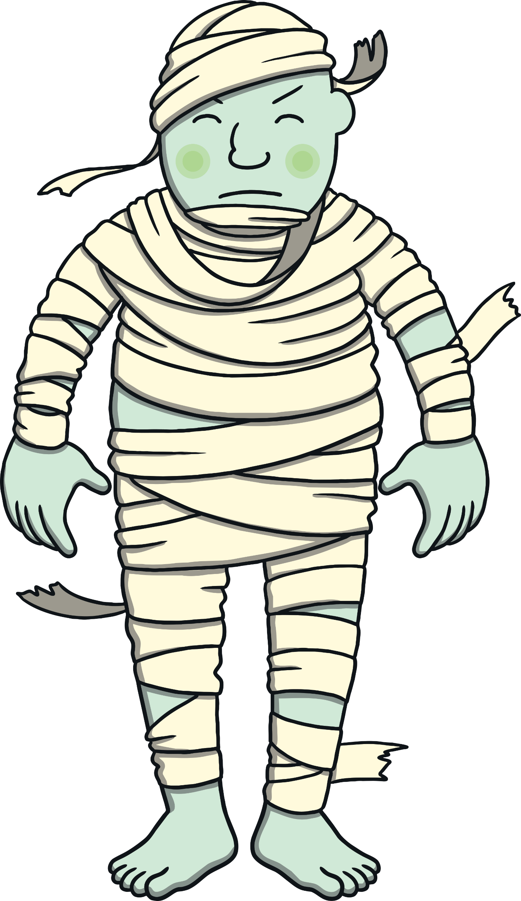
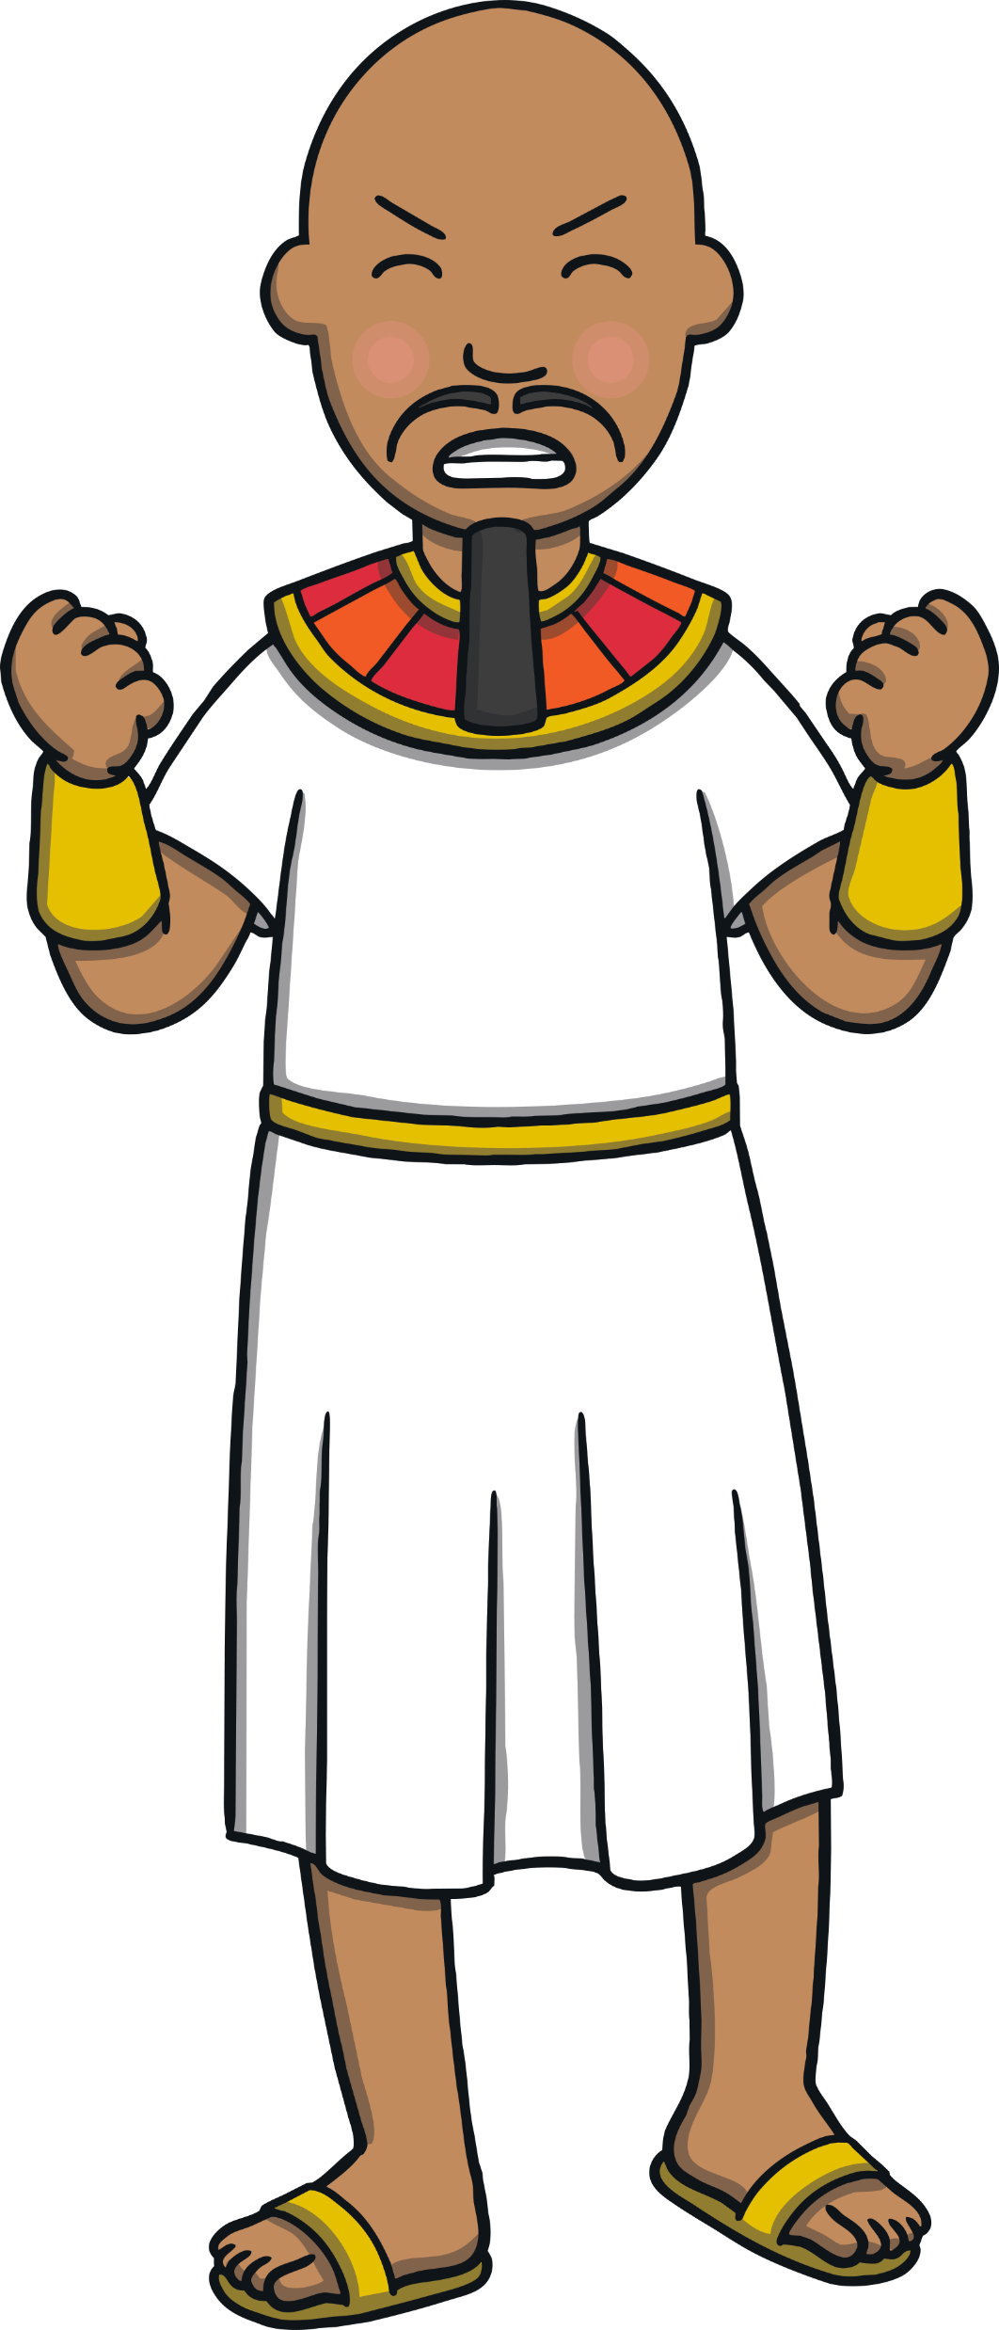
Teach
“Oo, his uncle and the giant were scary!” shuddered Sam.
“Yes,” said Kit. “I wonder what happened to them after we left?”

Slide 19
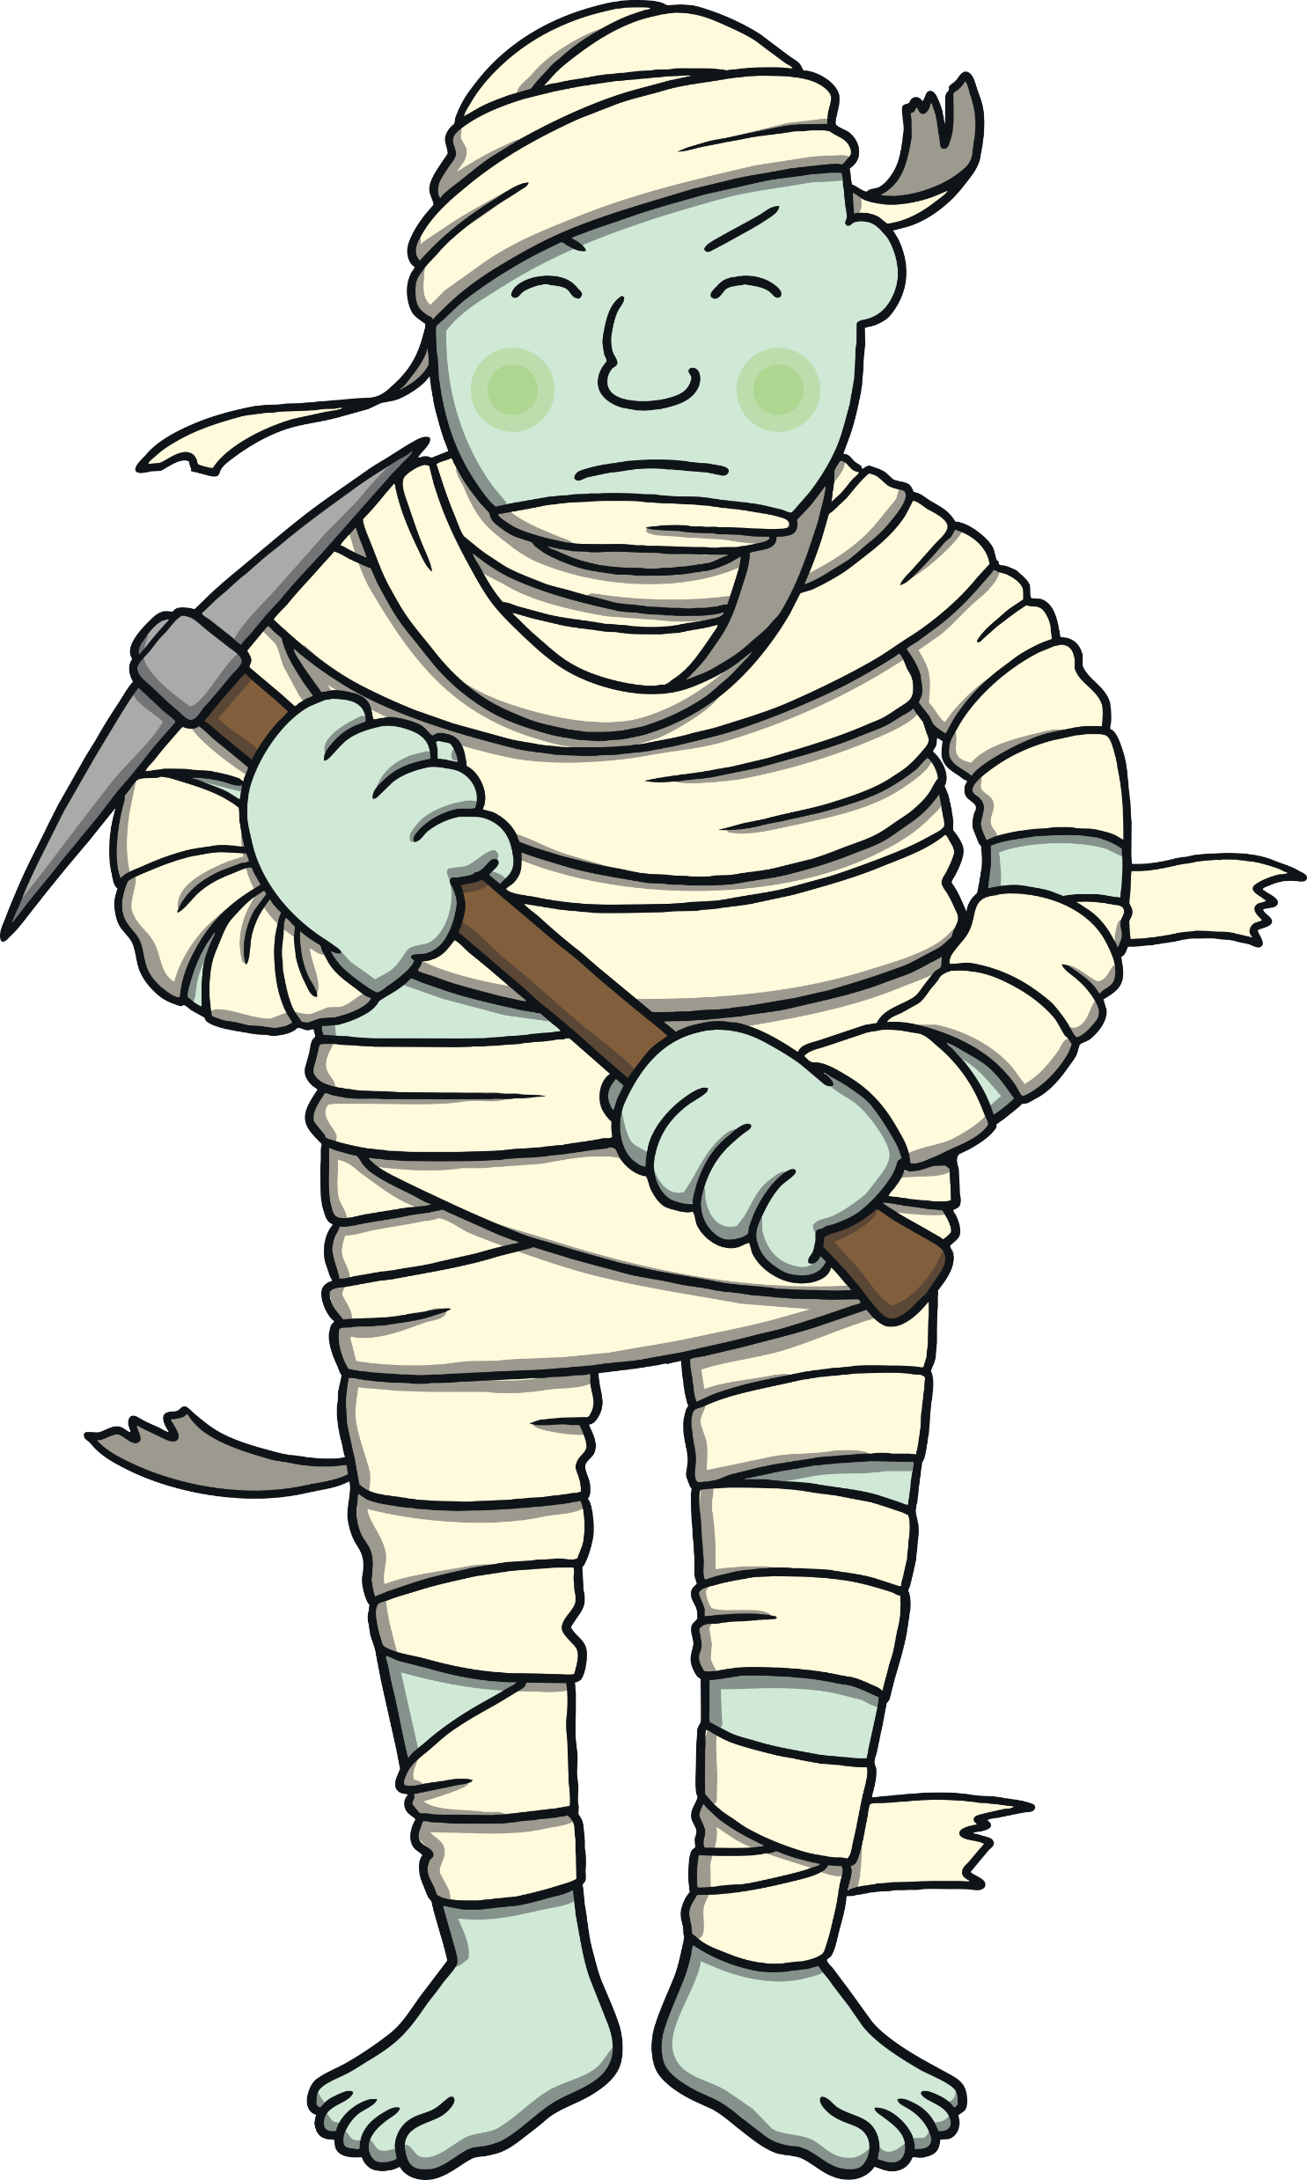
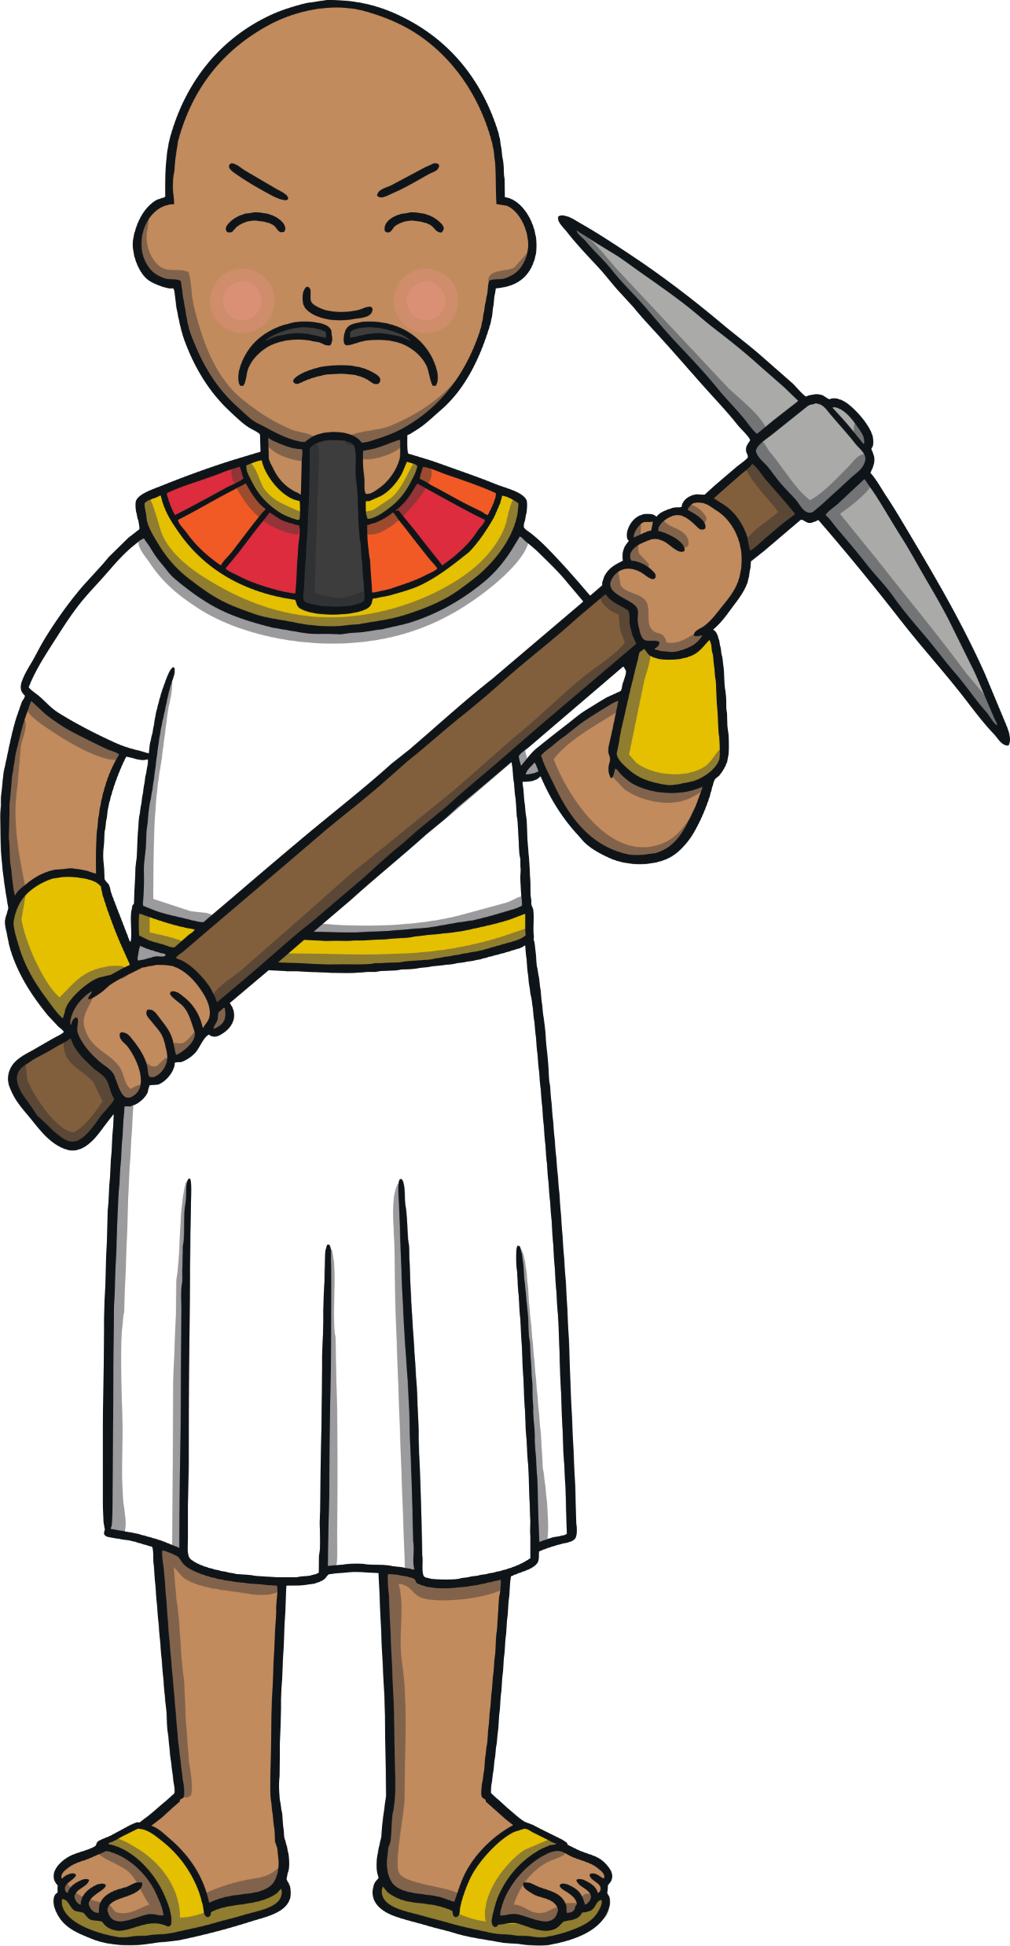
The Gem Mine
Practise
Prince Asim’s uncle and the giant were sent to work in the gem mine. Click on the gems to make words to match the pictures.

Slide 20
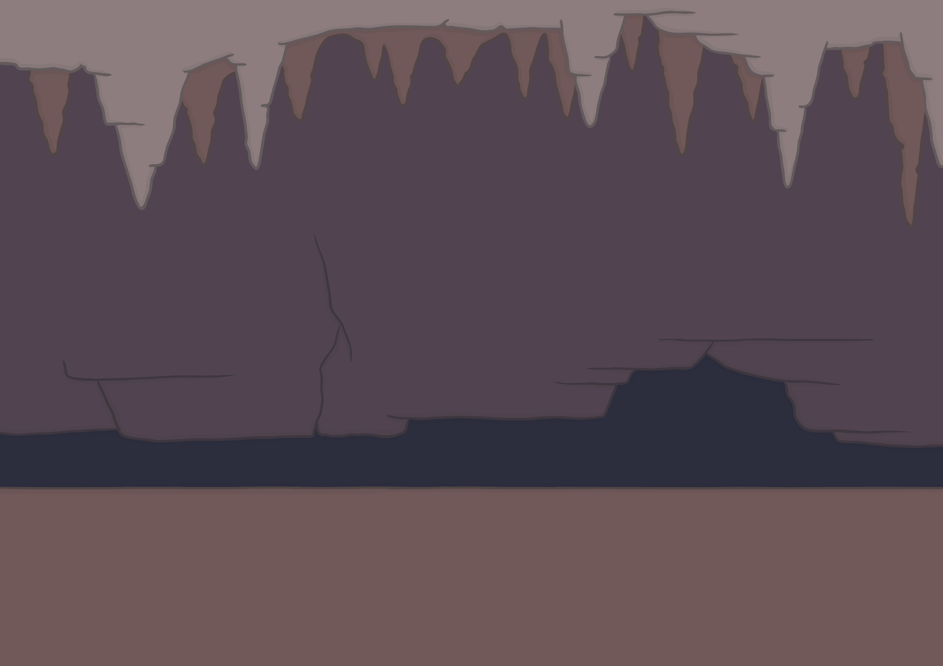
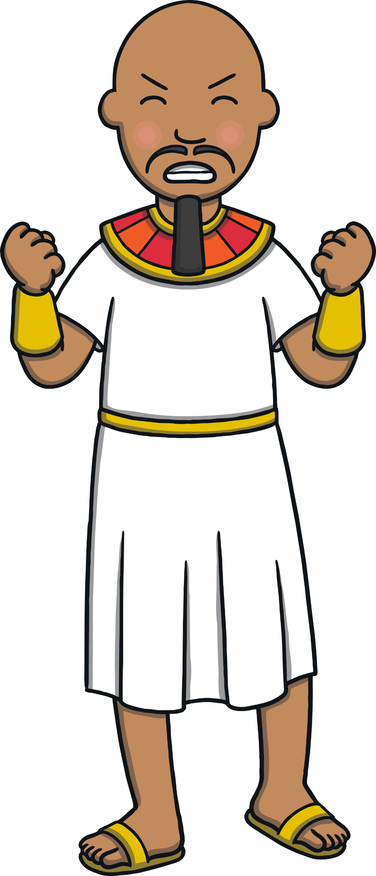
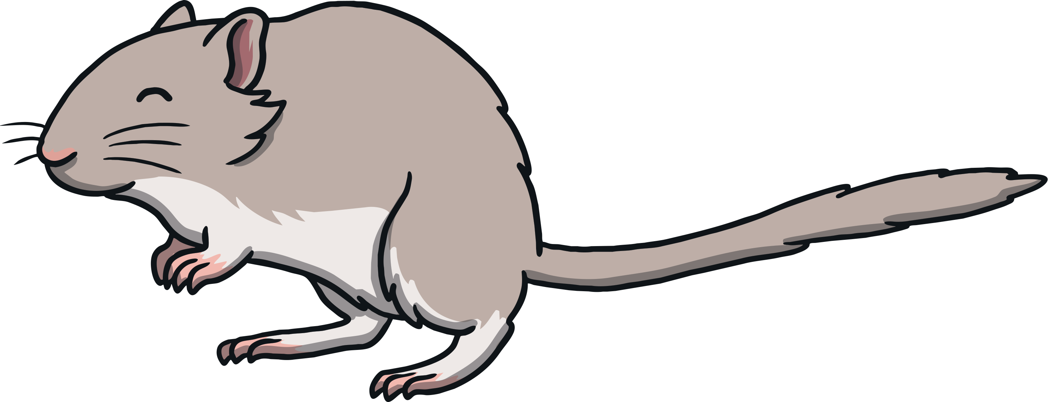
Practise
l
r
i
b
c
m
g
p
e
y
n
t

Slide 21
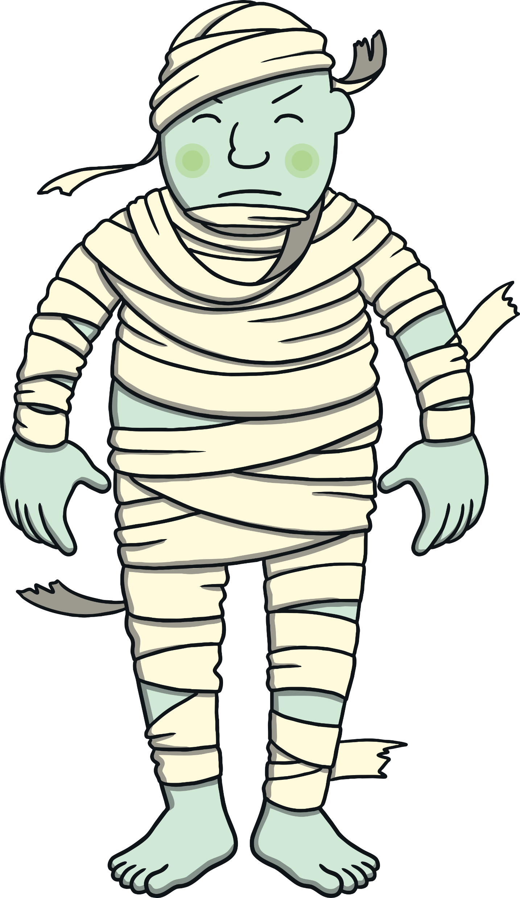
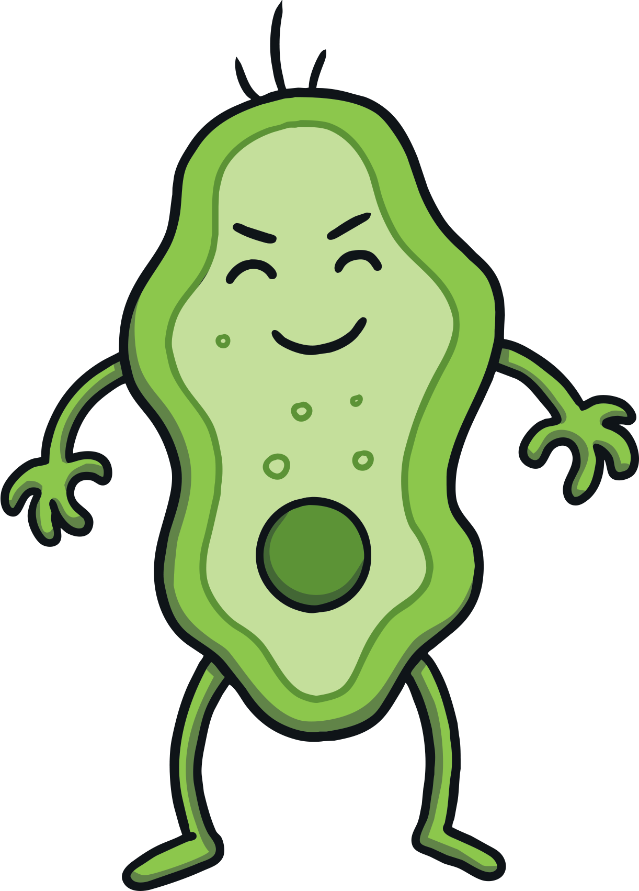
Practise
l
r
i
b
c
m
g
p
e
y
n
t

Slide 22
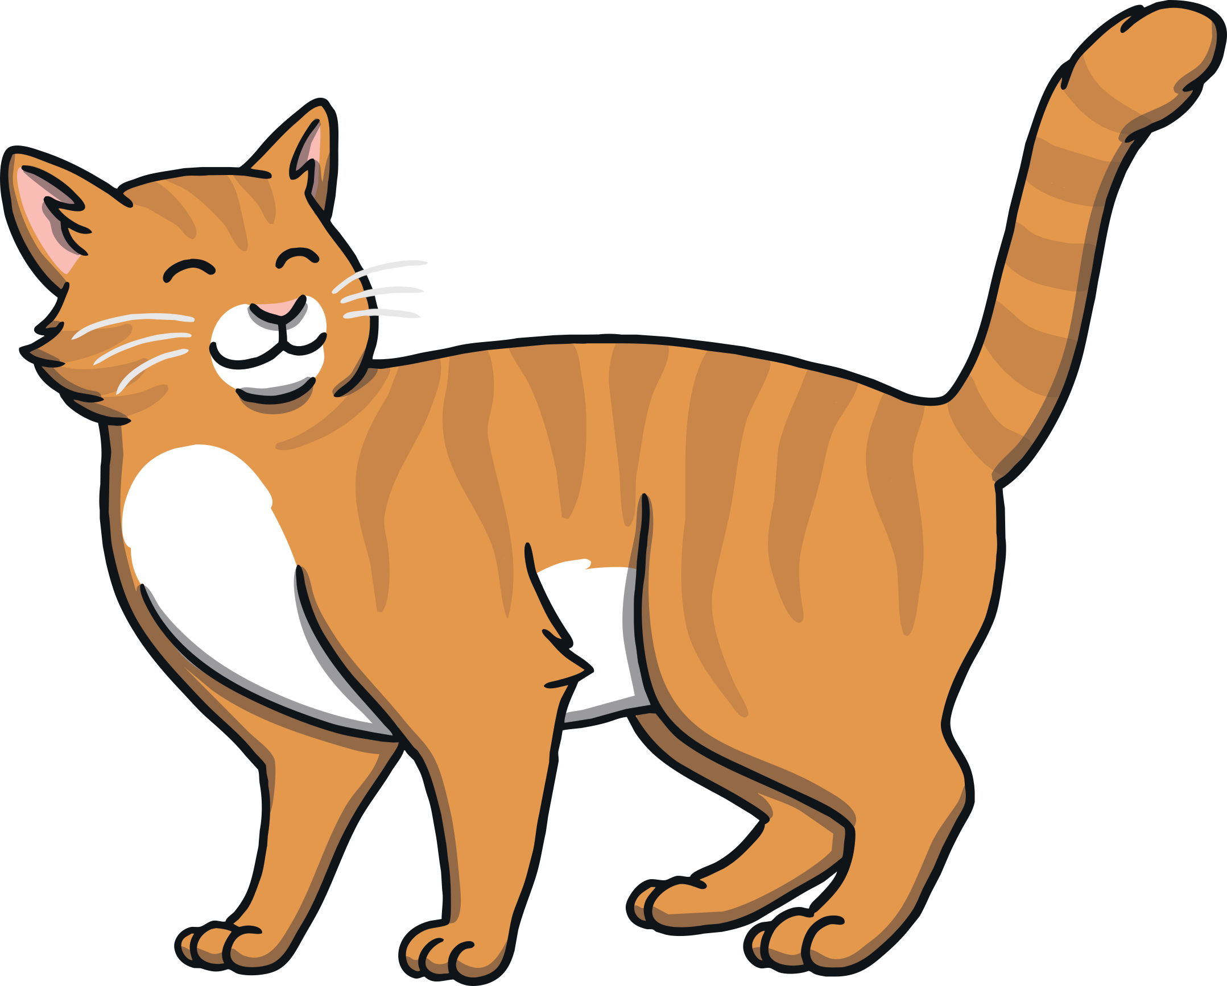
Practise
l
r
i
b
c
m
g
p
e
y
n
t
g

Slide 23
Practise
l
r
i
b
c
m
g
p
e
y
n
t

Slide 24
Practise
l
r
i
b
c
m
g
p
e
y
n
t

Slide 25
Practise
l
r
i
b
c
m
g
p
e
y
n
t

Slide 26
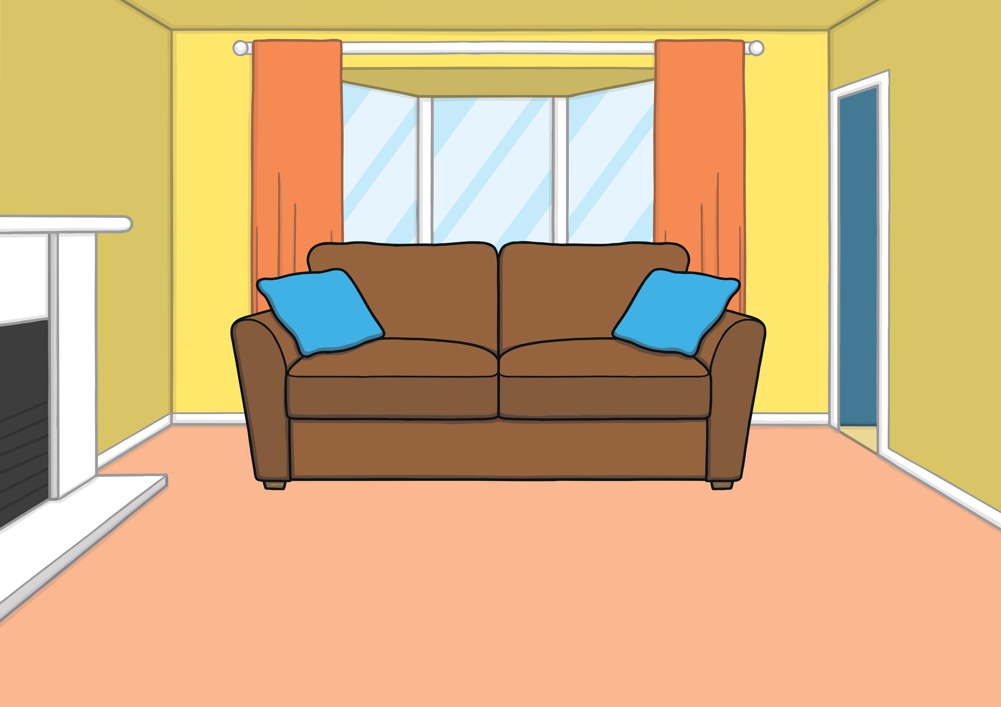
Apply
“I guess we’ll never know,” laughed Kit. “Why don’t we make a book all about our adventure with Prince Asim and the missing gem?” said Sam.

Slide 27
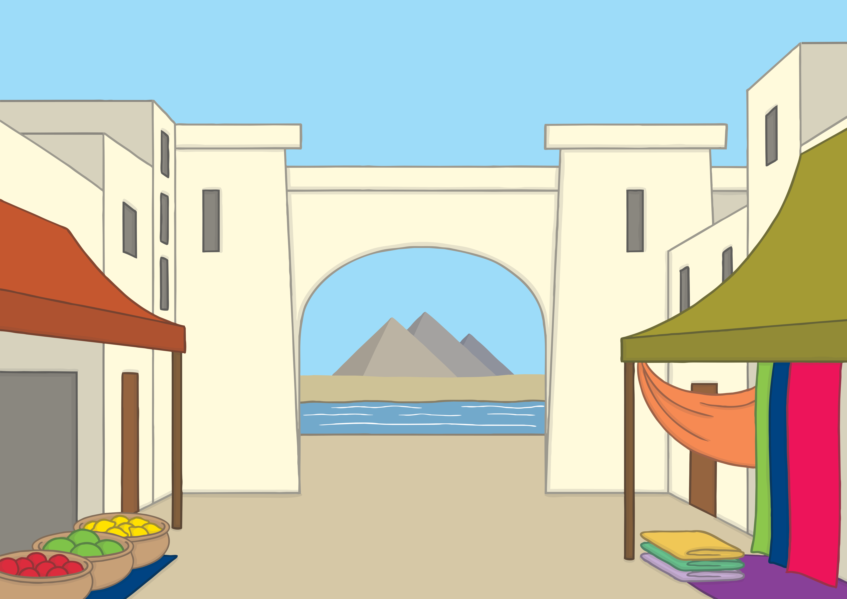
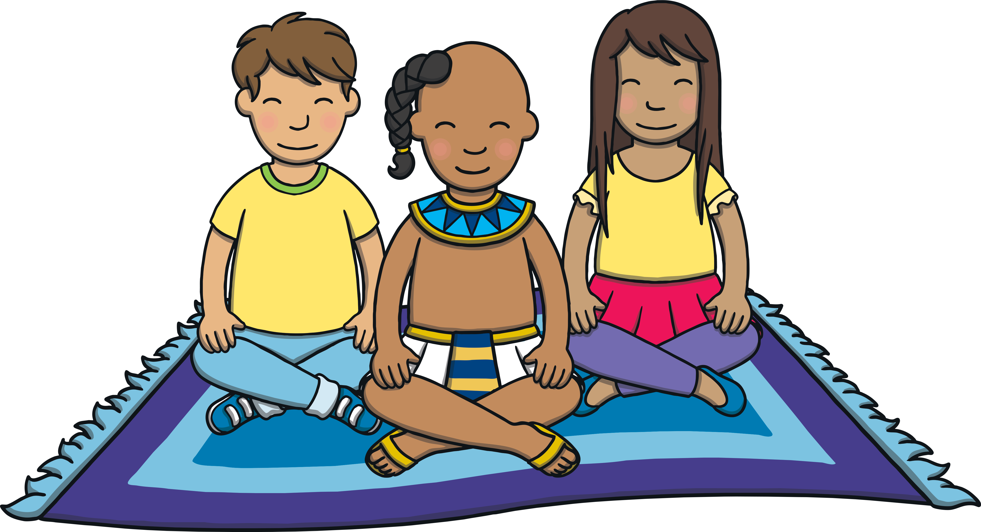
The Magic Carpet
Apply
A ‘Let’s Write Together!’ Book

Slide 28
Apply
We used the magic map and our bedroom rug to get to the desert. The rug became a magic carpet and flew! When we got there, we met a boy called Asim.
Show Suggestion

Slide 29
Apply
Asim needed our help because a gem had been stolen. We flew over the city on a magic carpet to look for clues to help us find the gem.
Show Suggestion

Slide 30
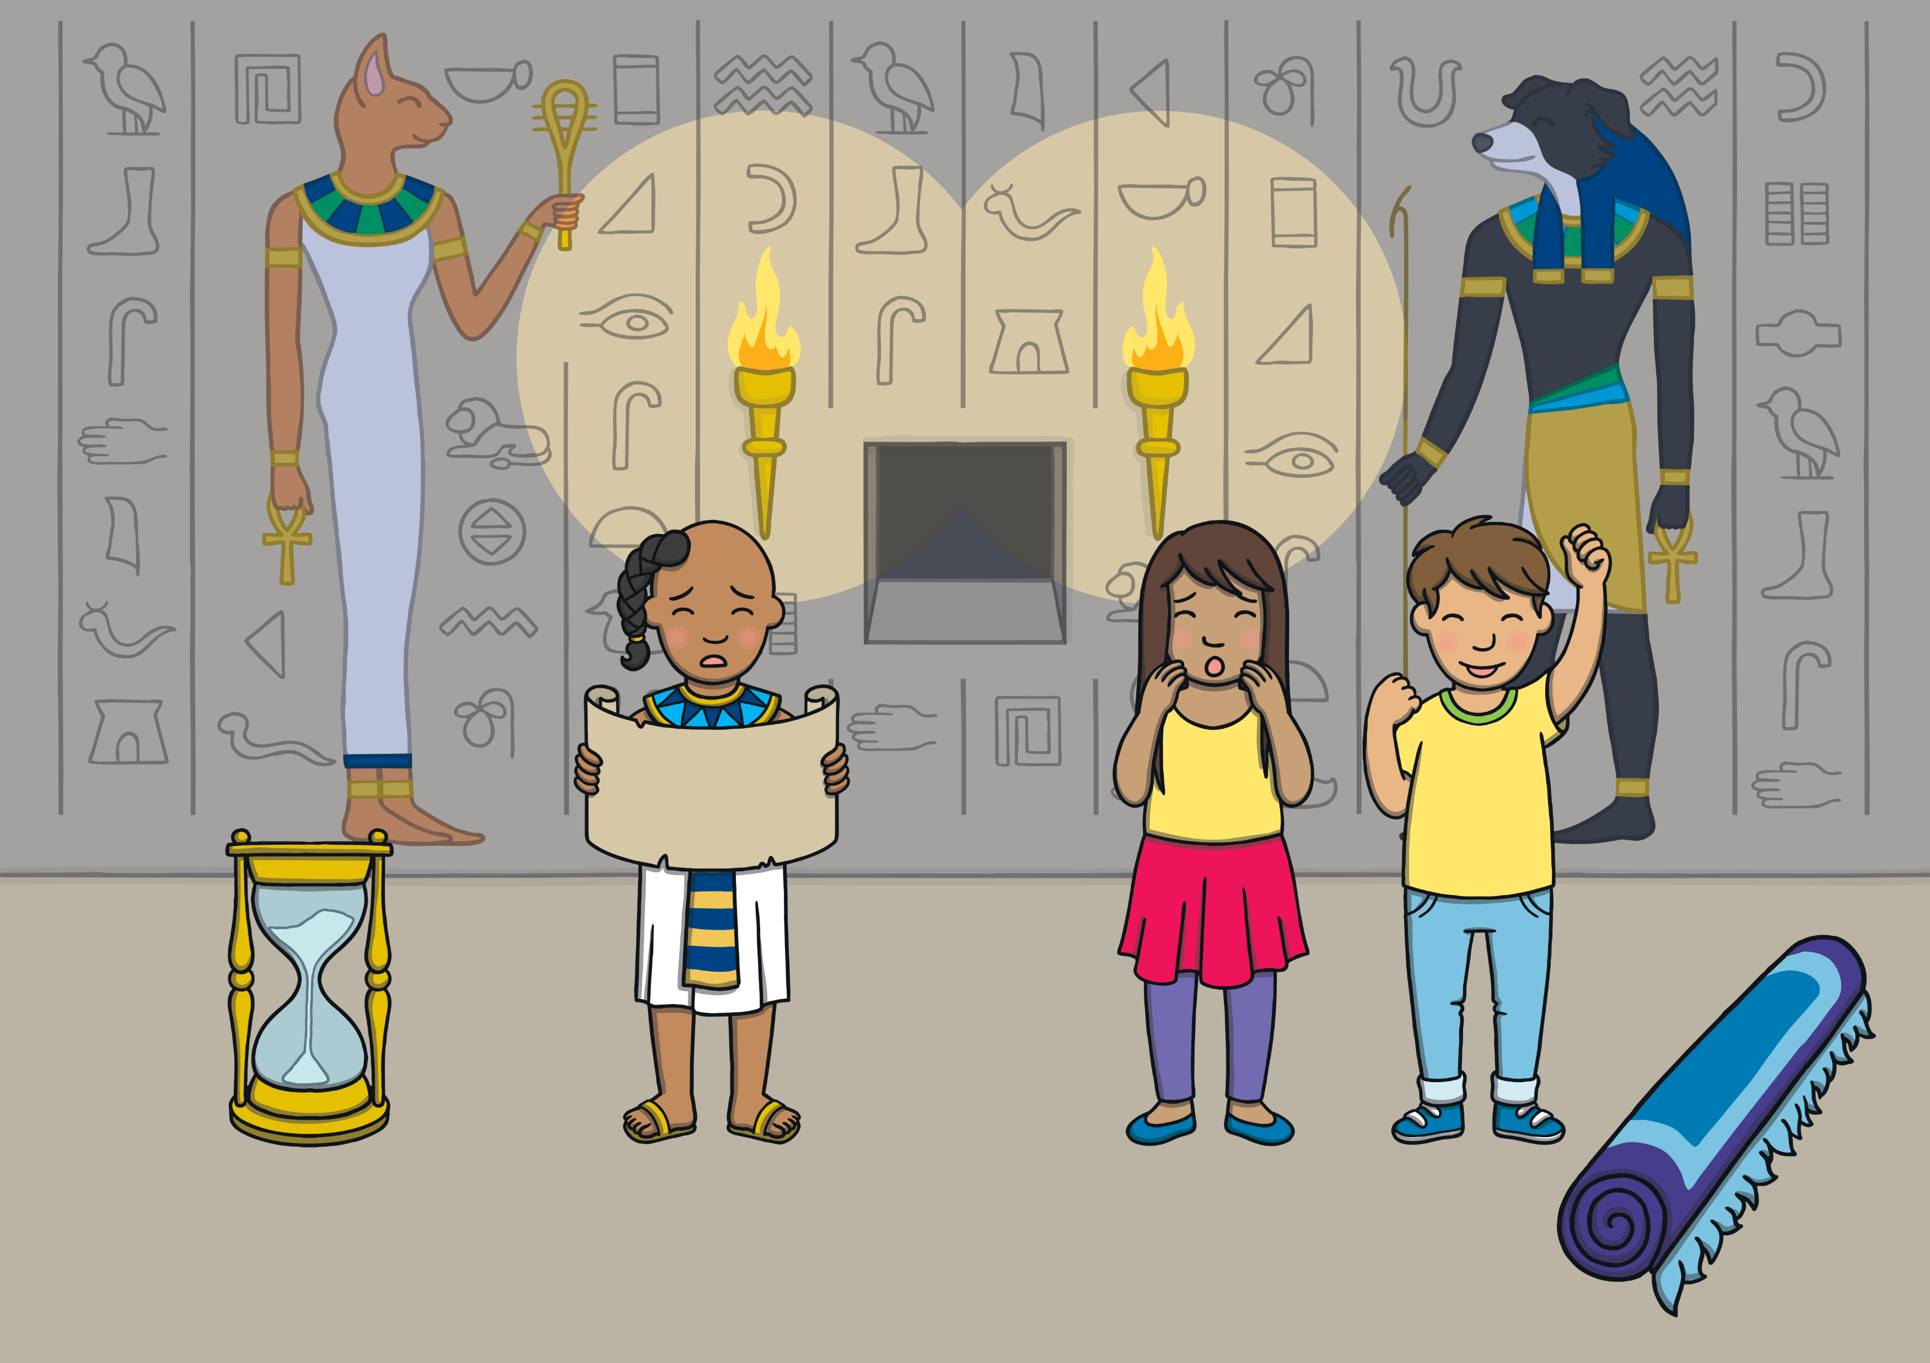
Apply
We found one clue just in time. It was a scroll that came out of a secret hole in the wall as the last grain of sand fell through the timer.
Show Suggestion

Slide 31
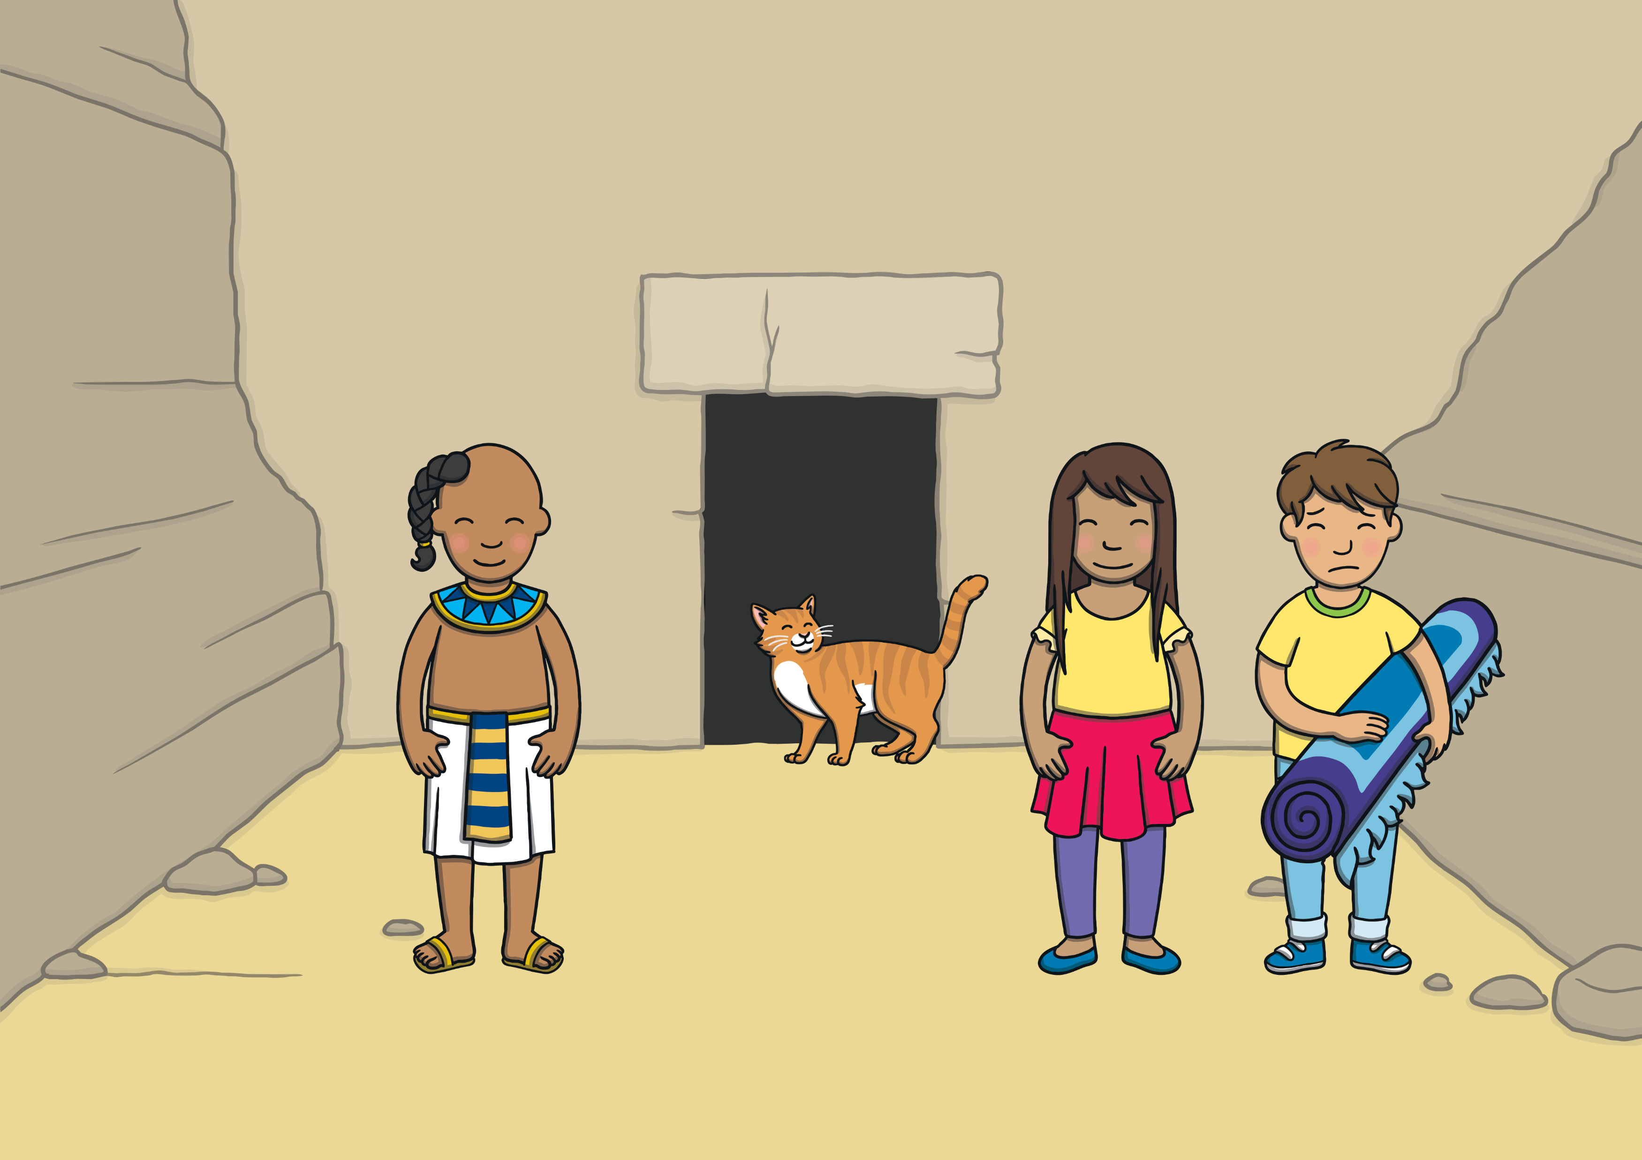
Apply
The scroll told us to follow a ginger cat if we wanted to find the missing gem. Once we found the cat, it quickly ran off. After a while, it led us to a secret cave.
Show Suggestion

Slide 32
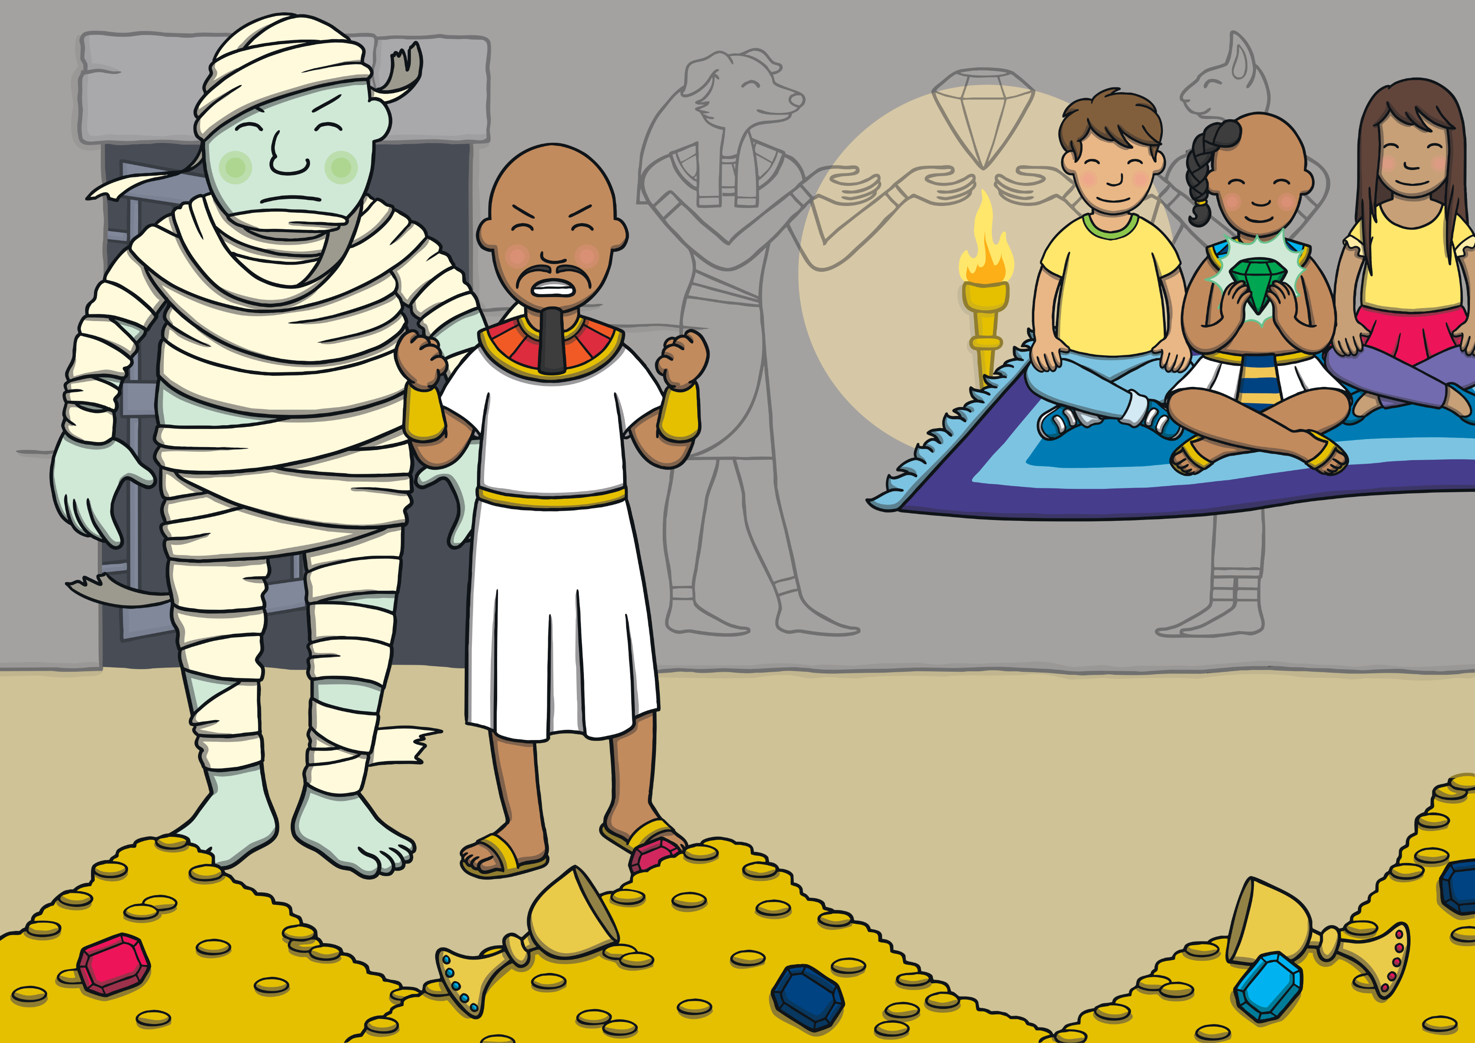
Apply
Inside the cave, Asim could see the gem behind the bars of a cell. However, his dad’s brother tried to stop us getting it. Asim bravely got the gem from the cell.
Show Suggestion

Slide 33
Apply
Just then, the giant came out of the cell and started to chase us! Sam quickly got our mat out. We got onto the magic carpet and flew away.
Show Suggestion

Slide 34
Apply
“I hope that we will see Prince Asim again one day,” sighed Kit.
“I have a feeling that we will,” smiled Sam as she closed the book.

Slide 35
Today, we have written sentences to write a book together.

