Slide 2
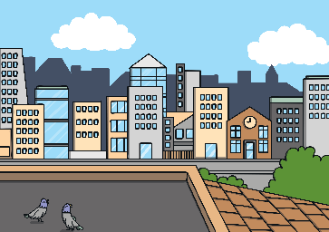
Revisit and Review
Let’s practise Sam’s Sounds and Common Exception Words!
g
c
ea
wh
ie
coming
February
more
January
before

Slide 3
Teach
This week, we are learning to spell the common exception words friend and once. Watch the magic pencil write the words. Can you join in?

Slide 4
Teach
friend
Play

Slide 5
Teach
once
Play

Slide 6
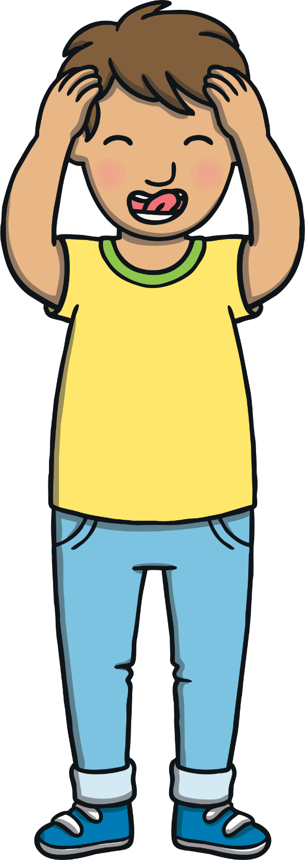
Teach
Today, we are learning to read words that contain ie saying /ee/.

Slide 7
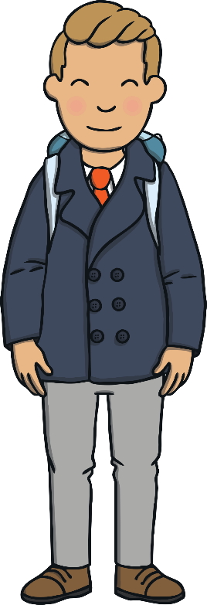
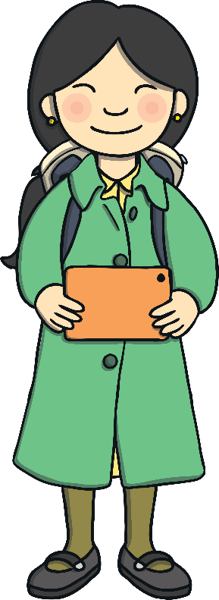
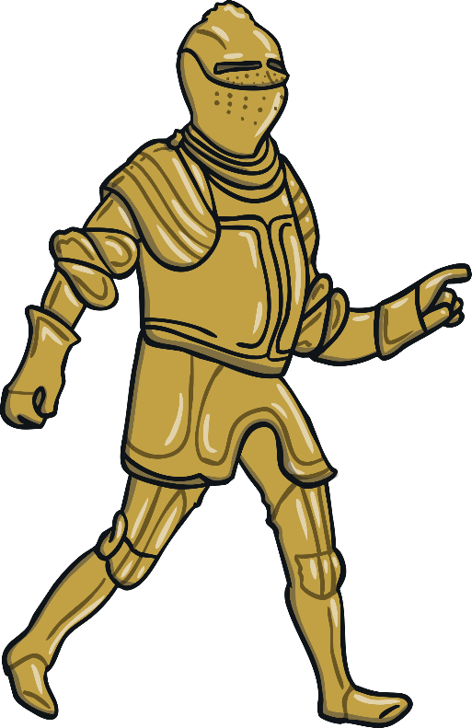
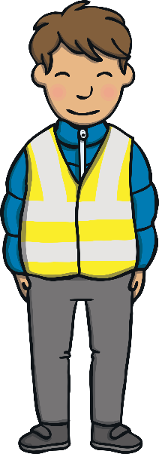
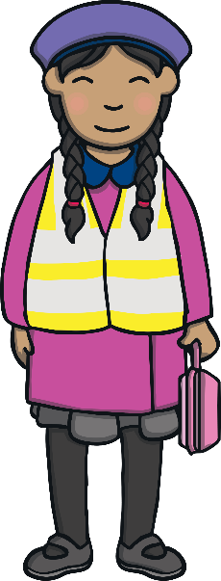
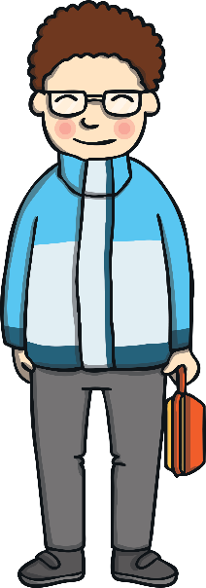
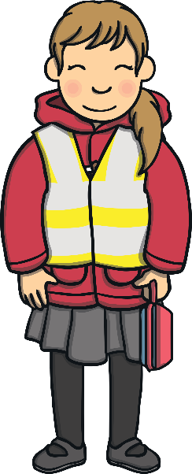
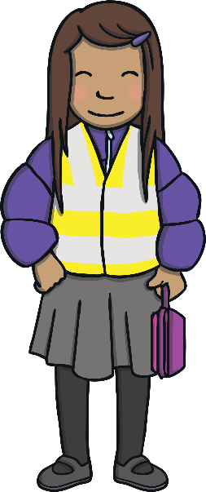
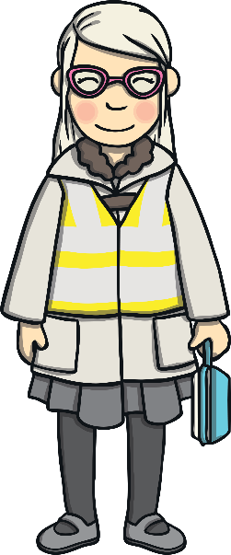
Teach
The children followed the knight up a grand staircase and into a large room. This was the solar room. Once, it would have been used by one of the family members of Highfields Estate.

Slide 8
Teach
It’s a room to relax in, as well as a bedroom.
“Oh, I thought solar was something to do with the sun and heat!” giggled Jake to Kit.

Slide 9
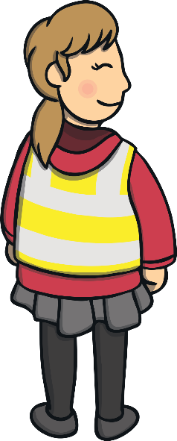
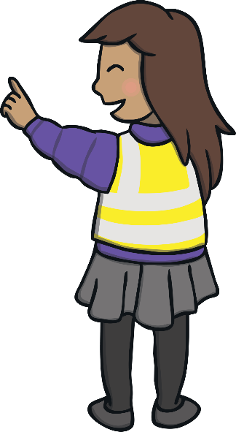
Teach
“Wow! Look at that bed!” gasped Sam in surprise.
“This room is very posh!” Gabi said in delight.
“I would love to have a big bed like that! It is so high that you need steps to get to the top tier!” Sam said.

Slide 10
Teach
“That bed looks enormous!” exclaimed Kit to Jake. “I think a king or prince would have slept in here.”
“Yeah, it is definitely for someone important… I know! For the chief of this place, King Jake!” joked Jake.
“You mean, King Kit! It sounds better!” laughed Kit.

Slide 11
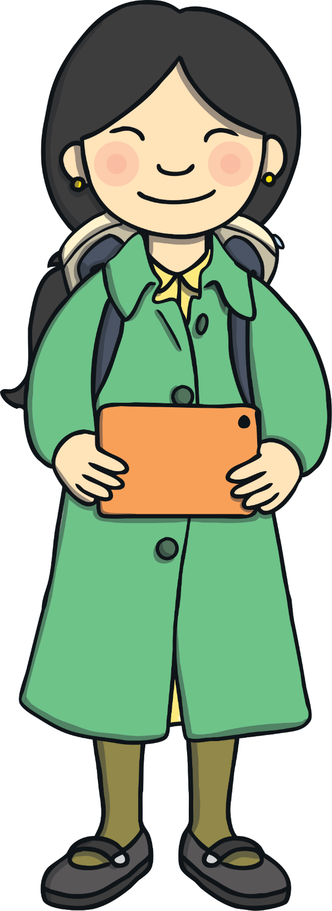
Teach
Mrs Tan takes some photos on her tablet. She notices the beautiful tapestry hanging on the wall. Click on the tapestries to spell each word.
X
They are all ‘ie’ words. The ‘ie’ goes in the middle of the word.
Click me for Kit’s teaching tips!

Slide 12
Teach
t
th
r
ch
th
ie
f
f
l
f
a
n
f

Slide 13
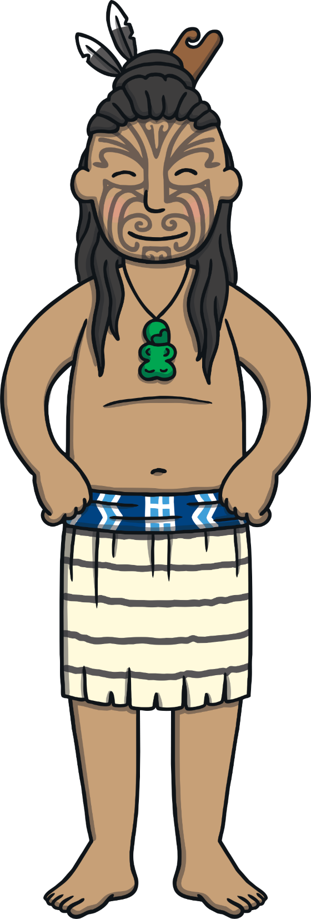
Teach
t
th
r
ch
ch
ie
f
f
l
f
a
n
f

Slide 14
Teach
t
th
r
ch
t
ie
r
l
f
a
n
f

Slide 15
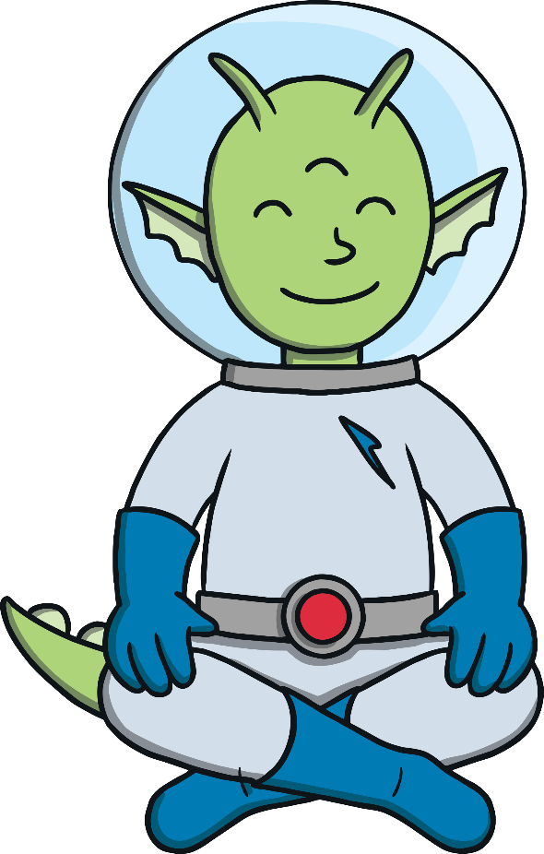
Teach
t
th
r
ch
a
l
ie
n
l
f
a
n
f

Slide 16
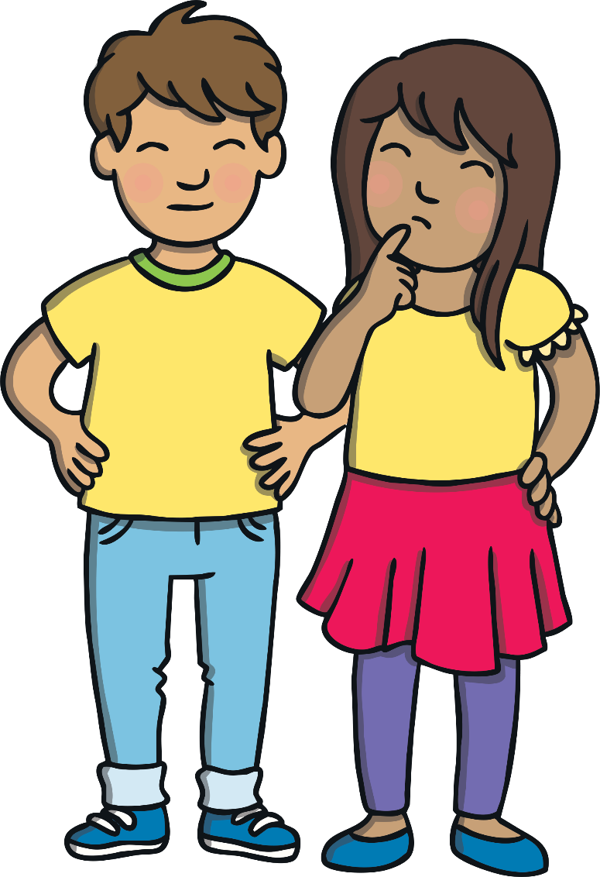
Solar Room Hidden Pictures
Practise
Find the ie pictures hidden in the room.
Write down the words.
Hint: There are four to find.
X
This is a great whiteboard activity.
Click me for Kit’s teaching tips!

Slide 17
Practise
shield
field
priest
briefcase
Check

Slide 18
Apply
After a short time in the solar room, everyone followed the knight out of it.
“I wonder where we are off to now?” Kit said to Jake.
“I don’t know. I hope it is warm as this castle is freezing!” replied Kit.

Slide 19
Apply
“Imagine what it would have been like here in January when it was snowing!” said Jake. Kit was too cold to reply.

Slide 20
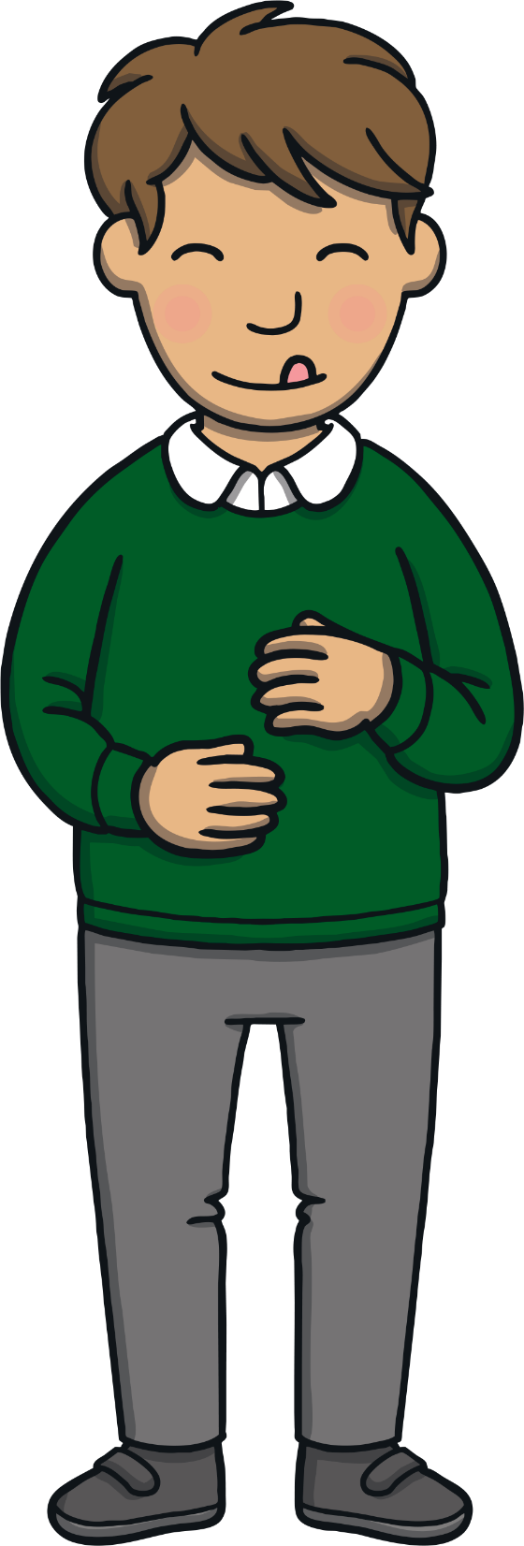
Sentence Time
Apply
Kit and Jake are enjoying the tour around the castle. However, they are both very hungry! Look at the picture and write a sentence to match.

Slide 21
Apply
Once we have had a brief stroll
around, let’s hope we can have lunch!
Sound Buttons On/Off
Show

Slide 22
Apply
After visiting several other rooms in Highfields Estate, it was lunchtime. All of the children were ready for some food. Thankfully, much to Kit’s relief, no thief had been in and taken his lunch box! “Once you have all eaten your lunch, we are going to visit the dungeon,” exclaimed the knight. Gabi smiled at Sam. That sounded fun!

Slide 23
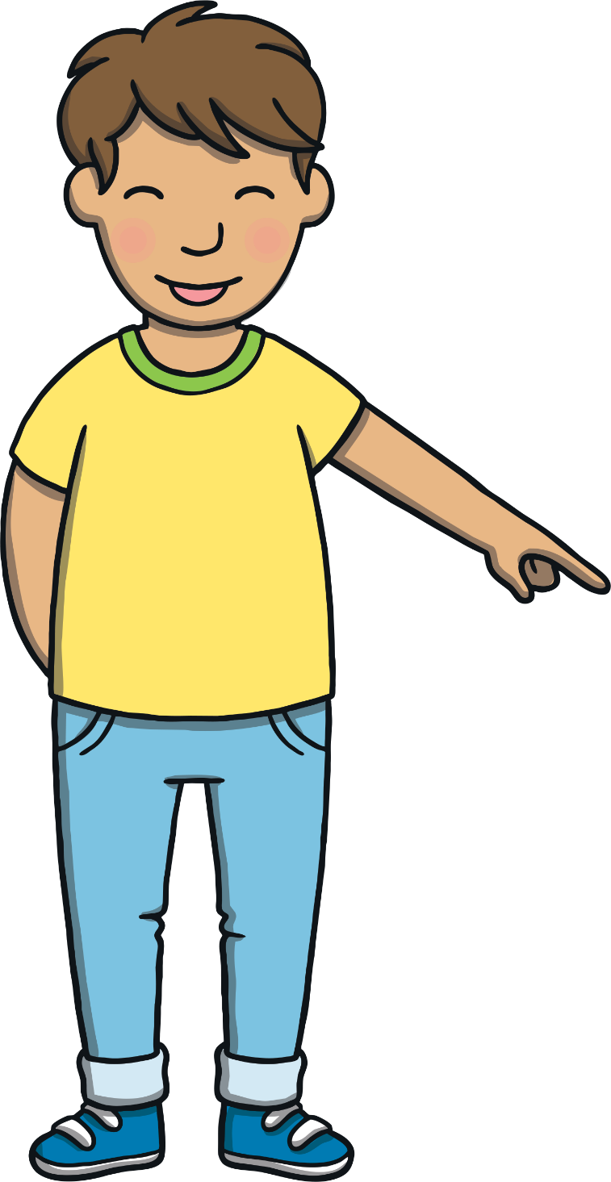
Today, we have learnt…
ie
saying /ee/
The adventure continues next lesson!

