Slide 1
Dear Parents,
This week we are learning about how we can add –s and –es to words to make them plurals.
Eg, skirts, raincoats, bracelets, glasses, buses, boxes and wishes.
The tricky words to focus on for reading and spelling are:
August, October (reading)
more, coming (spelling)
For children coming to school:
We will be teaching lessons 1 and 2 to Bubble A (children coming in on Mondays and Tuesdays).
We will be teaching lessons 4 and 5 to Bubble B (children coming in on Thursdays and Fridays).
You will then be able to teach the other lessons on the days that the children are not at school.

Slide 3
Revisit and Review
Let’s revisit last week’s focus words…
I’ll say them and you write them down!

Slide 4
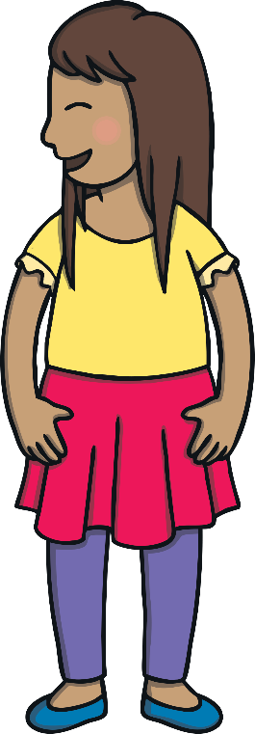
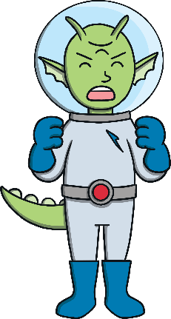
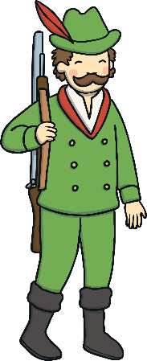
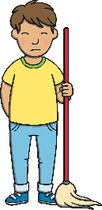
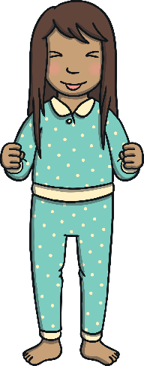
Revisit and Review

Slide 5
Teach
Here are this week’s focus words for reading…
August
October

Slide 6
Tricky Word Diary
Teach
Kit and Sam are having a look through the different months on their calendar. Can you spot the words August and October?

Slide 7
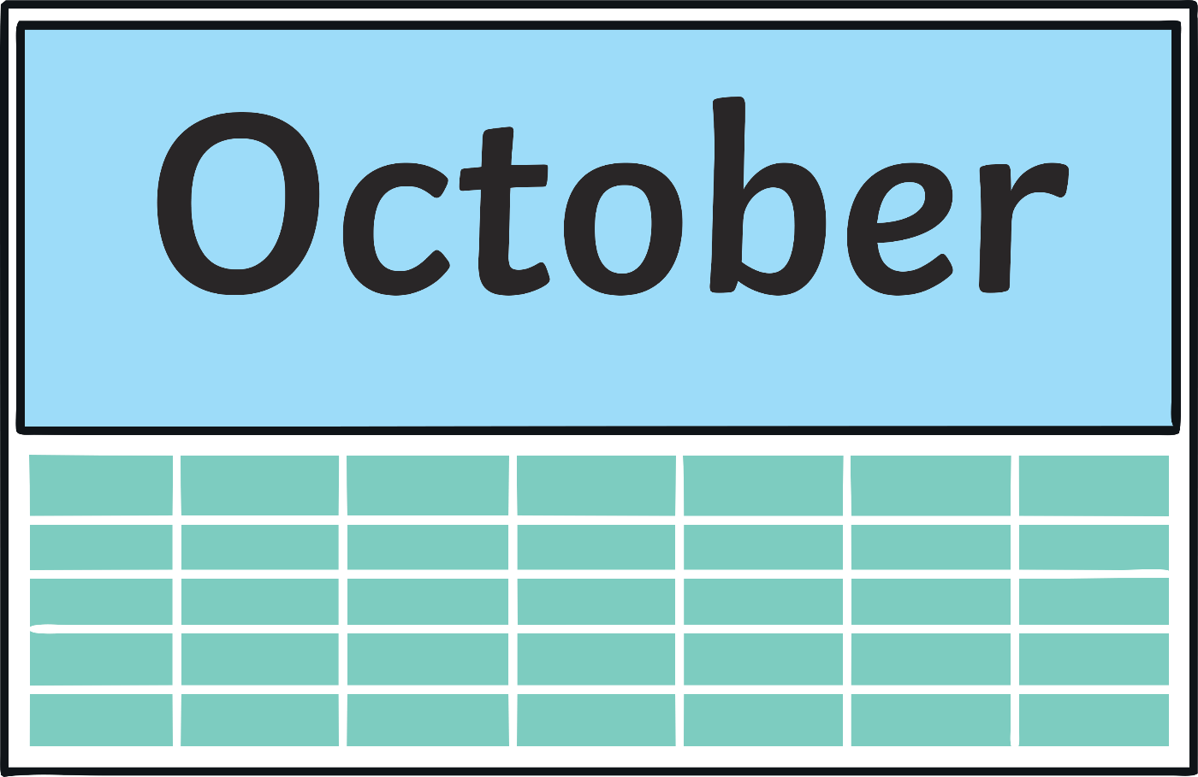
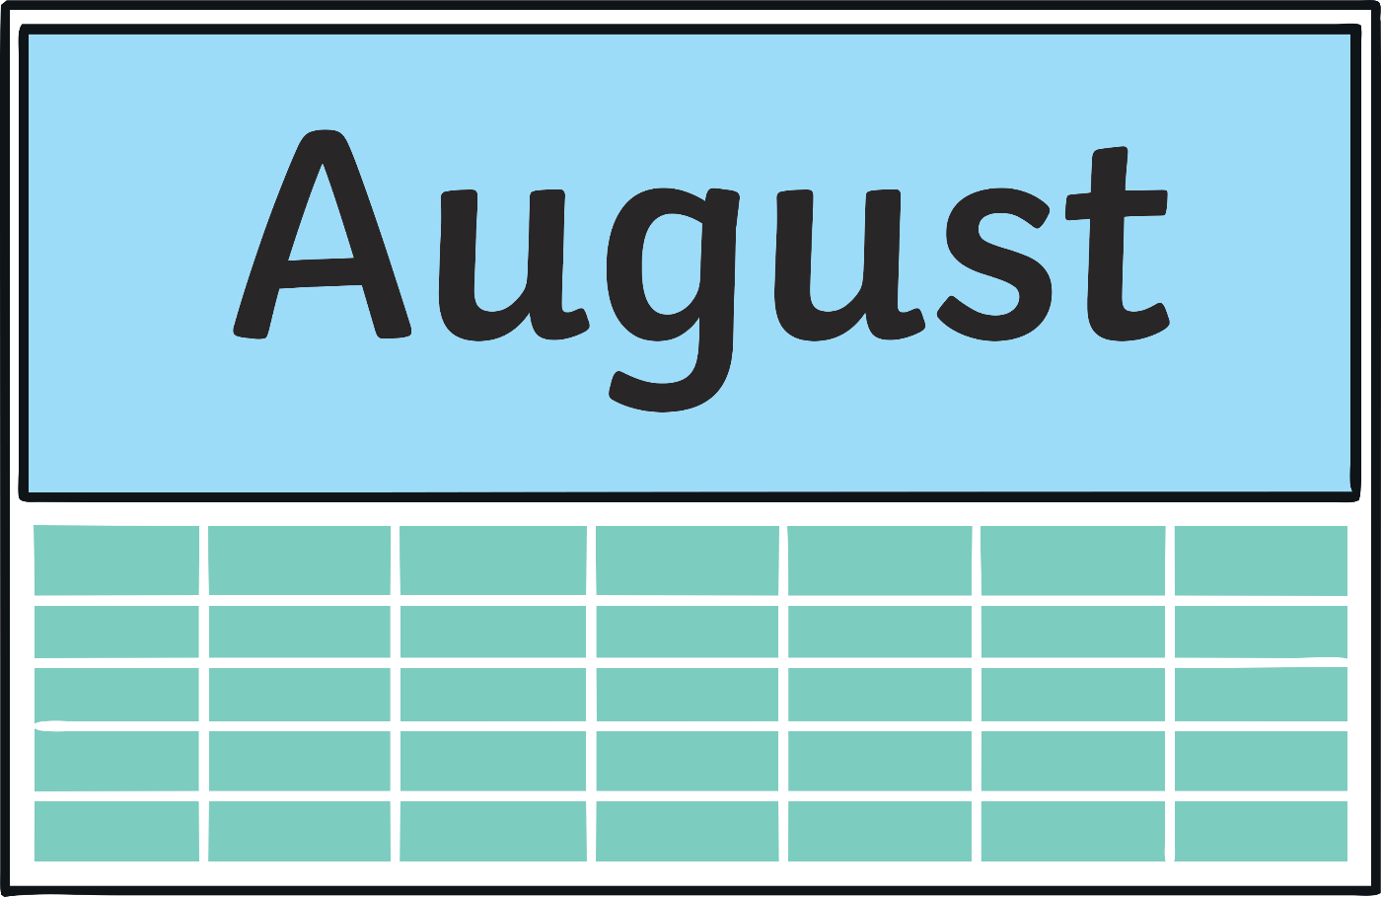
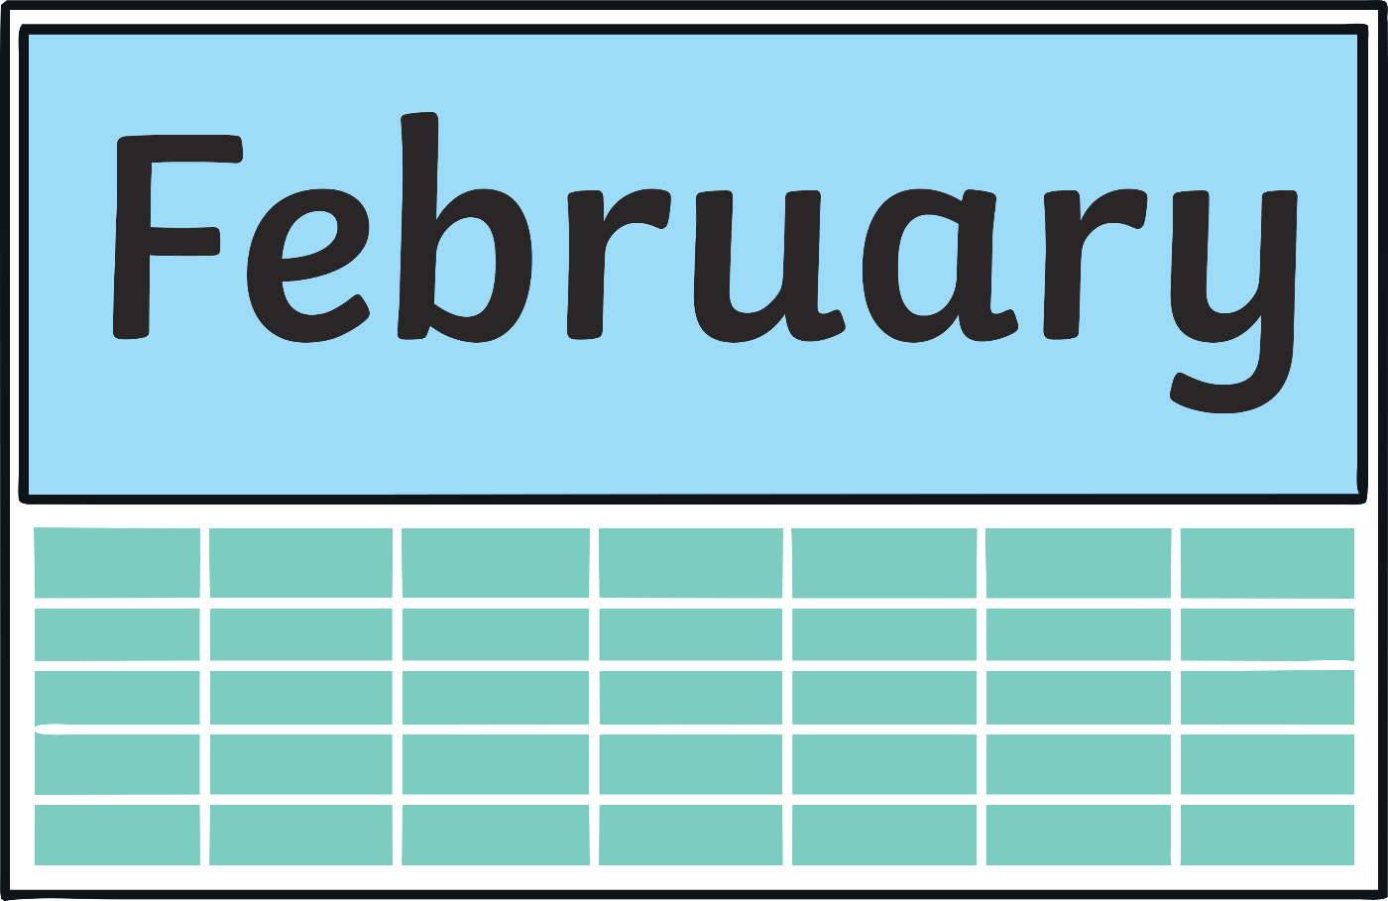
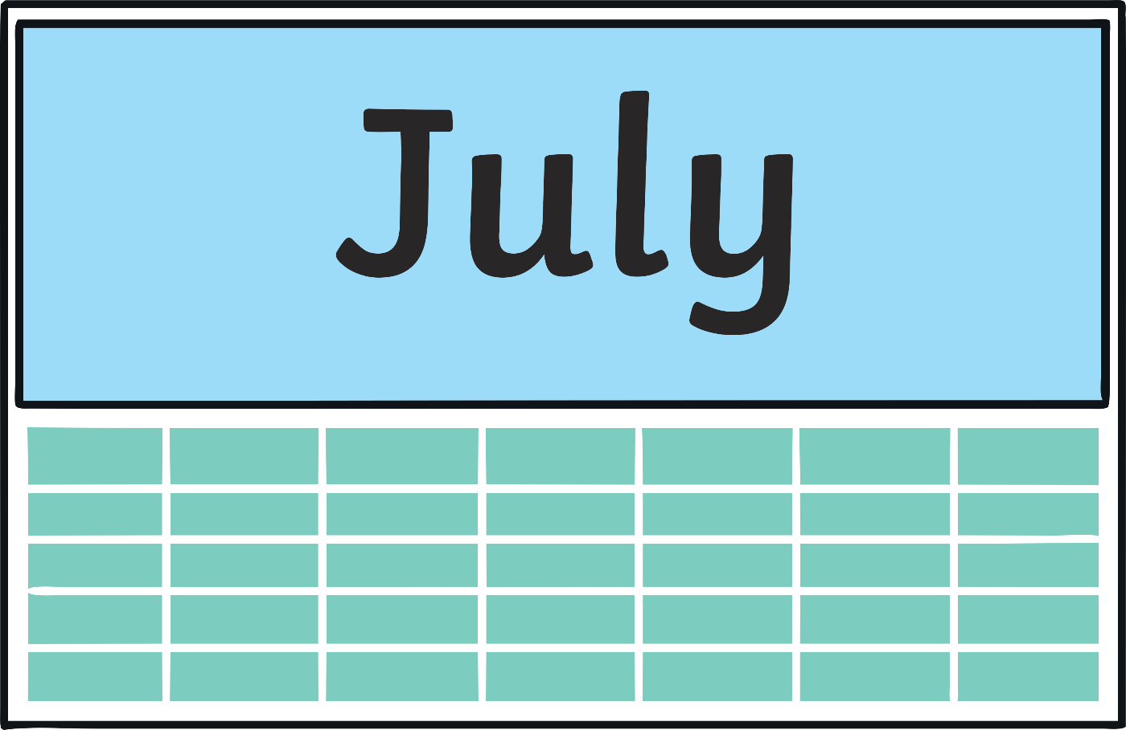
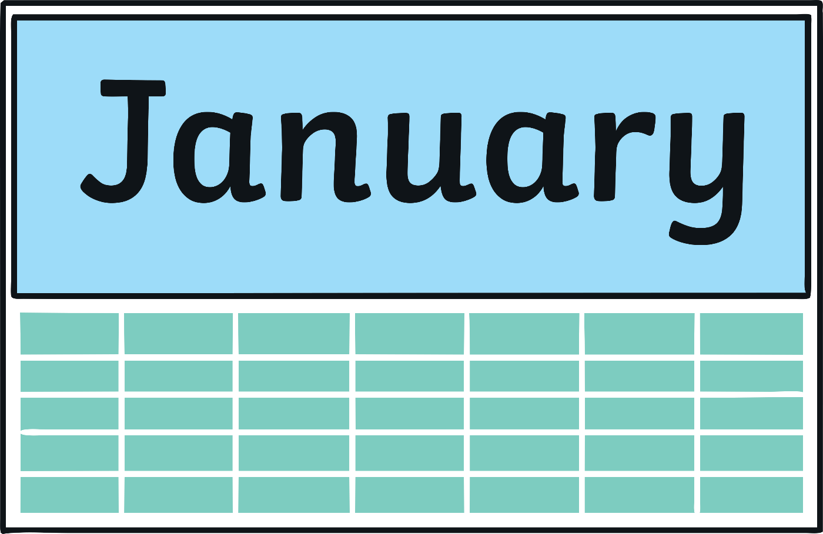
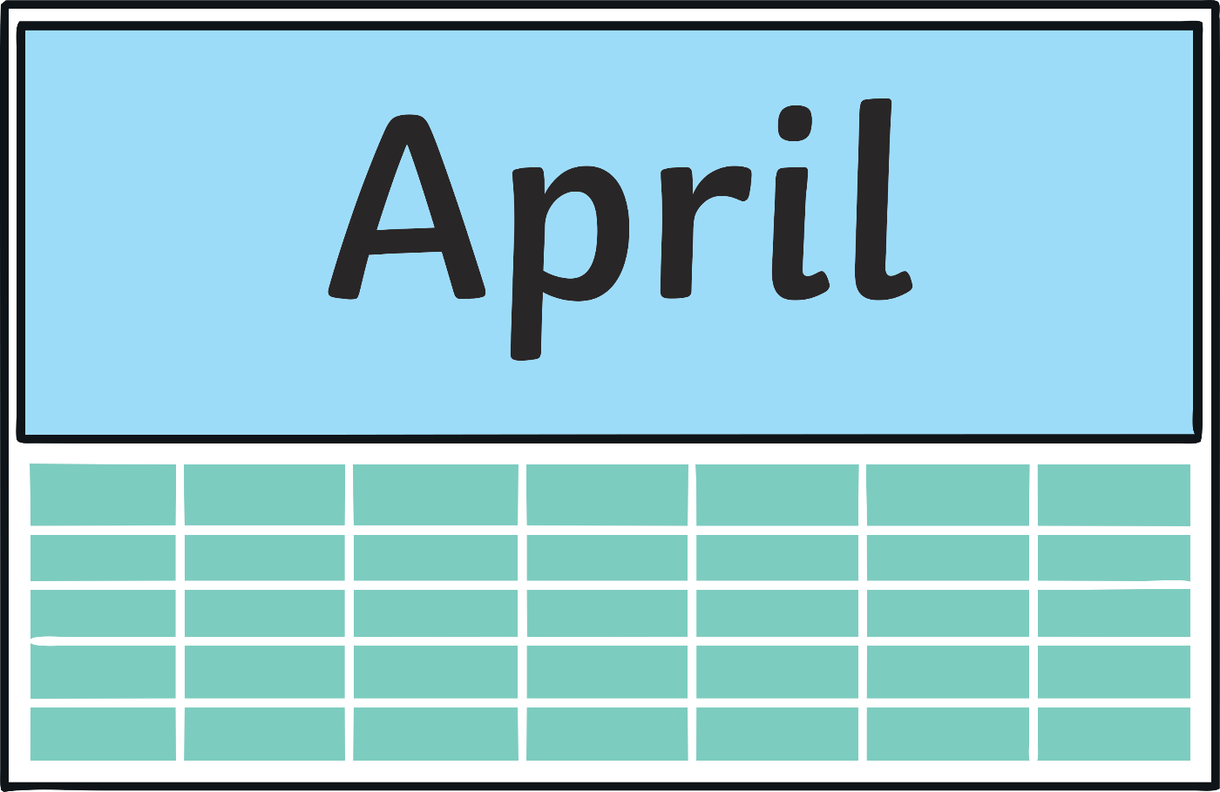

Slide 8
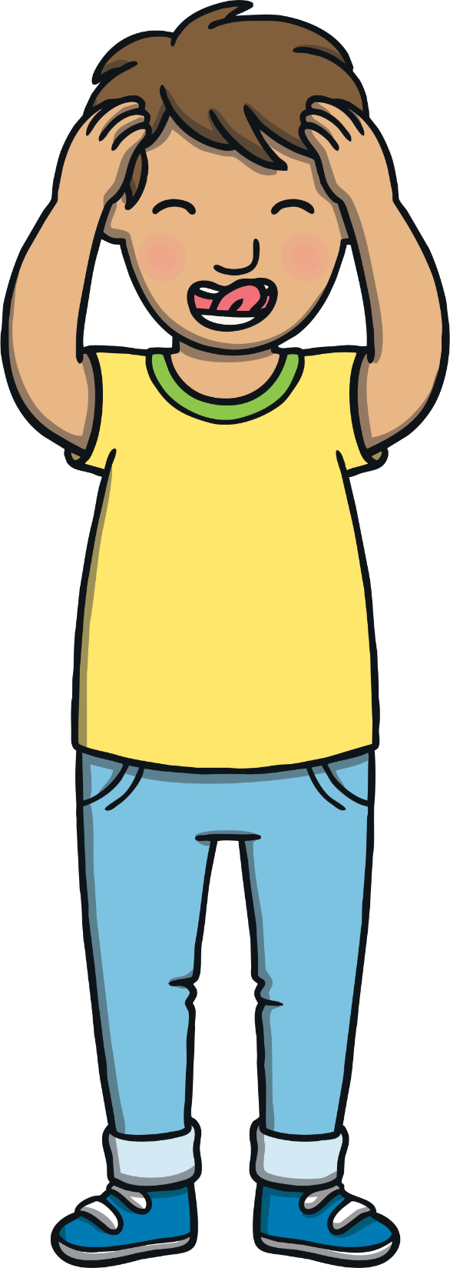
Teach
Today, we are learning to read words that end in -s and –es.

Slide 9
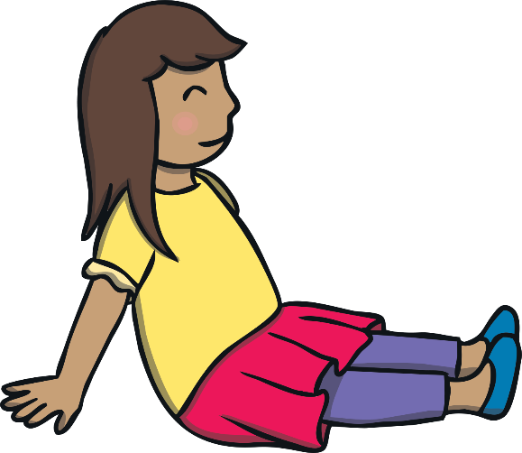
Teach
It was the start of the summer holidays and Kit and Sam were looking forward to having the whole of August off school. “It’s so exciting,” grinned Sam. “I wonder what we’ll do!”

Slide 10
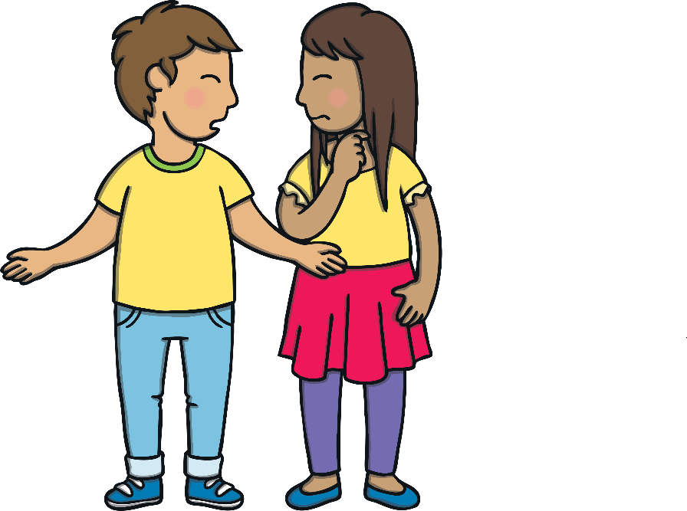
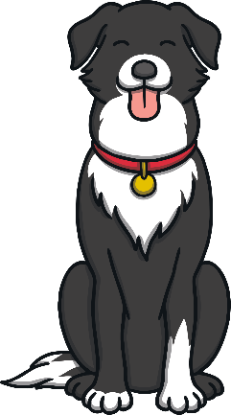
Teach
Kit and Sam could hear their Mum inside, talking to someone on the phone. She sounded very excited and was talking very fast. “Who do you think that is?” asked Kit.
“Hmm, I’m not sure. Mum will probably tell us soon enough,” replied Sam.

Slide 11
Teach
Mum appeared in the back garden. “You need to pack some suitcases quickly,” she said with a grin. Kit and Sam looked puzzled. “You remember that Grandma Dadi and Grandpa Dada are going to India to meet baby Diya? Well, your Dad has managed to get us last minute tickets on the same flight! We leave tomorrow.”

Slide 12
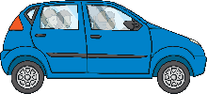
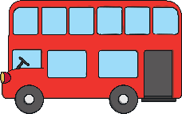
Teach
-s and -es can be added to make a noun plural. This means that there is more than one. Let’s try these examples together:
car
cars
car
bus
X
Ensure children understand the definition of ‘plural’, which means more than one item or living thing. The examples will help to illustrate this.
bus
buses
Click me for Kit’s teaching tips!

Slide 13
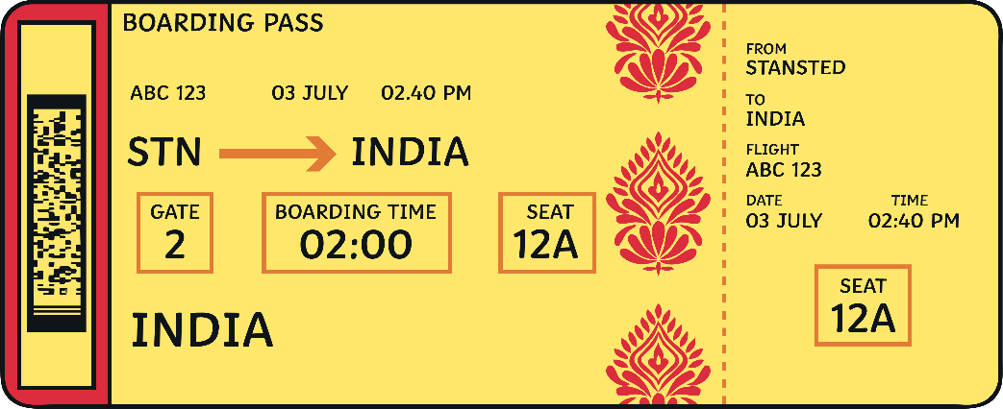
Teach
Kit and Sam are packing their suitcases. Read some of the plural nouns ending in -s and -es.
X
Early in Level 6, children will learn how to add -es to words which end in ‘y’. For example, ‘spy’ becomes ‘spies’ or ‘carry’ becomes ‘carries’.
Click me for Kit’s teaching tips!

Slide 14
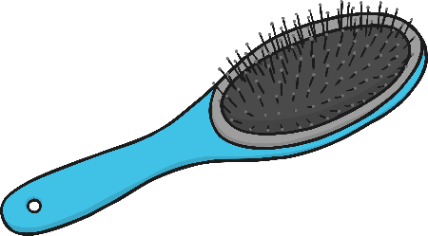
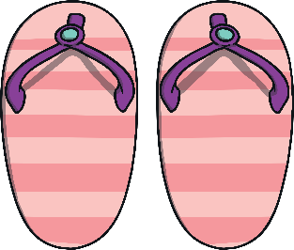
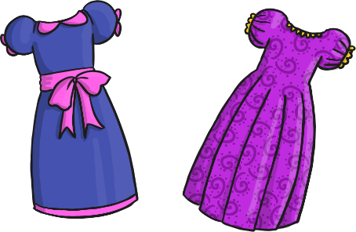
Teach
hats
brushes
flip-flops
dresses
sunglasses
books
shorts

Slide 15
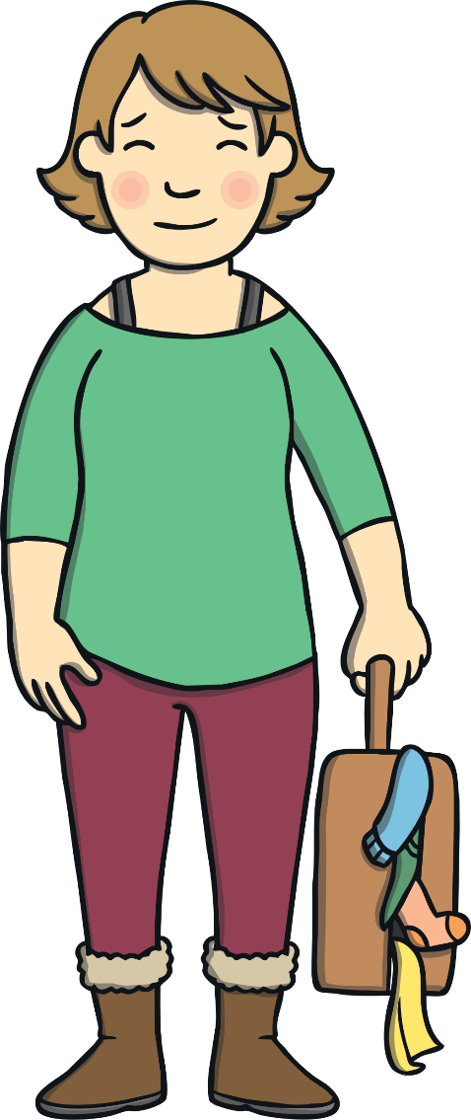
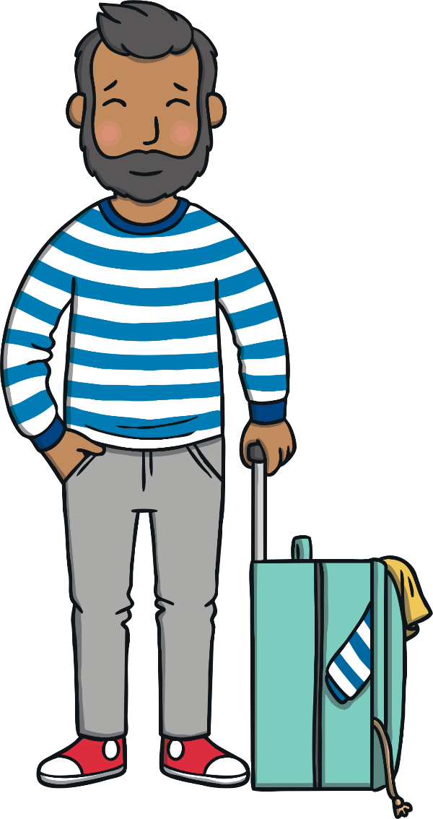
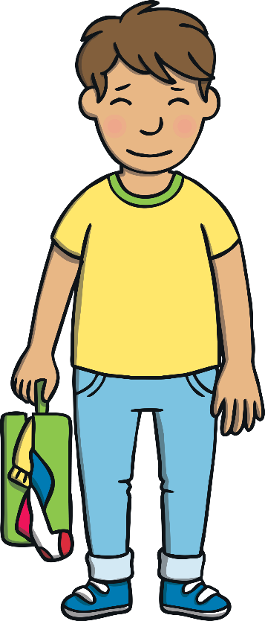
Practise
Kit, Sam, Mum and Dad are all frantically trying to pack their suitcases. Can you choose the correct word to describe what they are packing?
Hint: One word will be plural and the other word will be single!

Slide 16
Practise
Practise
jumper
jumpers

Slide 17
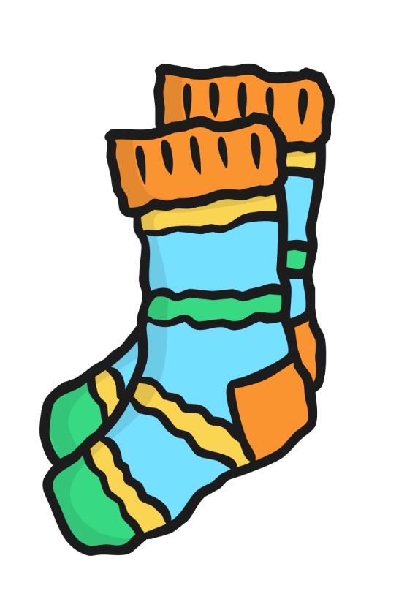
Practise
Practise
sock
socks

Slide 18
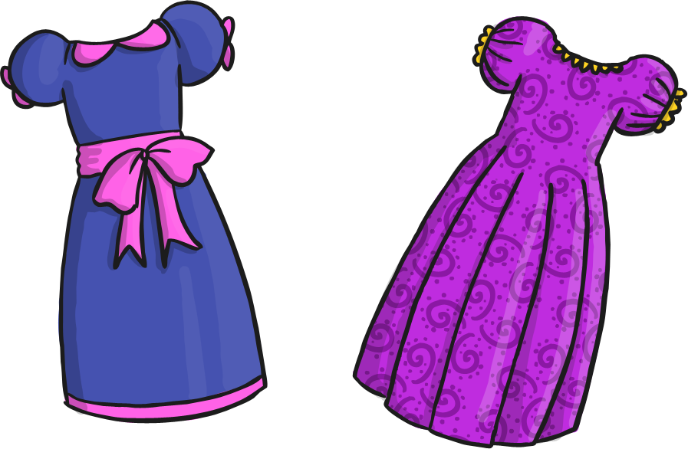
Practise
Practise
dresses
dress

Slide 19
Apply
That evening, Grandma Dadi and Grandpa Dada came over to discuss the plan with the family. Kit and Sam were very excited as they had heard their Grandparents talk so much about the places that they grew up.

Slide 20
Apply
Kit and Sam were bursting with questions. “What places will we visit?” asked Sam.
“Will we eat different kinds of food?” asked Kit.
“You are so impatient,” laughed Grandma. “You’ll find out soon enough.”

Slide 21
Sentence Time
Apply
What does Dad suggest that Kit and Sam should do?

Slide 22
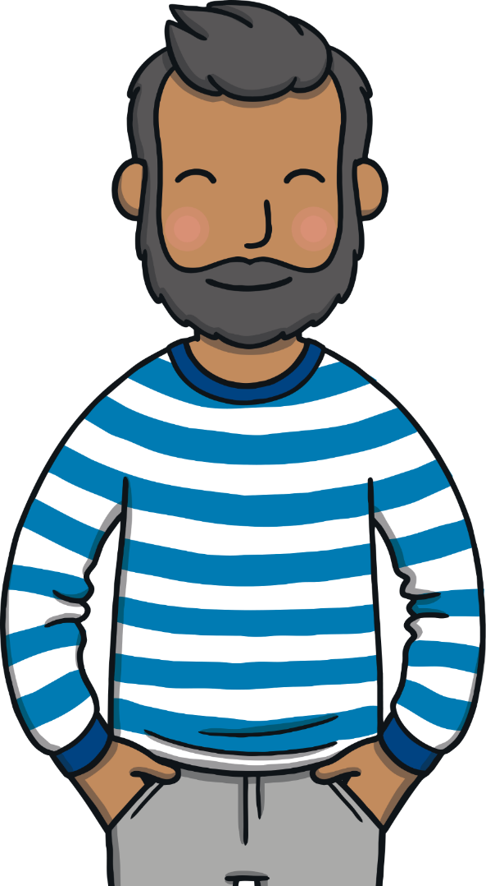
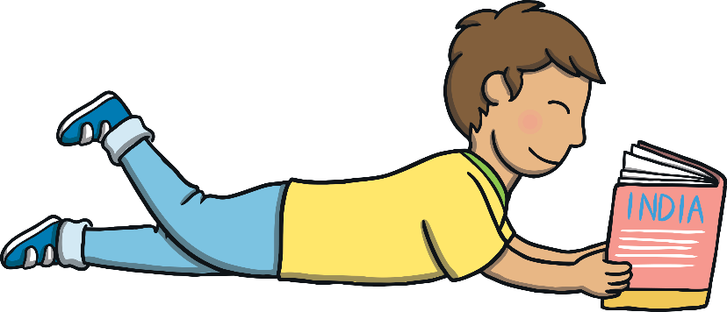
Apply
“Books and websites might
provide you with some clues.”
Sound Buttons On/Off
Show

Slide 23
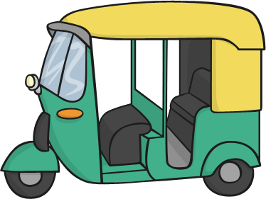
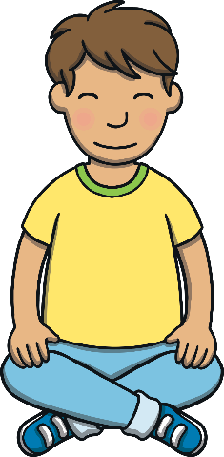
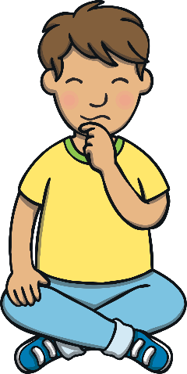
Apply
Kit and Sam could not sleep that evening. Their heads were full of thoughts about their upcoming adventure. “I’d love to visit some temples,” said Kit. “We were learning about them in school.”
“I think that I would like to ride in an auto-rickshaw,” said Sam. “Grandpa Dada was talking about them. They sound cool!”

Slide 24
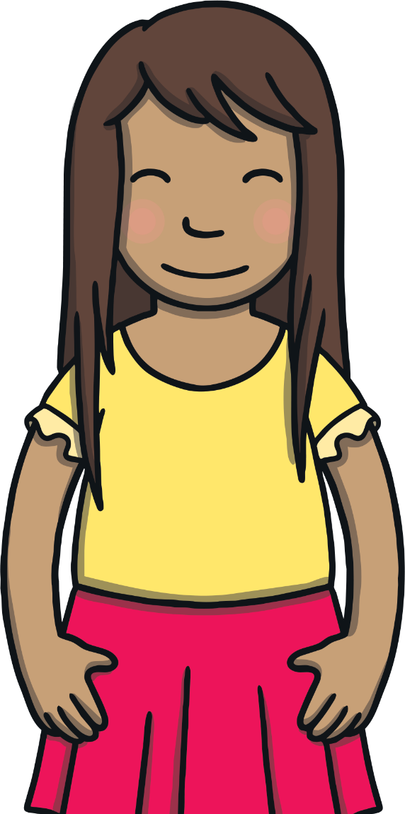
Apply
“We should get some sleep,” yawned Kit.
“Yes,” replied Sam. “We have got a long way to travel tomorrow. Over eight-thousand kilometres!”
“Clever clogs,” laughed Kit. “Sleep well!”

Slide 25
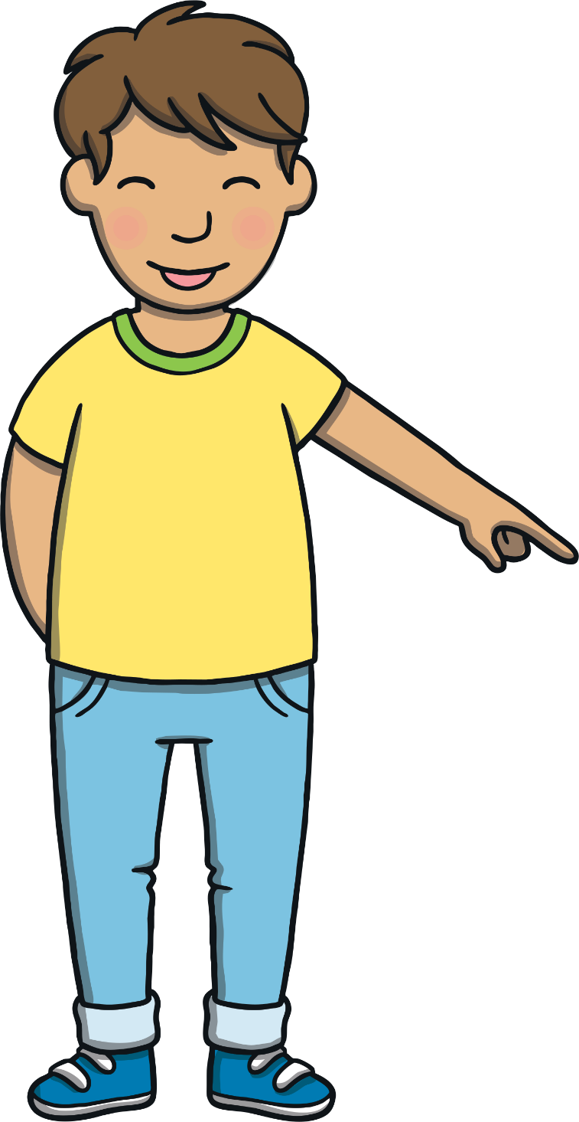
Today, we have learnt…
Adding
-s and -es
The adventure continues next lesson!

