Slide 2
Revisit and Review
Let’s practise Sam’s Sounds and Common Exception Words!
au
ea
wh
ie
aw
ph
April
August
coming
February
more
January
before
July
January
October

Slide 3
Teach
This week, we are learning to spell the common exception words more and coming. Watch the magic pencil write the words. Can you join in?

Slide 4
Teach
more
Play

Slide 5
Teach
coming
Play

Slide 6
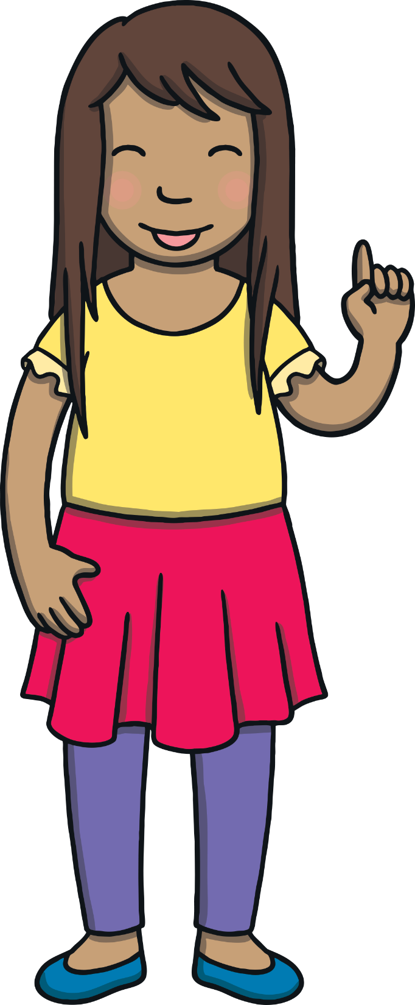
Teach
Today, we are learning to write words that have
-s and -es added.

Slide 7
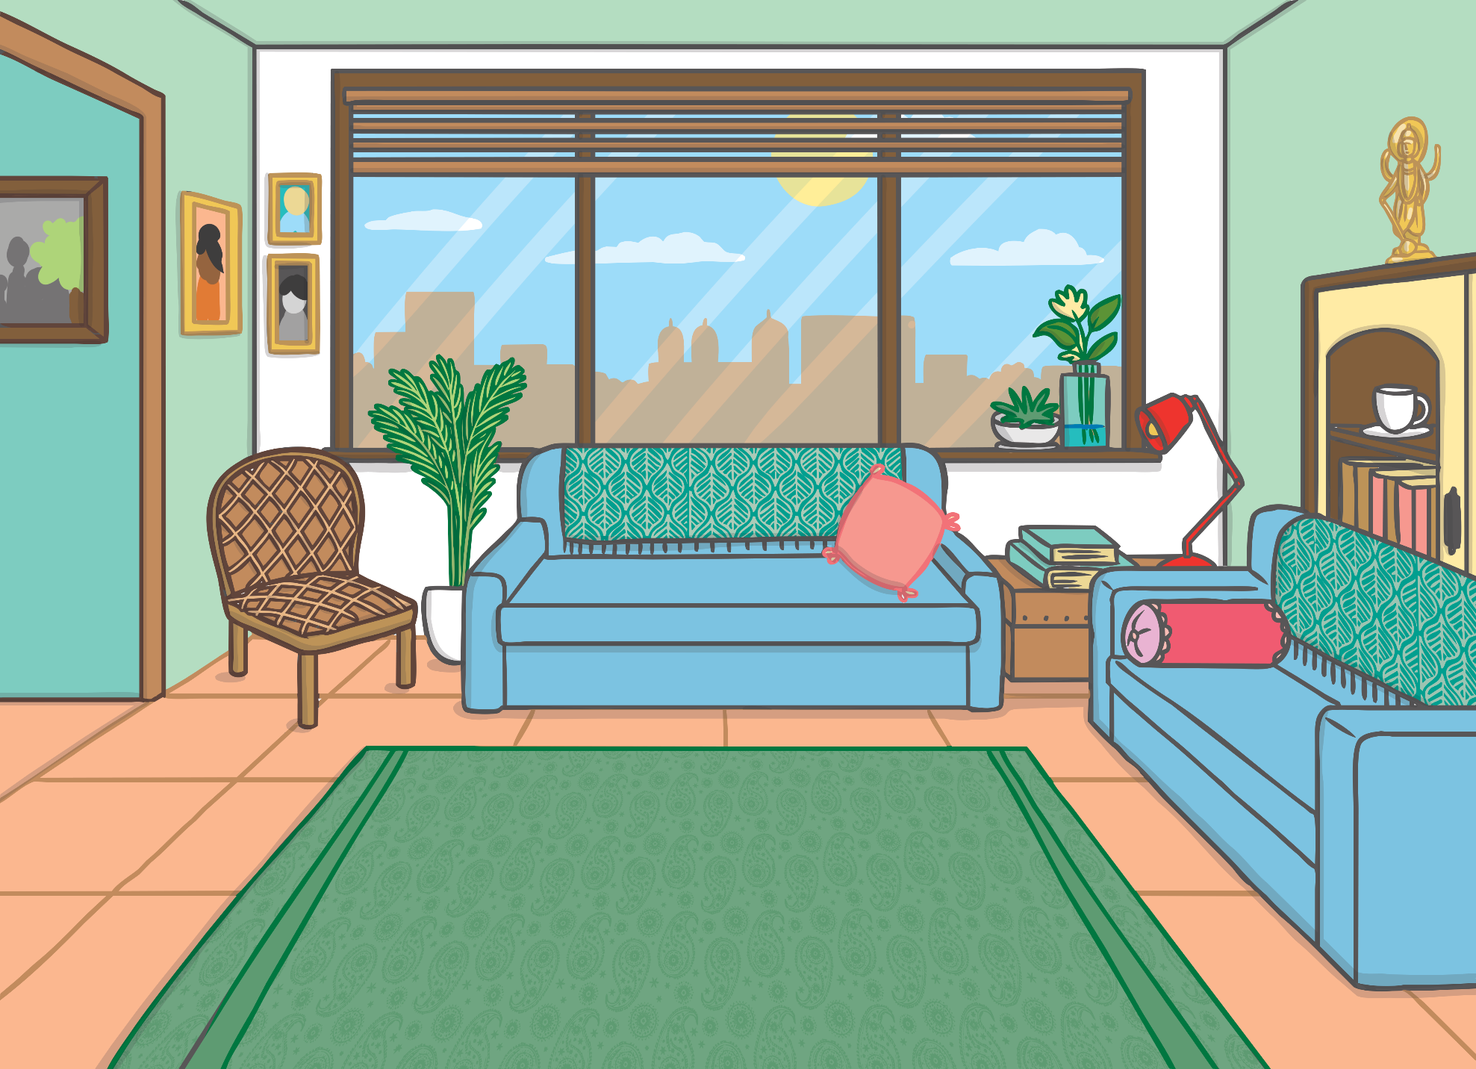
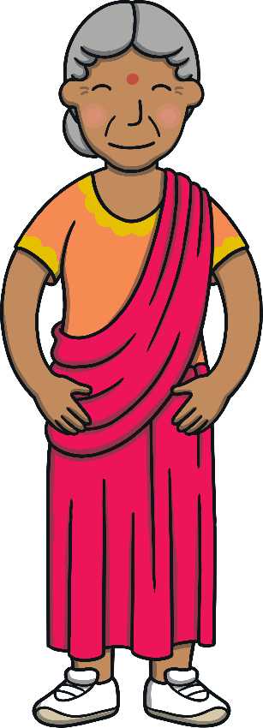
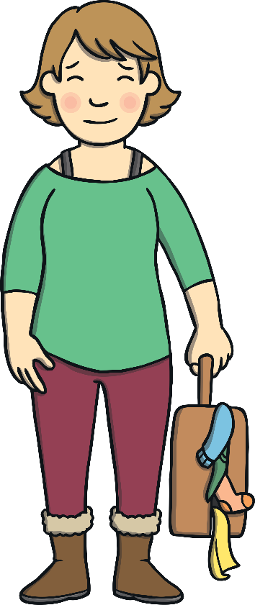
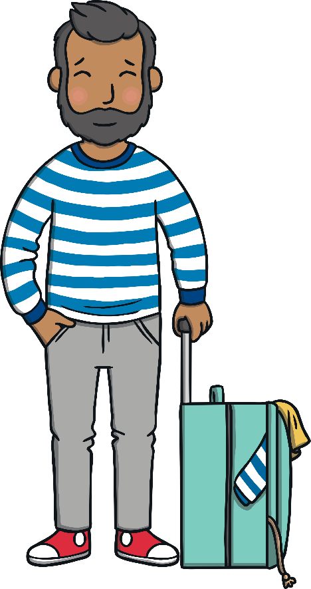
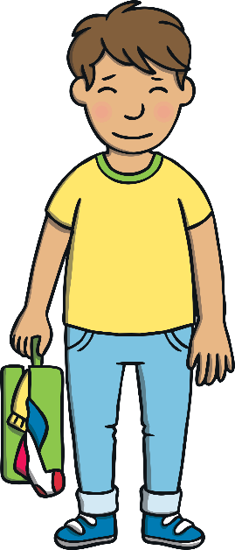
Teach
Kit and Sam had arrived at their family’s house in Kanpur. “Mmm, smell those Jasmine flowers,” said Grandpa Dada outside. “They remind me of my childhood. They always came out around August time.”

Slide 8
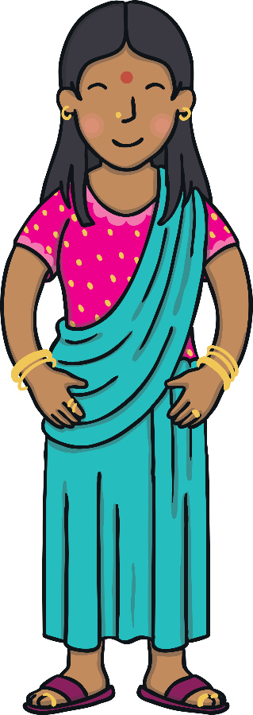
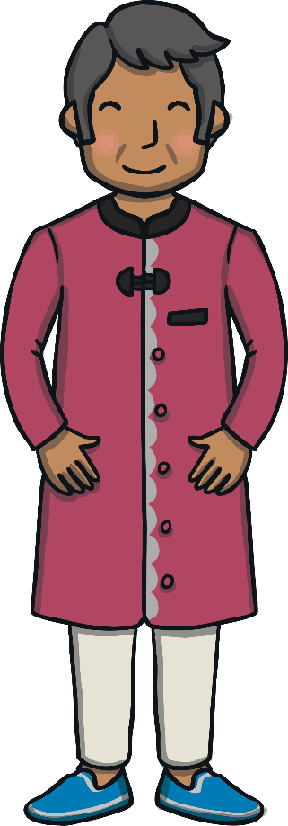
Teach
They walked inside into the living room to see Aditi and Ravi smiling!

Slide 9
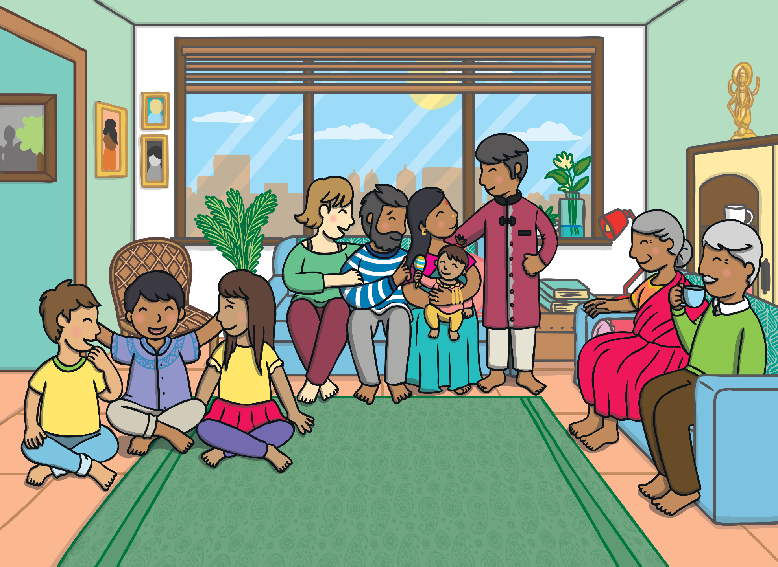
Teach
Grandma Dadi, Grandpa Dada, Mum and Dad cooed over baby Diya while Kit and Sam chatted with their cousin Ankit. “I’m so excited that you are here,” he said. “I have loads to show you! What do you want to do in Kanpur?”

Slide 10
Teach
Sam takes out the list of things that she would like to do in Kanpur. Can you add the missing letters to the words?
X
Hint: They are all words ending in -s or -es.
Click me for Kit’s teaching tips!

Slide 11
Teach
Go and get some new bracelets from the shops.
Go and get some new bracel___ from the sh_p_.
Look at the colourful dresses and skirts.
Look at the colourful dress__ and skir__.
Ride on some buses through Kanpur.
Ride on some bus__ through Kanpur.
Find some books about Kanpur to take home.
Find some bo_k_ about Kanpur to take home.
Spend time with baby Diya and her toys.
Spend time with baby Diya and her toy_.
Check

Slide 12
The Travel Guide
Practise
Cousin Ankit has a travel guide for Kanpur. Kit and Sam can’t understand the words because it is written in Hindi. Look at the pictures. Write a word in English to say what each one is showing.
X
This is a great whiteboard activity!
Click me for Kit’s teaching tips!

Slide 13
Practise
skirts
______
Check

Slide 14
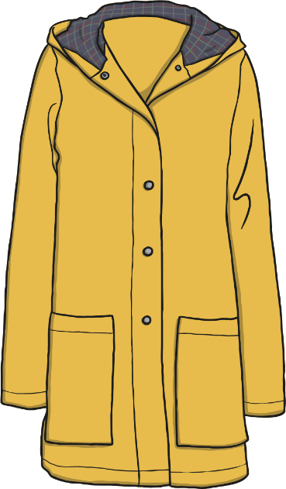
Practise
raincoats
_________
Check

Slide 15
Practise
hoodies
_______
Check

Slide 16
Practise
bracelets
_________
Check

Slide 17
Practise
glasses
_______
Check

Slide 18
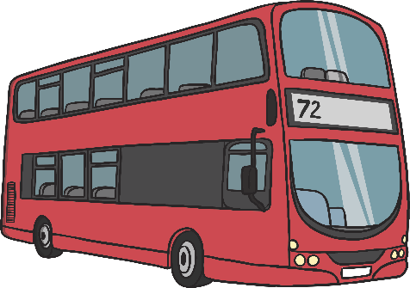
Practise
buses
_____
Check

Slide 19
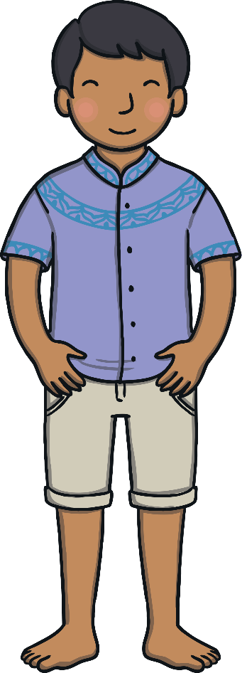
Apply
After Ankit had finished looking through his guide book, he sprang to his feet. “Let’s get showing you around!” he said. “We don’t have long!” Kit and Sam grinned. They were pleased to be hanging out with their cousin and he was turning out to be pretty cool!

Slide 20
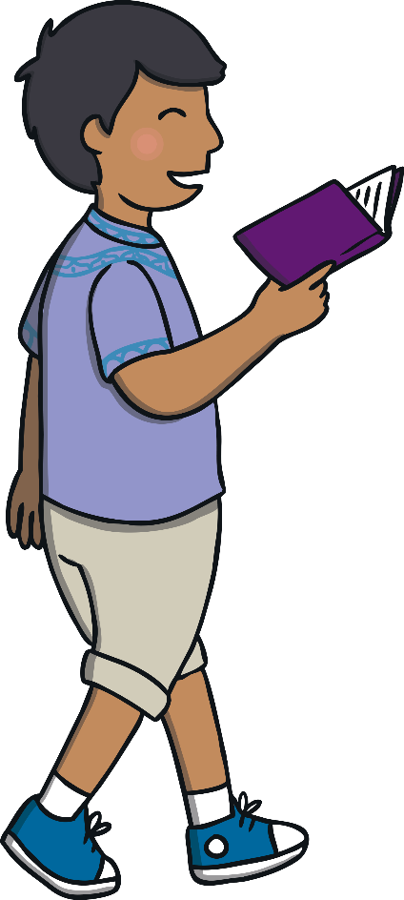
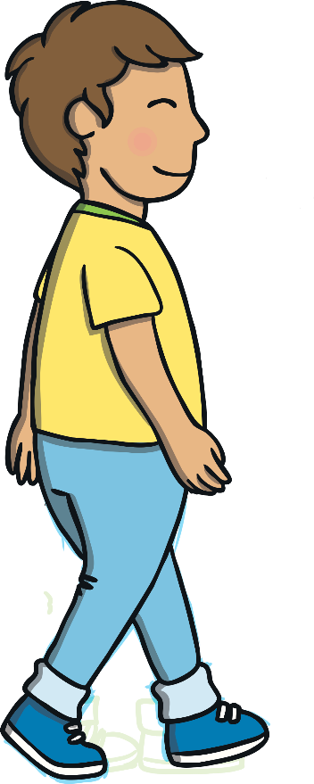
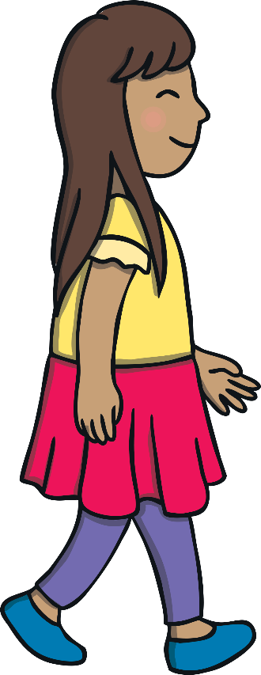
Sentence Time
Apply
Where does Ankit take Kit and Sam first? Look at the picture and write a sentence to match.

Slide 21
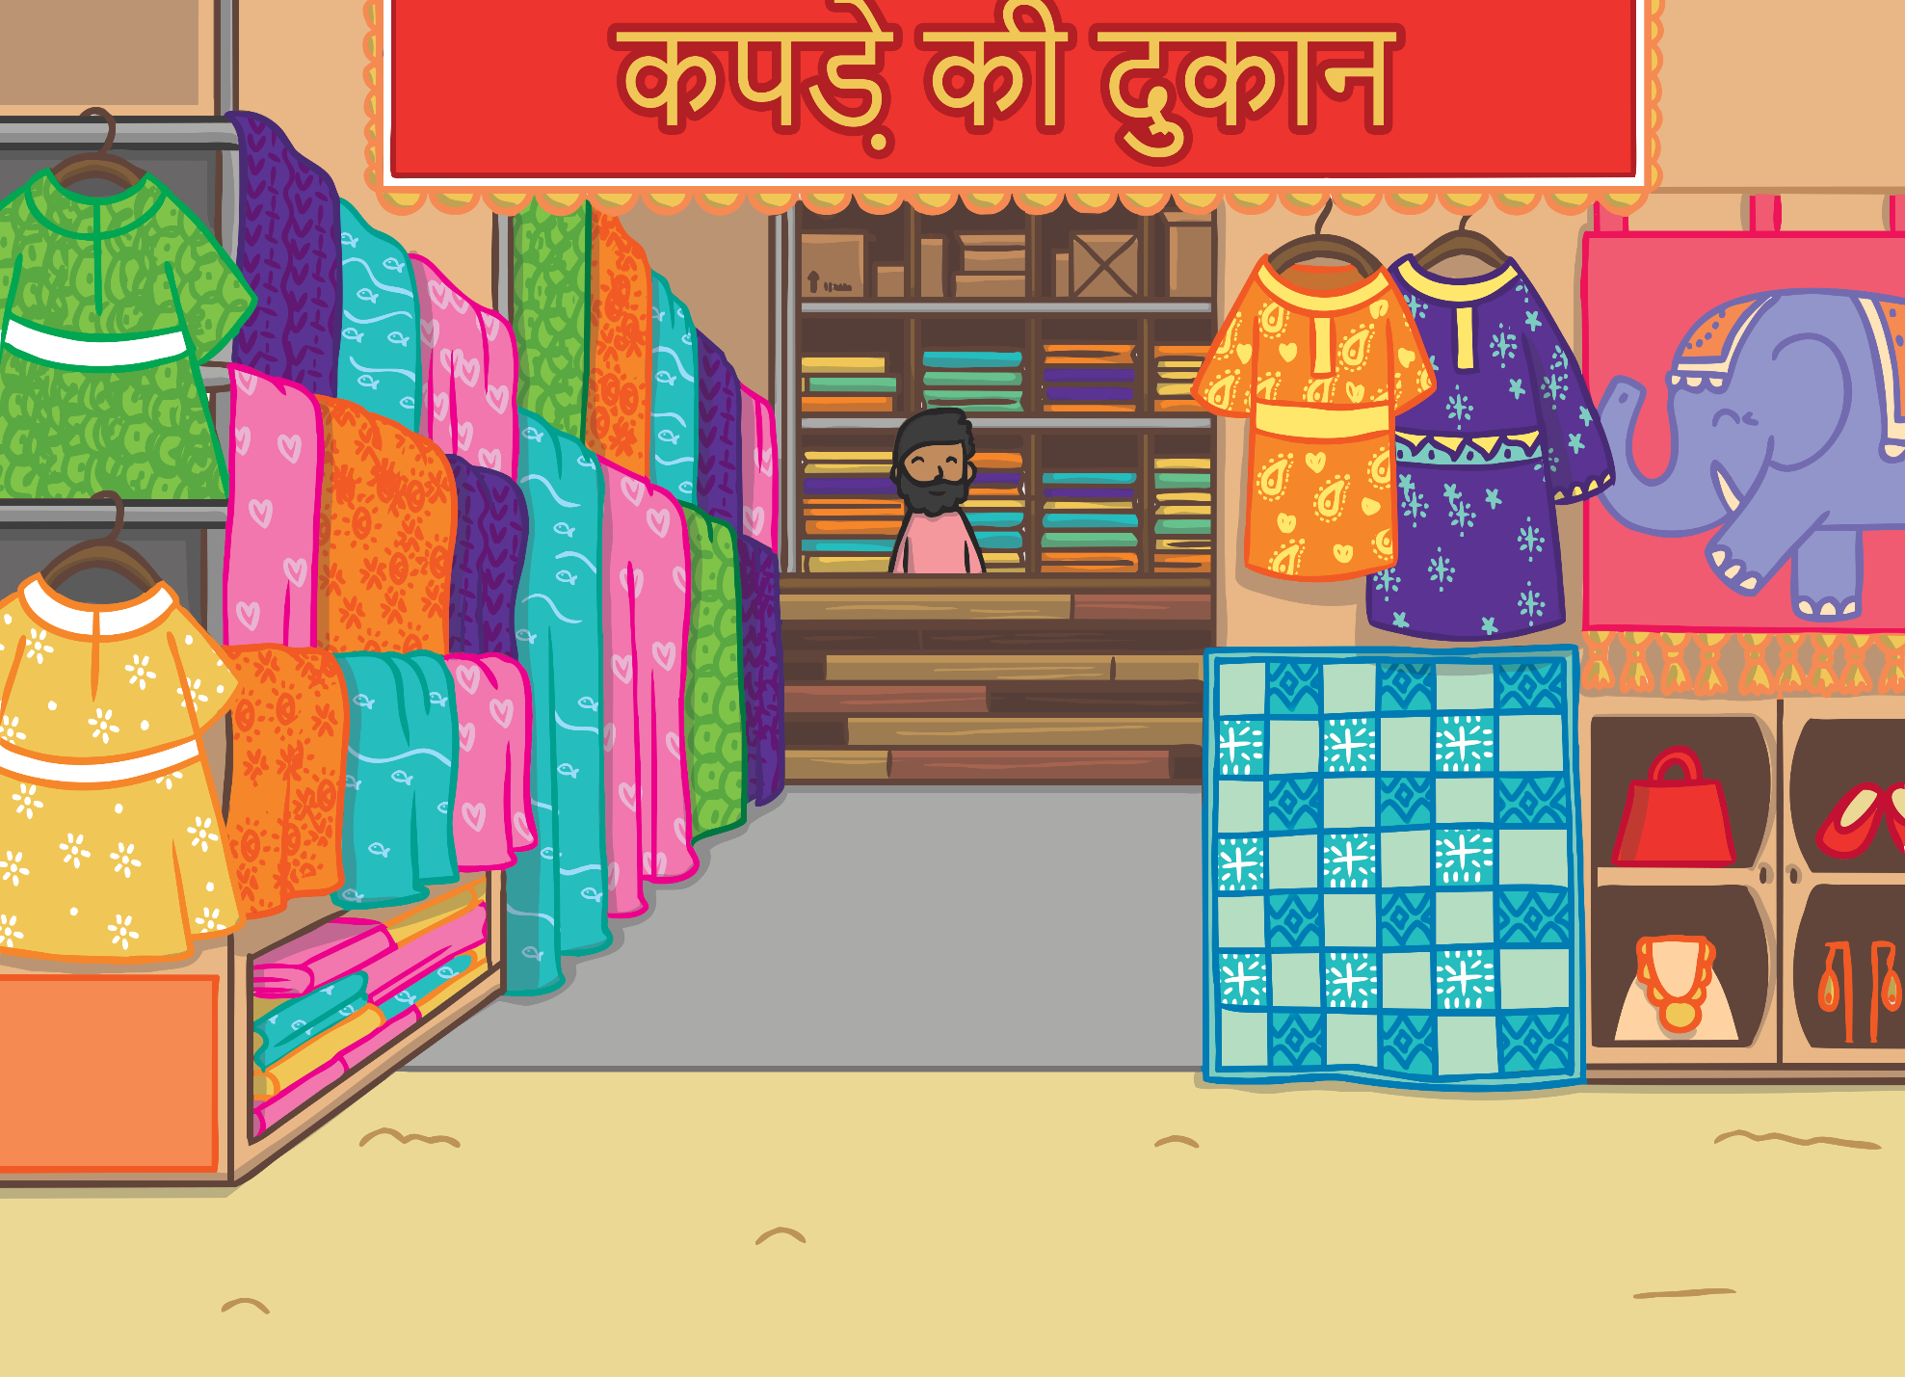
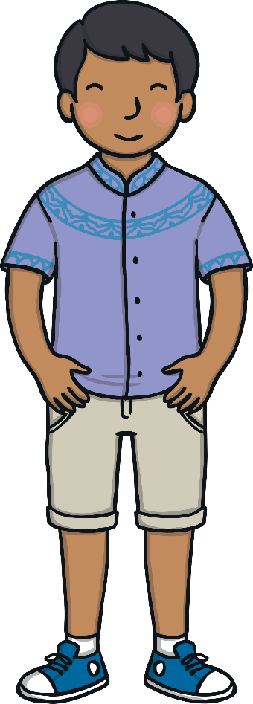
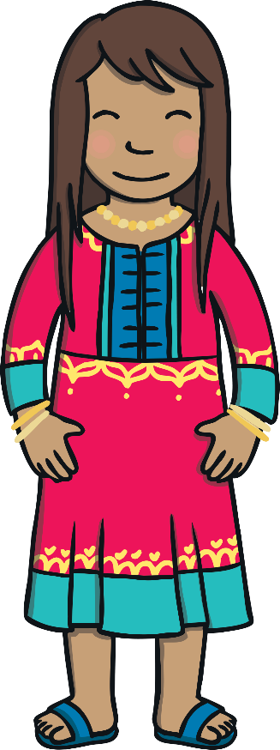
Apply
Ankit takes Kit and Sam to the shops so that Sam can get some dresses and bracelets.
Sound Buttons On/Off
Show

Slide 22
Apply
After Sam had chosen herself a new Shalwar Kameez and some bracelets, Ankit led them from the bazaar. “There are loads of buses going all over Kanpur from there. We can get ourselves a day ticket and ride all over the city,” he grinned.

Slide 23
Today, we have learnt…
Adding
-s and -es
The adventure continues next lesson!

