Slide 2
Revisit and Review
Let’s practise Sam’s Sounds and Common Exception Words!
ea
wh
ie
ph
April
August
February
January
July
January
October
November
December

Slide 3
Teach
Today, we are learning to spell words that end in -est.

Slide 4
Teach
Let’s practise reading some of this week’s focus words that end in -est.
loudest
freshest
quickest
coldest

Slide 5
Teach
Watch the magic pencil write the words.
Can you join in?

Slide 6
Teach
loudest
Play

Slide 7
Teach
freshest
Play

Slide 8
Teach
quickest
Play

Slide 9
Teach
coldest
Play

Slide 10
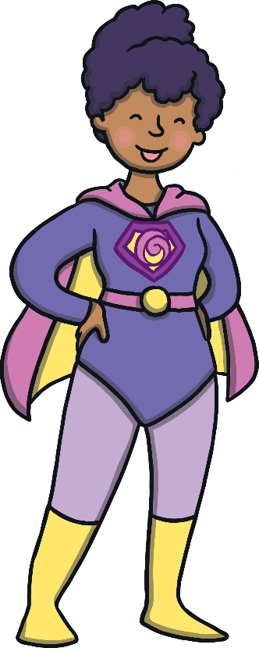
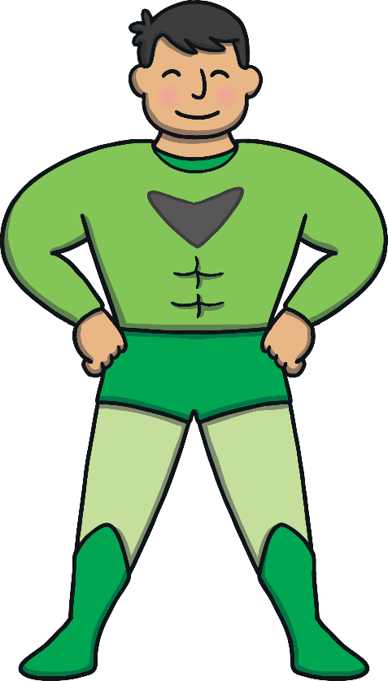
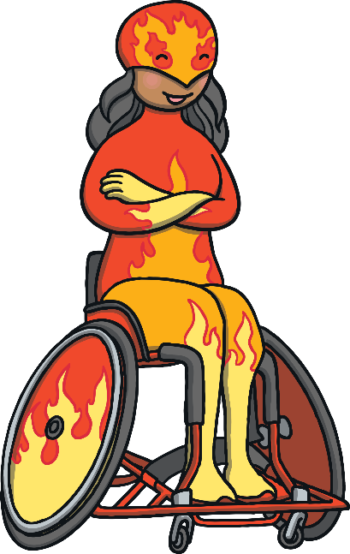
Teach
After a short time in the glass room, all of the superheroes were back in the giant hall. Kit and Sam were also back in the hall. They both felt very energetic and ready to face the next challenge.

Slide 11
Teach
“I feel a bit strange,” said Sam to Kit.
“I know what you mean but it is a good sort of strange,” replied Kit.

Slide 12
Teach
All of a sudden, Kit and Sam stopped talking. They heard a very loud sound. Kit and Sam covered their ears. They gazed up at the superhero making its way across the hall.

Slide 13
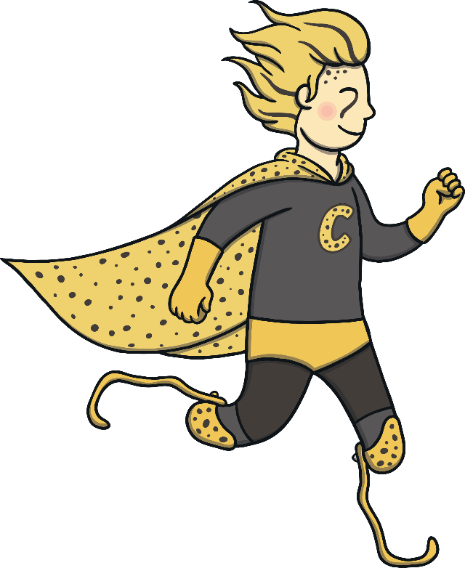
Teach
Kit could not believe his eyes. The superhero making the terrible deafening noise was the superhero from his cards. It was the one whose profile he had read out to Sam.

Slide 14
Teach
Before Kit got a chance to tell Sam who the superhero was, the superhero sped across the hall. “Wow! Did you just see that? He must be the quickest superhero ever!” said Sam, excitedly.

Slide 15
Teach
The superhero that Kit and Sam are watching is one of the top superheroes.
On his profile card are a list of words to describe him. Work out the missing letters and write the words down.
Hint: Use the pictures to help you!

Slide 16
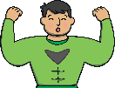
Teach
loudest
quickest
strongest
smartest
9
10
9
9
loudest
quickest
strongest
smartest
Check

Slide 17
Cape Words
Practise
Can you choose the word with the correct spelling?

Slide 18
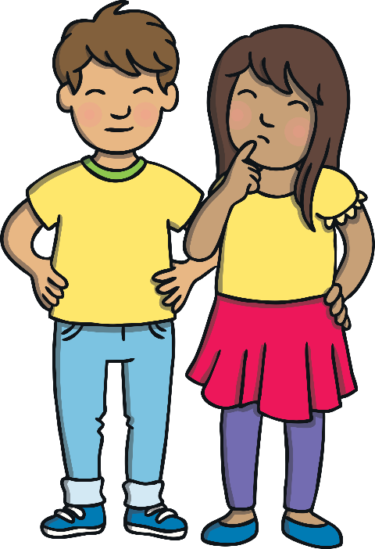
Practise
tallest
tallist

Slide 19
Practise
quietst
quietest

Slide 20
Practise
weekest
weakest

Slide 21
Practise
lightest
lightst

Slide 22
Practise
coolist
coolest

Slide 23
Practise
longest
longst

Slide 24
Practise
“Time for the next lesson to commence. Take your positions. Cheetman will demonstrate what to do,” announced the voice from the speaker.
“That’s Cheetman! I got his card with my magazine. He is the one I showed you,” said Kit enthusiastically to Sam.

Slide 25
Sentence Time
Apply
Sam looks puzzled. If his name is Cheetman, he must be a cheat!
Look at the picture. What is she thinking? Write a sentence to match.
X
Click ‘Show Suggestion’ to see a suggested sentence for the picture.
Click me for Kit’s teaching tips!

Slide 26
Apply
Is cheetman the loudest and quickest or is he a cheater?
Sound Buttons On/Off
Show

Slide 27
Apply
“Is Cheetman a cheat? Is that why he is called Cheetman?” asked Sam to Kit.
“No! Superheroes do not cheat. They have magic powers. He is called Cheetman because he is fast like a cheetah!” replied Kit, laughing.

Slide 28
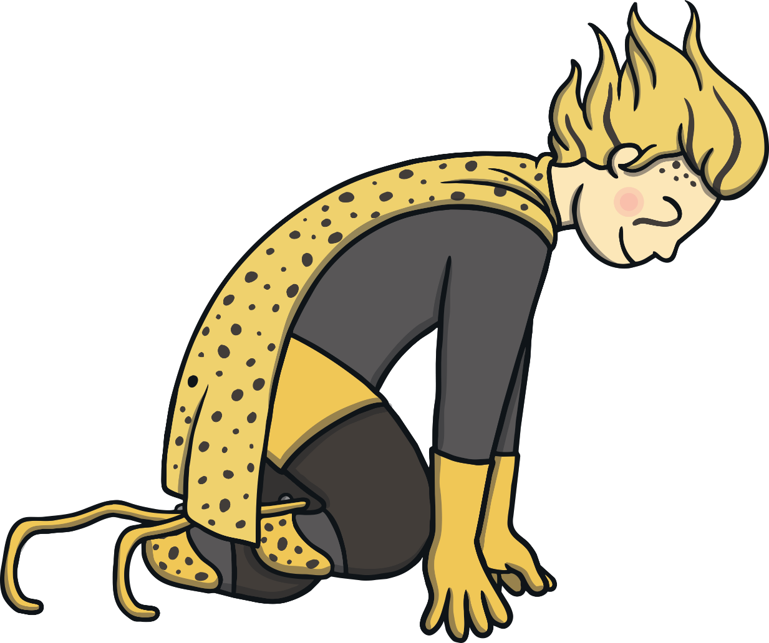
Apply
Cheetman was stood at the front of the hall. He was showing everyone how to position themselves before starting to run.
“Remember, the more focused you are, the greater you will succeed,” called out Cheetman.

Slide 29
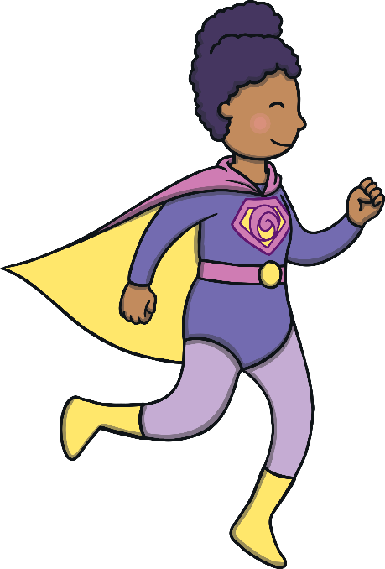
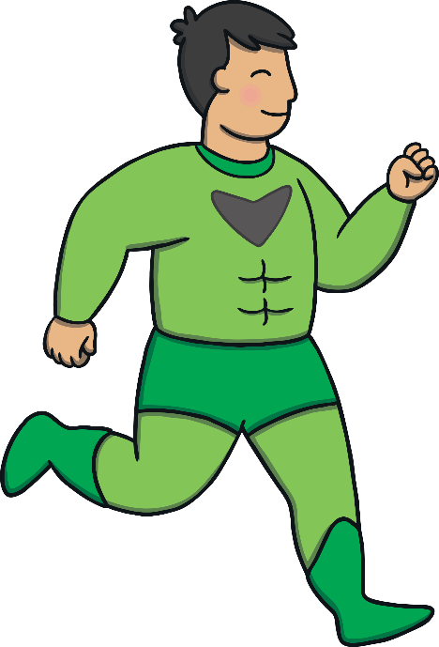
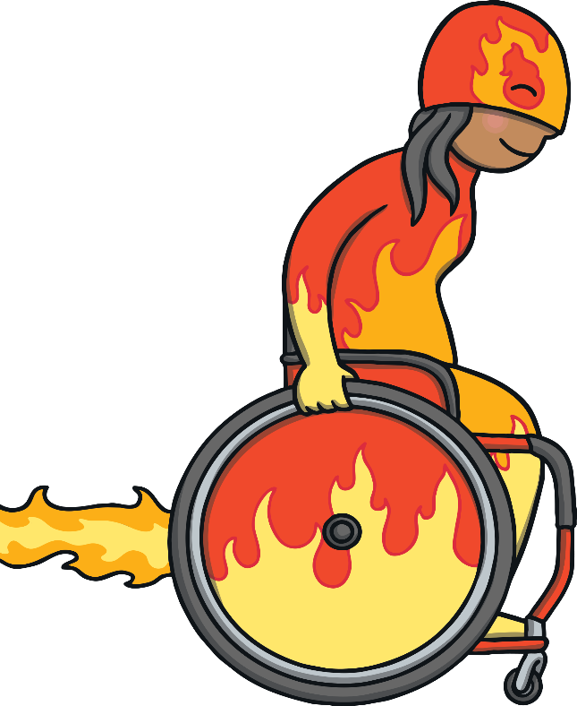
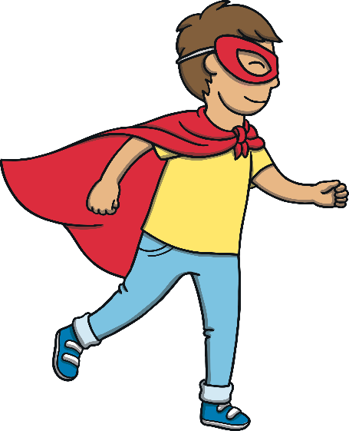
Apply
Kit, Sam and the other superheroes started to run. Kit and Sam could not believe what was happening. Their feet seemed to move at such an incredible speed.

Slide 30
Apply
They had never been able to run as fast as this in all of their lives.
“I am Cheetgirl!” shouted Sam to Kit. “I am the fastest girl ever!” Kit giggled. What was going to happen next?

Slide 31
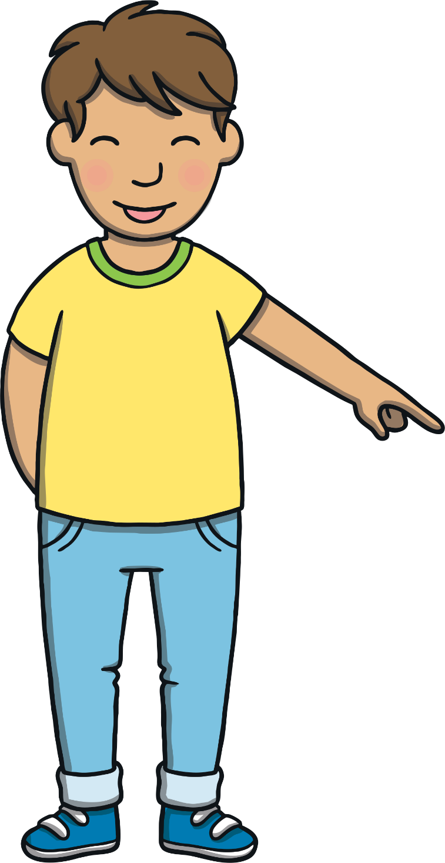
Today, we have learnt…
Adding
-est
The adventure continues next lesson!

