Slide 1
Dear Parents,
This week we are learning the sound ‘tch’ saying /ch/ in catch, match, fetch, witch, stitch, ditch, crutch and kitchen.
The tricky words to focus on for reading and spelling are:
door, floor (reading)
Wednesday, Thursday (spelling)
For children coming to school:
We will be teaching lessons 1 and 2 to Bubble A (children coming in on Mondays and Tuesdays).
We will be teaching lessons 4 and 5 to Bubble B (children coming in on Thursdays and Fridays).
You will then be able to teach the other lessons on the days that the children are not at school.

Slide 3
Revisit and Review
Let’s revisit last week’s focus words…
I’ll say them and you write them down!

Slide 4
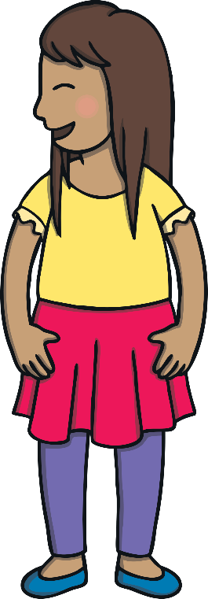
Revisit and Review

Slide 5
Teach
Here are this week’s focus words for reading…
door
floor

Slide 6
Tricky Word Trickery
Teach
Click to reveal the words.
floor
floor
door
floor
door
door

Slide 7
Teach
Today, we are learning to read words that contain tch saying /ch/.
X
‘tch’ is a trigraph which makes the same sound as the digraph /ch/.
Click me for Kit’s teaching tips!

Slide 8
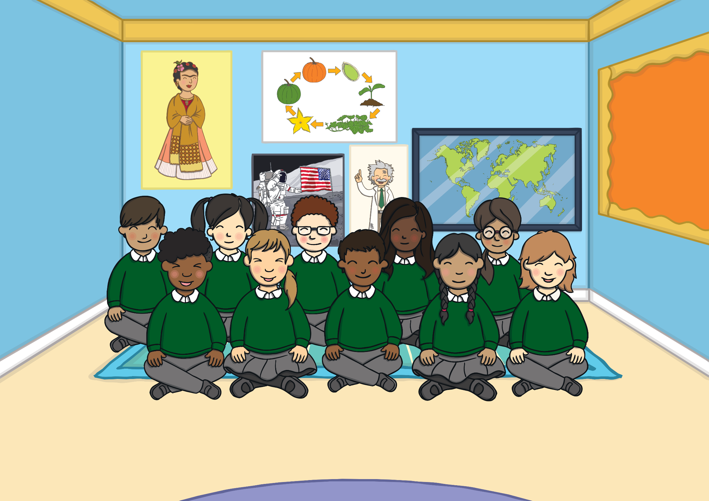
Teach
Mrs Tan’s class had started reading the fairytale ‘Hansel and Gretel’. They loved how Hansel and Gretel had escaped from the wicked witch by being so cunning. “Today, we are going to do some role play,” said Mrs Tan. “You will be acting out the story of ‘Hansel and Gretel’ for us.”

Slide 9
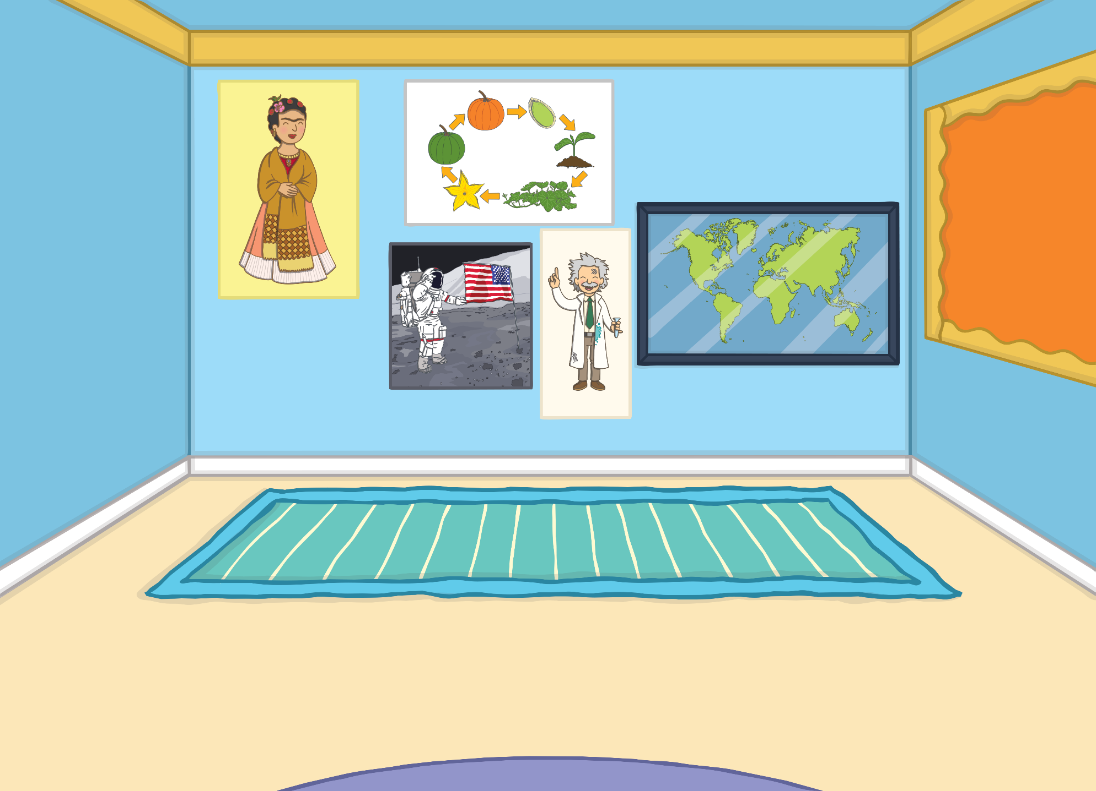
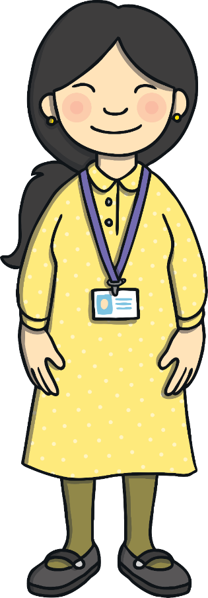
Teach
Kit, Tess, Sam and Gabi decided to work in a group together. “I want to be the witch,” said Sam, pulling on a long cloak.
“Ooh, wear this too!” said Gabi, handing her a cloak. “It matches the hat.”

Slide 10
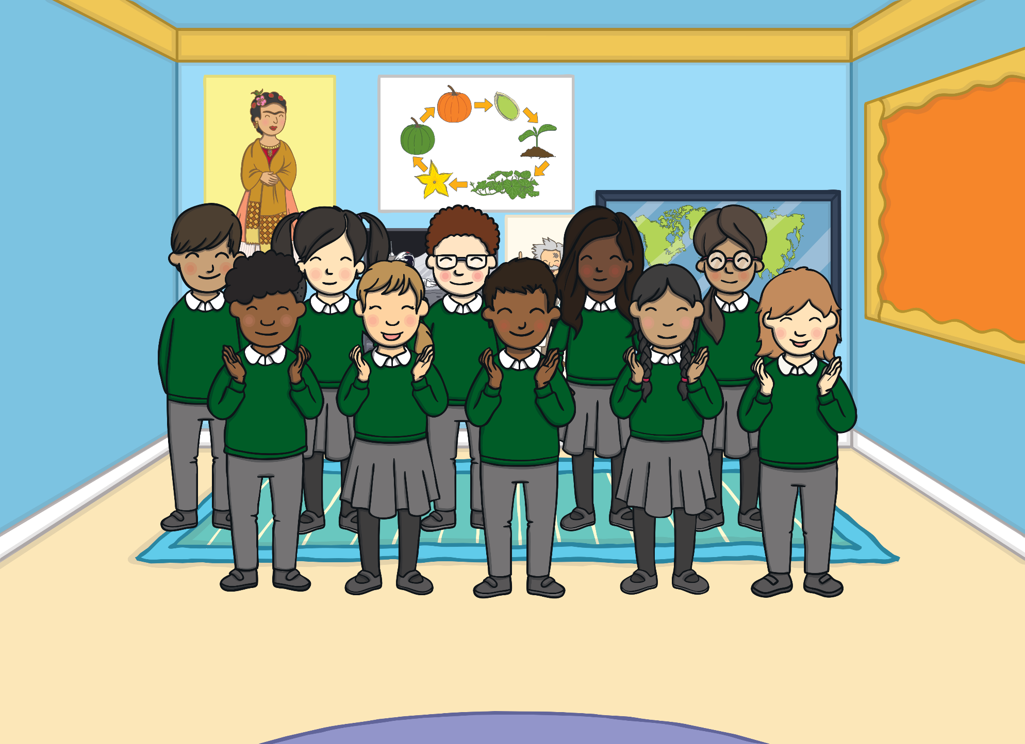
Teach
Kit and Sam had loved dressing up and acting out ‘Hansel and Gretel’ for the class. “Let’s get our dressing up clothes out when we get home and do some more acting,” said Sam.

Slide 11
Teach
When you see t and ch working together, it always makes the /ch/ sound. The t is silent.
Let’s say these examples:
match
fetch
X
‘ch’ is the more common grapheme for the /ch/ sound. However, ‘tch’ is more commonly used after a short vowel sound as in these examples.
witch
Click me for Kit’s teaching tips!

Slide 12
Teach
Kit and Sam are looking through their dressing-up box. Click on the different costumes and read the words.

Slide 13
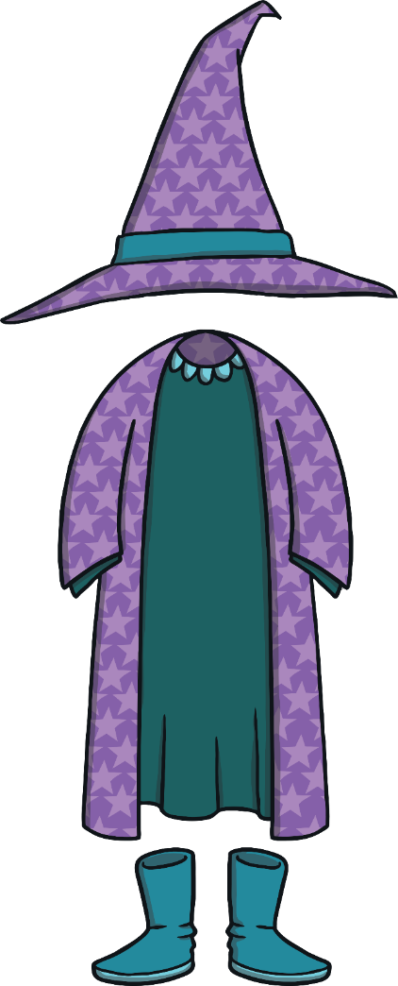
Teach
catch
fetch
match
witch

Slide 14
Fancy Dress Pairs
Practise
Turn over two cards. If the word matches the picture, you get to keep the cards. If not, try again.
X
This is a great game to play as a class!
Click me for Kit’s teaching tips!

Slide 15
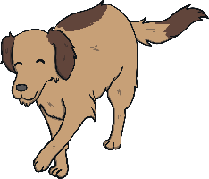
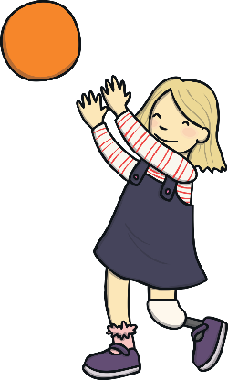
Practise
catch
door
fetch
floor
match

Slide 16
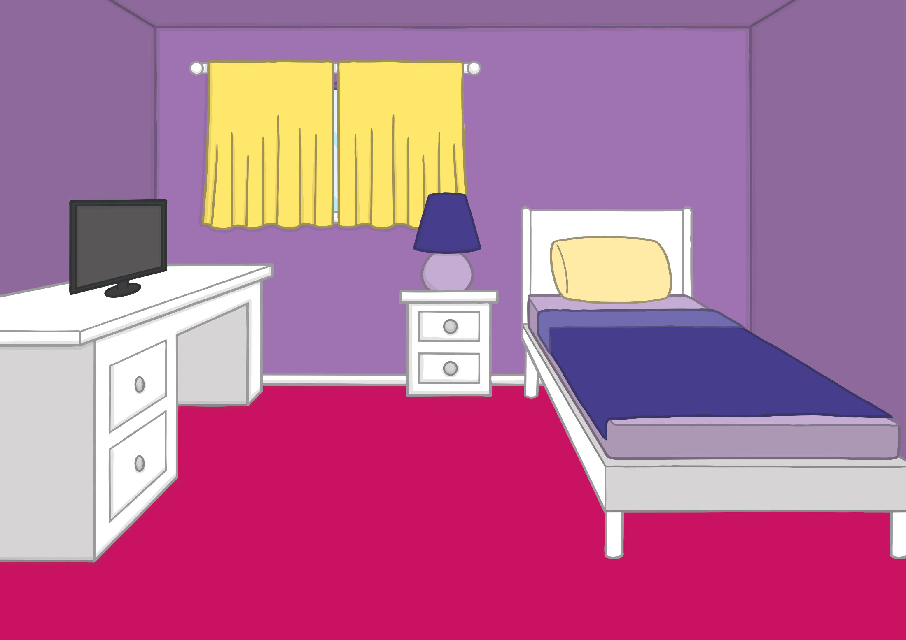
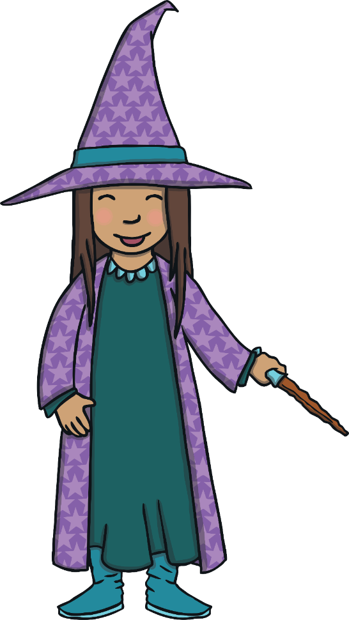
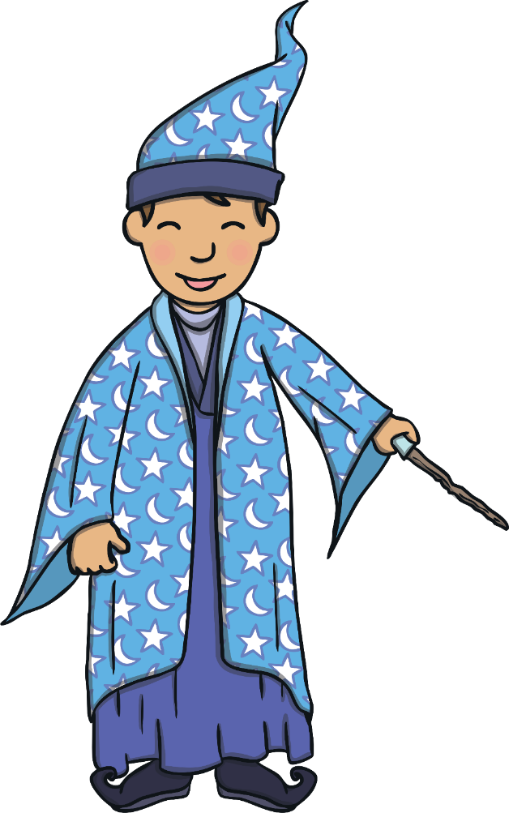
Practise
Kit and Sam enjoyed their dressing-up game. Sam wanted to be a witch again but this time, she decided to be a good witch. Kit decided to be a mighty wizard who helped out his friend, the witch. Together, they fought baddies and monsters… until Mum called them downstairs for their tea.

Slide 17
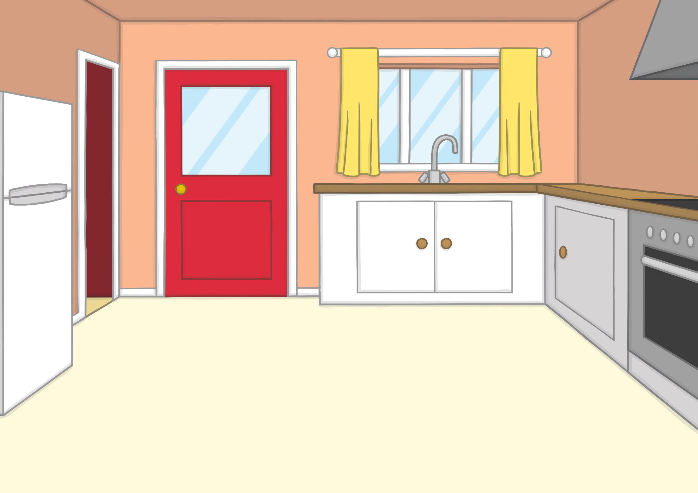
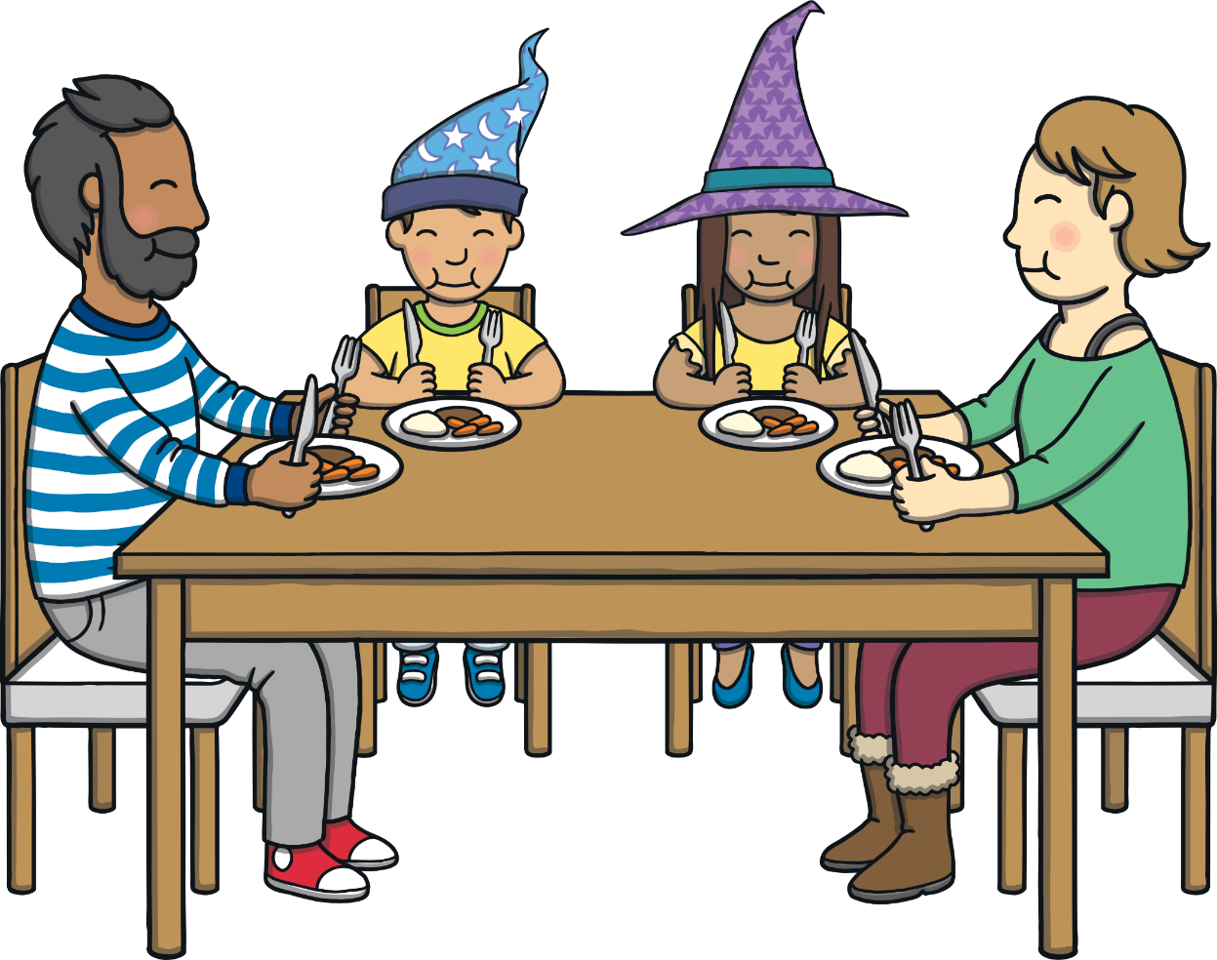
Practise
“You two sounded like you were having fun,” said Mum.
“We were,” grinned Sam. “Kit was a wizard and I was a witch. We were busy saving people from baddies and monsters,” said Sam.
“I see,” laughed Mum and Dad. “We are all safe with you two around then!”

Slide 18
Sentence Time
Apply
After dinner, Kit and Sam go upstairs to finish their homework but Kit can’t concentrate. He’s had an idea. What is his idea? Read the sentence to find out.

Slide 19
Apply
Let’s use the magic book to go and visit a real witch. We might even catch some baddies!
Sound Buttons On/Off
Show

Slide 20
Apply
When Kit told Sam his idea, she wasn’t very sure about it. “But the witch in ‘Hansel and Gretel’ isn’t nice at all,” said Sam nervously.
“Yes, but we are not Hansel and Gretel,” said Kit. “We are Kit and Sam – a powerful witch and mighty wizard.”

Slide 21
Apply
“OK,” said Sam. “Where do we find a witch then?”
“That’s easy,” said Kit. “They live in magical forests. We’ll head to one and see what we can find.” Kit and Sam just had time to grab their hats before the room began to fade.

Slide 22
Today, we have learnt…
tch saying /ch/
The adventure continues next lesson!

