Slide 2
Aim
Distinguish between regular and irregular polygons based on reasoning about equal sides and angles.

Slide 3
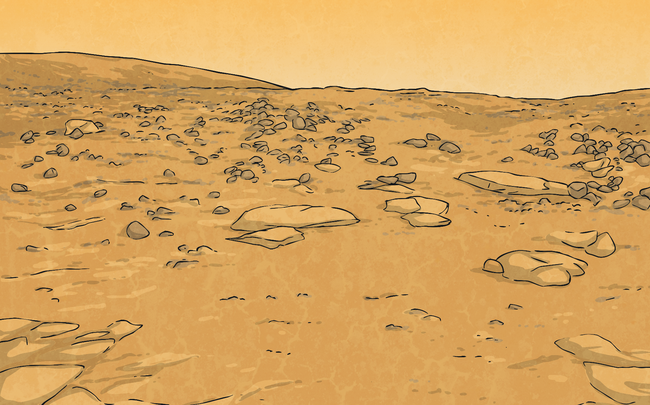
Regular and Irregular Polygons
Diving
Sort these 2D shapes in the Carroll diagram.
 | Regular polygon | Irregular polygon
At least one right angle
No right angles
 | Regular polygon | Irregular polygon
At least one right angle
No right angles

Slide 4
Regular and Irregular Polygons
Diving
On your whiteboards, draw an irregular pentagon.
Convince your learning partner that you have drawn an irregular pentagon.

Slide 5
Regular and Irregular Polygons
Deeper
Sam says, “I have drawn a regular pentagon. All the sides are the same length.”
I do not agree with Sam. The pentagon is not regular because the angles are not the same size as each other. To be a regular shape, the sides AND angles must be of equal length/size.
Do you agree with Sam? Why/Why not?
Discuss with your learning partner.

Slide 6
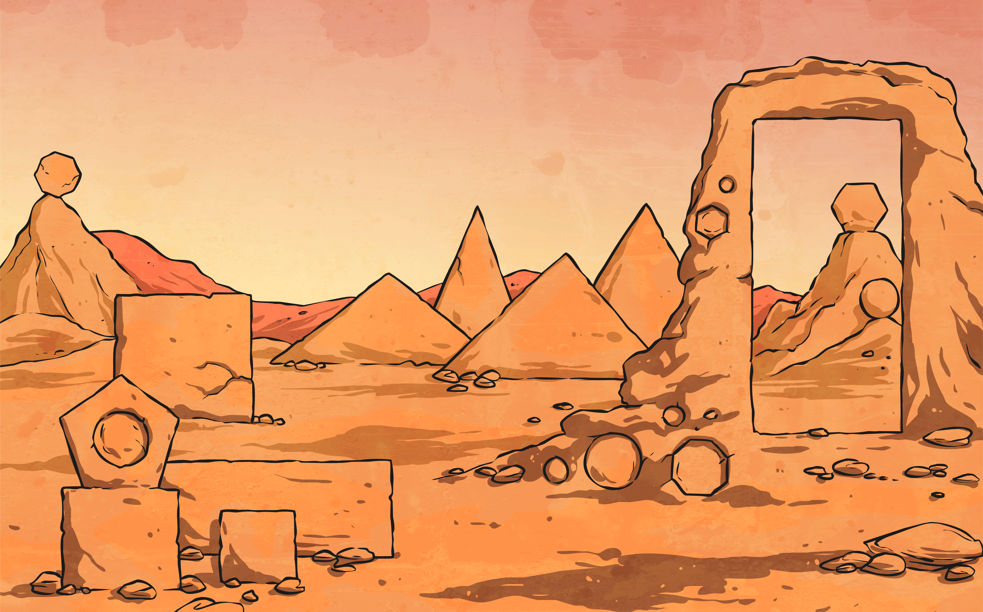
Regular and Irregular Polygons
Deepest
Are these 3D shapes correctly placed in the Venn diagram?
Irregular Polygon
Irregular Polygon
At Least One Line of Symmetry
At Least One Line of Symmetry

Slide 7
Regular and Irregular Polygons
Deepest
Are these 3D shapes correctly placed in the Venn diagram?
Answers
Irregular Polygon
At Least One Line of Symmetry
What 2D shape could go here?

Slide 8
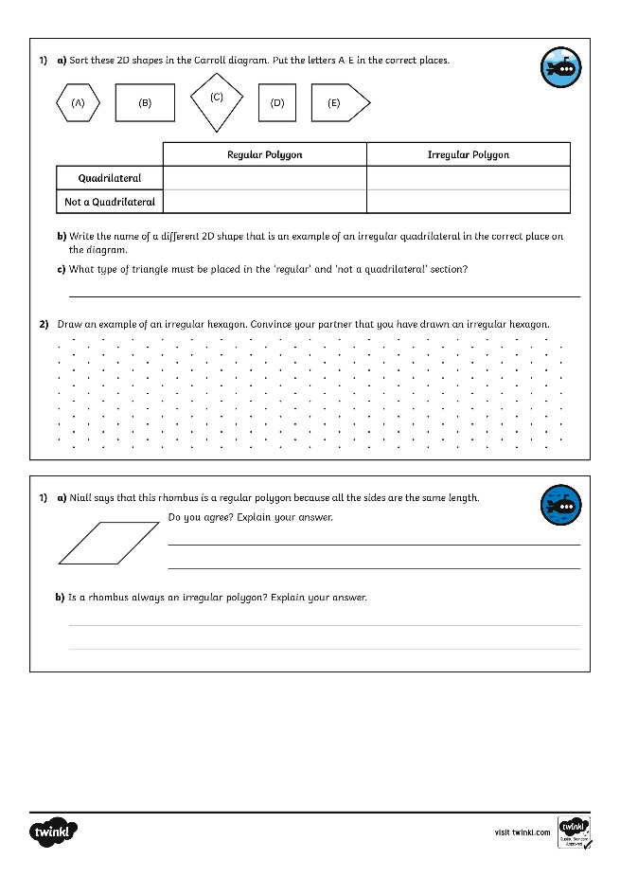
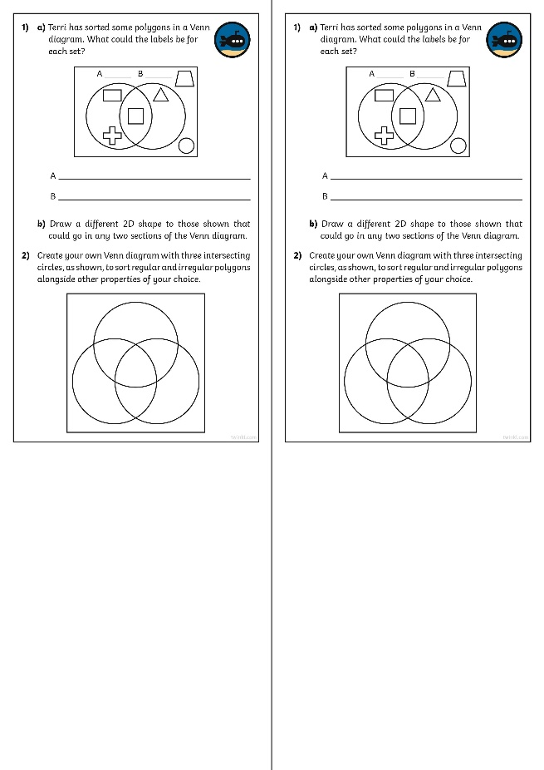
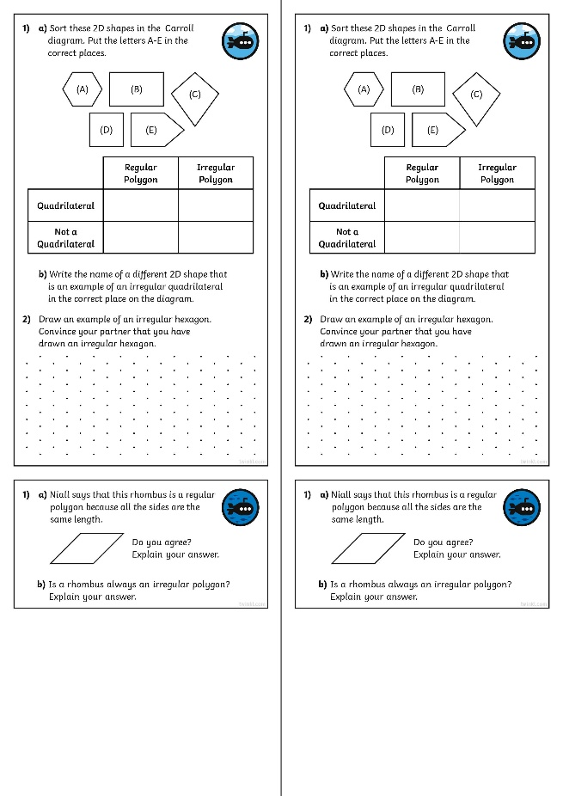
Regular and Irregular Polygons
Dive in by completing your own activity!

